Slide 1
ETSI’s ongoing Activities in the area of Autonomous Networks
ETSI TB/ISG Officials
Multi SDO workshop on Autonomous Networks
28th September 2020

Slide 2
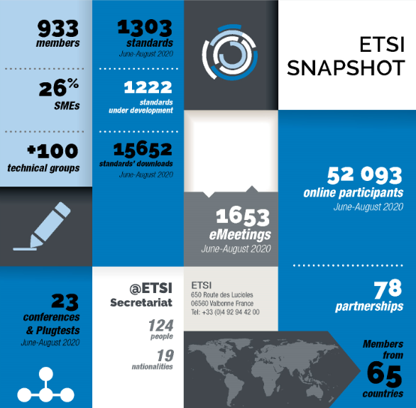
About ETSI - Bringing people together…
Independent, non-profit standards organization
Officially recognized by the European Union to support EU regulation
30 year track record of technical excellence in the ICT sector
Founding Partner Member of both 3GPP and oneM2M
Over 930 members from 65 countries over 5 continents
Diverse community: private companies, research and academia, governments, public bodies, societal stakeholders
Over 49 000 standards published to date, 2 000+ published per year
17.5 million downloads per year, All specs. can be downloaded for free
Over 100 technical groups holding more than 4 000 (e)meetings per year
More than 50 conferences / workshops and interop events per year
Vast majority of meetings and event are now electronic/virtual
Taken from the ETSI Enjoy! magazine https://www.etsi.org/newsroom/magazine
https://www.etsi.org/

Slide 3
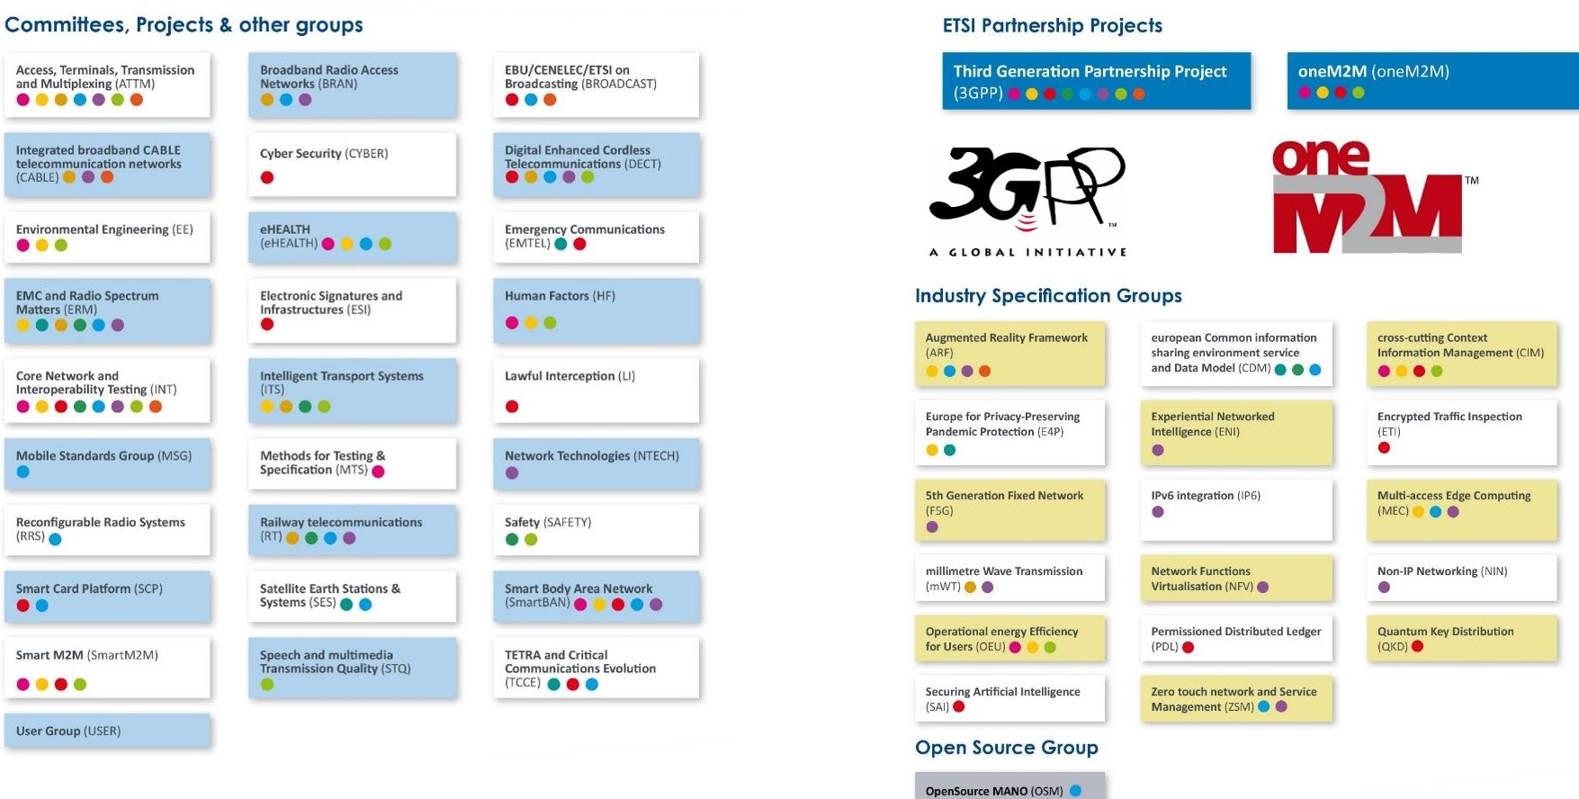
About ETSI - At the heart of digital…
To design tomorrow’s digital world
5G (mobile and fixed)
IoT / M2M
Cybersecurity
Network Virtualization
Multi-access Edge Computing
Automated Network Management
Artificial Intelligence
Blockchain
Quantum (Compute & Key)
AR/VR/XR
..and many others
Integration

Slide 4
ETSI Groups working on Autonomous Networks
F5G
5th Generation Fixed network (Optical / Wireless)
NFV
Open Source Mano
MEC
Interoperable Multi-access Edge Computing
ENI
Improve Operator experience through closed-loop Artificial Intelligence
Network Functions Virtualization, and related topics
OSM
TC INT AFI
Management / automation of emerging and future networks and services
ETSI home of GANA
ZSM

Slide 5
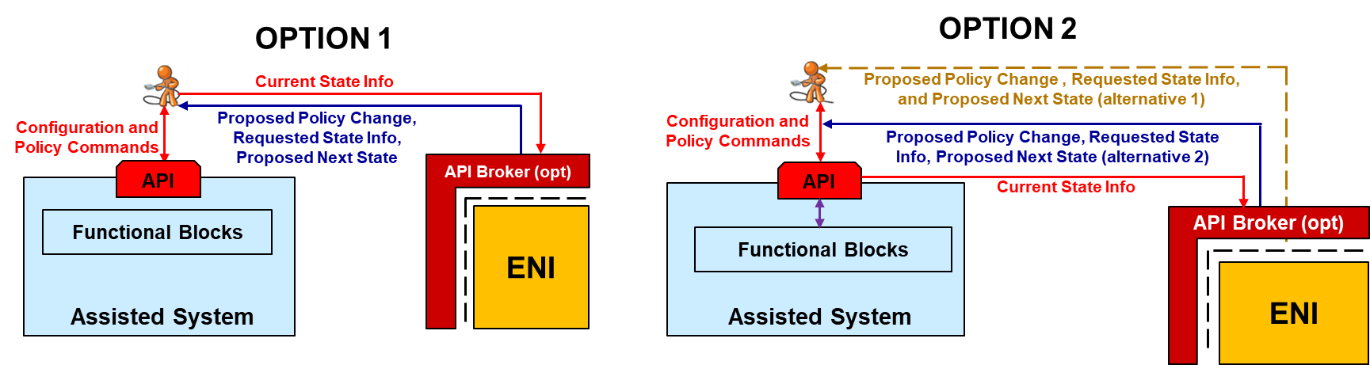
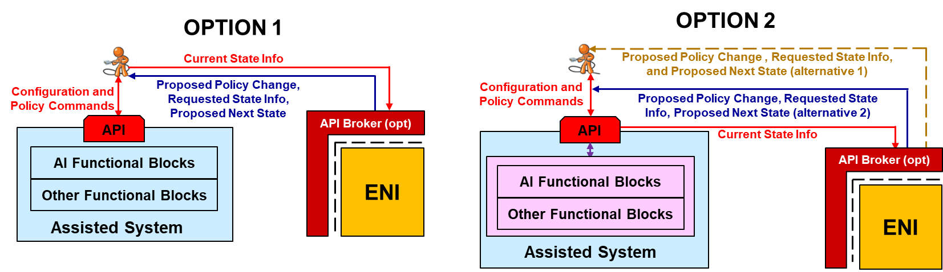
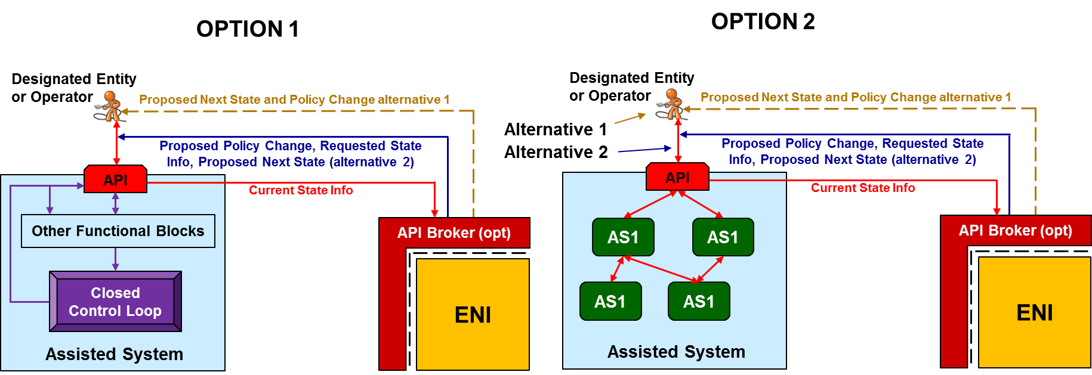
ISG ENI System Architecture - Mode of Operation and Class
Class 1: An Assisted System that has No AI-based Capabilities
Class 2: An Assisted System with AI that is Not in the Control Loop
Class 3: An Assisted System with AI Capabilities in its Control Loop
In each case, ENI requires data from the Assisted System.
Changes to the Assisted System are not required for any class of Assisted System in order to facilitate the use and rapid adoption of ENI.
ENI shall use the API Broker to mediate between ENI and the Assisted System
ENI provides actionable decisions back to the assisted system (autonomous or recommendatory)
ENI monitors the effect
Notes:
Need to updated according to the new fig

Slide 6
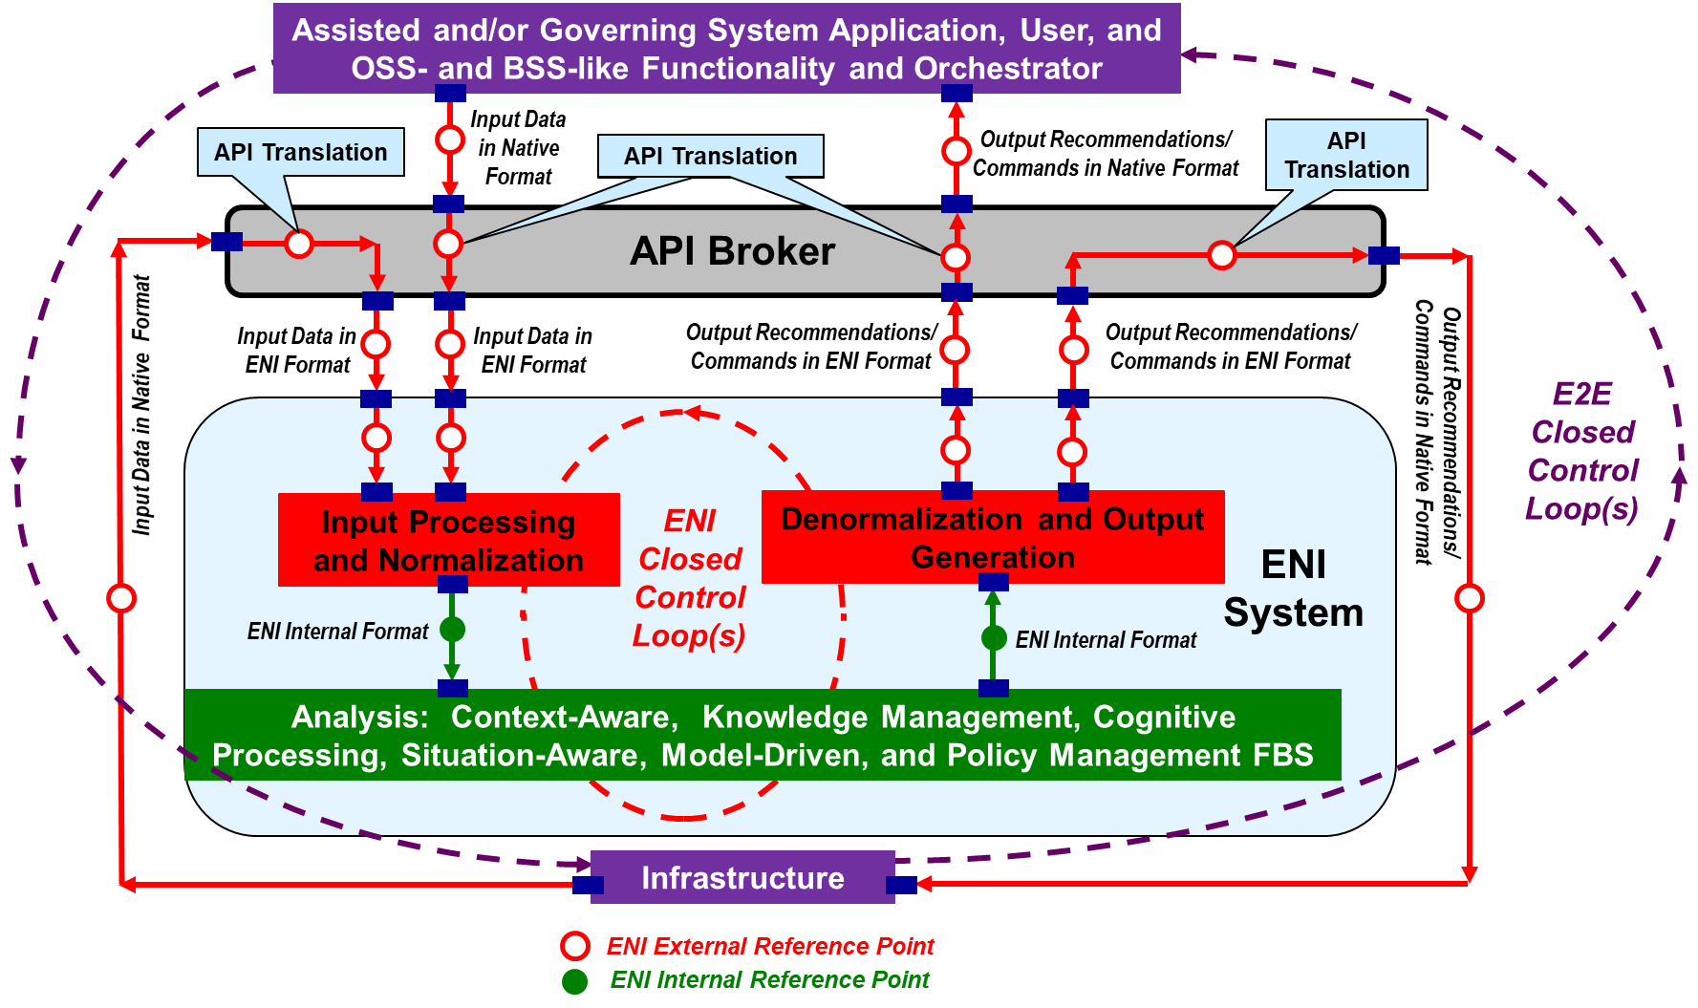
ISG ENI from a High-Level (Functional Architecture)
Focus on improving the operator experience, adding closed-loop artificial intelligence mechanisms based on context-aware, metadata-driven policies.
Enabling the quick recognition and incorporation of new and changed knowledge, and hence, make actionable decisions.
ISG ENI specified a set of use cases, and the architecture, for a network supervisory assistant system based on the ‘observe-orient-decide-act’ control loop model.
High-Level Functional Architecture Diagram in GS ENI 005 (GS ENI 005) published in 2019, revision 2 available https://docbox.etsi.org/ISG/ENI/Open/0016

Slide 7
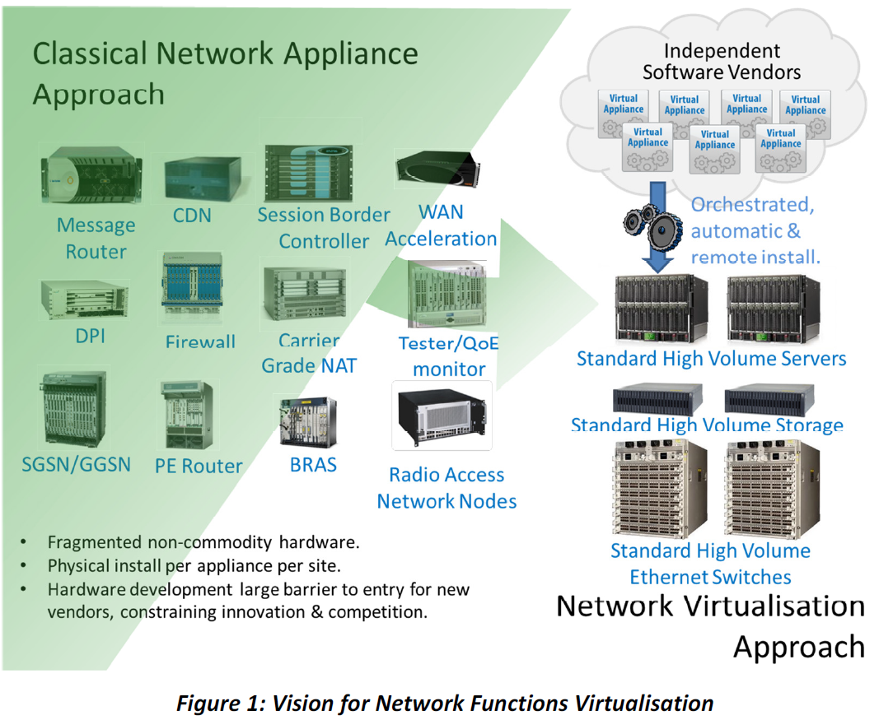
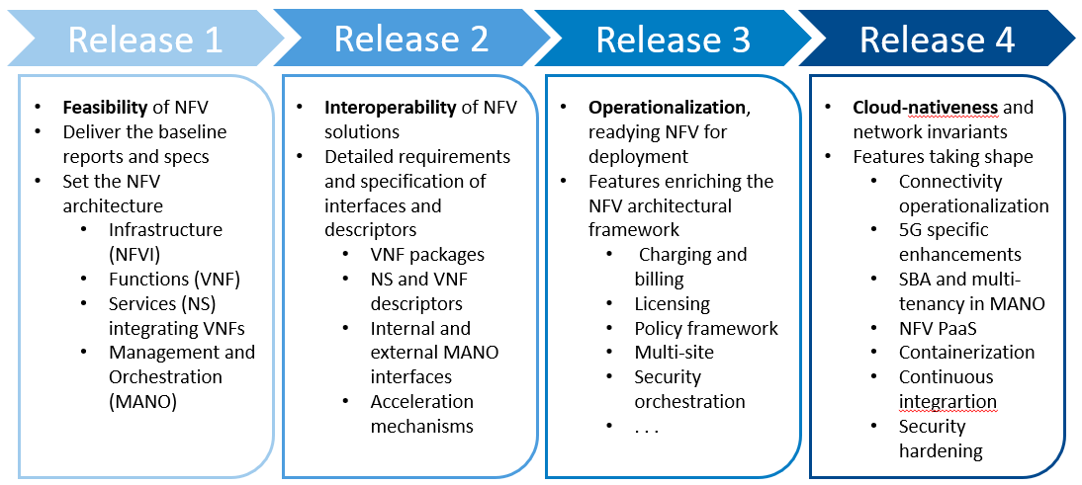
ISG NFV at a glance
From a vision
to specifying NFV, technically and practically
Report on enabling autonomous management in NFV-MANO (DGR/NFV-IFA041), under development:
  Studies introduction of autonomous networks mechanisms e.g.,:
    Intent-based network service management
    Management Data Analytics assisted management
    Autonomous container infrastructure management
  Work will align with automation related work in organizations such as ETSI ISG ZSM, ETSI ISG ENI and 3GPP SA5.
includes
An original evolution with many future plans

Slide 8
The NFV open, double virtuous circle with respect to open source
  Shaping the interaction with open-source communities
    Bi-directional relationship
    Reference to NFV specs
    Feedback from implementation practice
  Direct feedback to OpenStack
    Gap resolution roadmap
  Cooperation with OPNFV
    Demonstrative deliverables
  Collaboration with OSM
    Tight feedback loop
  Synergies with ONAP
    Models and API adoption
  Coordination with the Linux Foundation

Slide 9

OSM Provides an Open-Source,
Production-Quality MANO Stack
Capable of consuming openly published IM/DM
Available for everyone, to minimize uncertainties
Suitable for all VNFs, capturing real production complexity
Operationally significant: including Service Orchestration too!
VIM-independent, WAN-independent
Aligned to NFV ISG information models
  And capable of providing prompt and constructive feedback whenever needed
Enabling an ecosystem of IM-compliant VNF vendors
  Ready to be offered to cloud and service providers
  No need of integration per- customer & MANO vendor basis

Slide 10
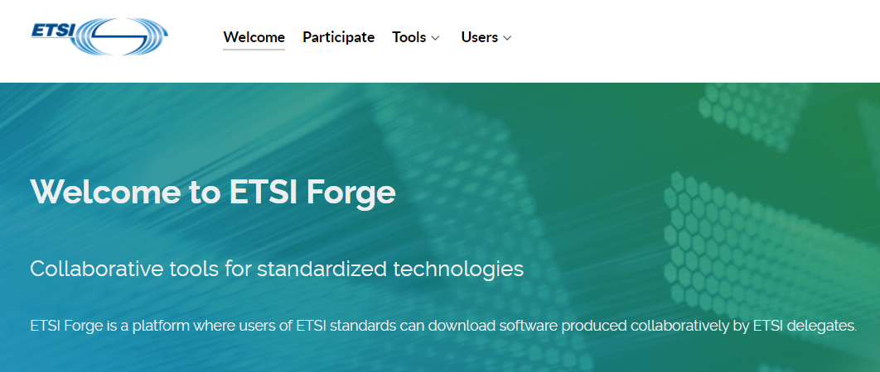







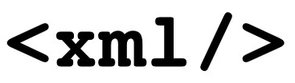
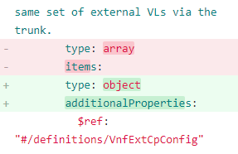


ETSI Forge (forge.etsi.org)
Create, share, collect and publish machine readable standards in a collaborative way
Benefits
  For standard-makers
    Accelerate development
    Ensure quality of specifications
  For users
    Well known, open tools
    Easier adoption and integration
    Easier and quicker feedback loop
Features
  Version control
  Quality Assurance
  Easy collaboration
  Integrated into ETSI Standard making process and IPR framework
  Independent, ETSI operated
Widely adopted
  ISGs CIM, MEC and NFV
  TC CYBER, ESI, LI, MTS, SCP, SmatM2M
  Explore projects

Slide 11






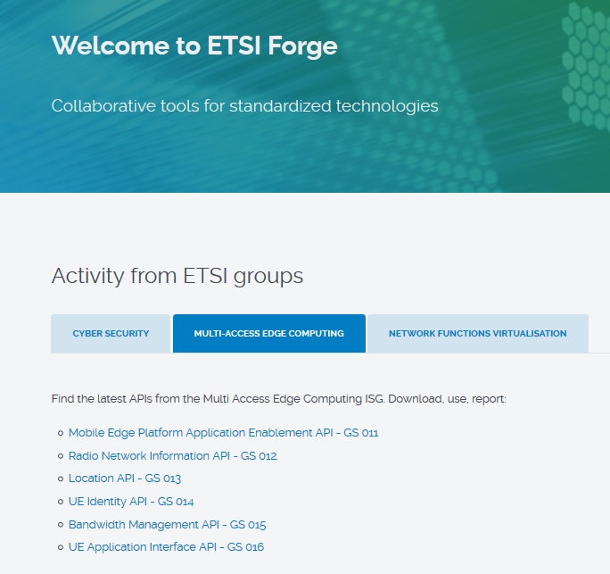
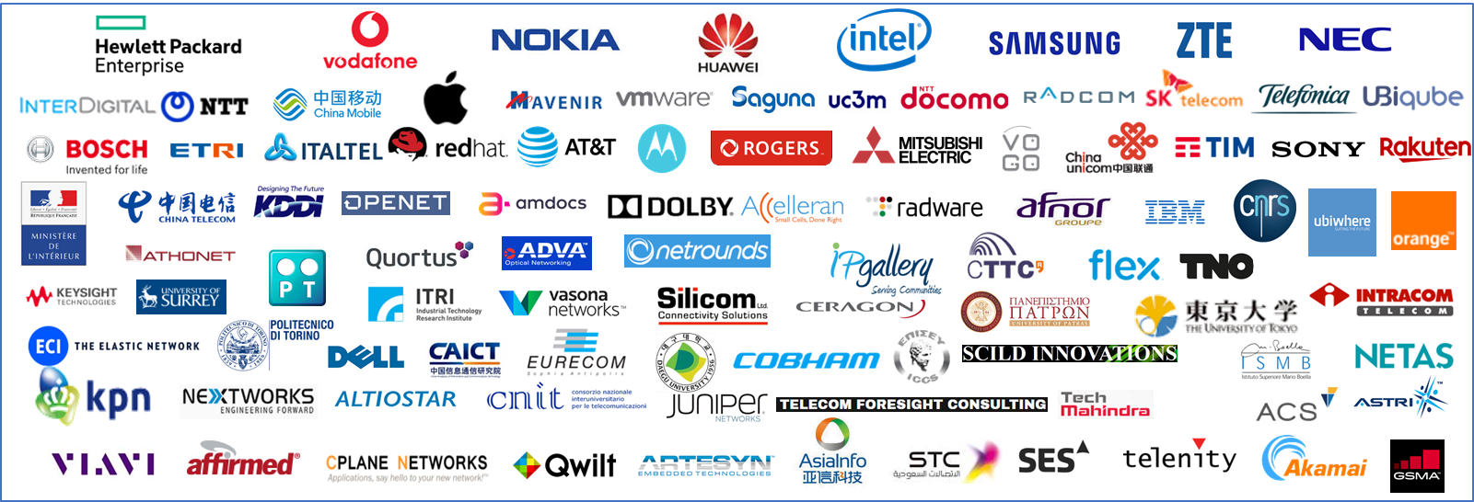
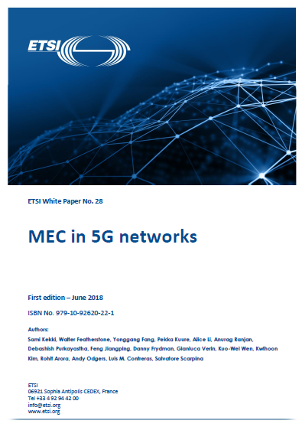

ISG MEC, what we do (in one slide)
Foundation for Edge Computing created – Fully standardized solution to enable applications in distributed cloud created by ETSI MEC + 3GPP
Application Life Cycle Management
NFV
MEC
RESTful based APIs for Runtime Application Services
110 members - Operators – Technology Vendors – IT players – Application developers

Slide 12
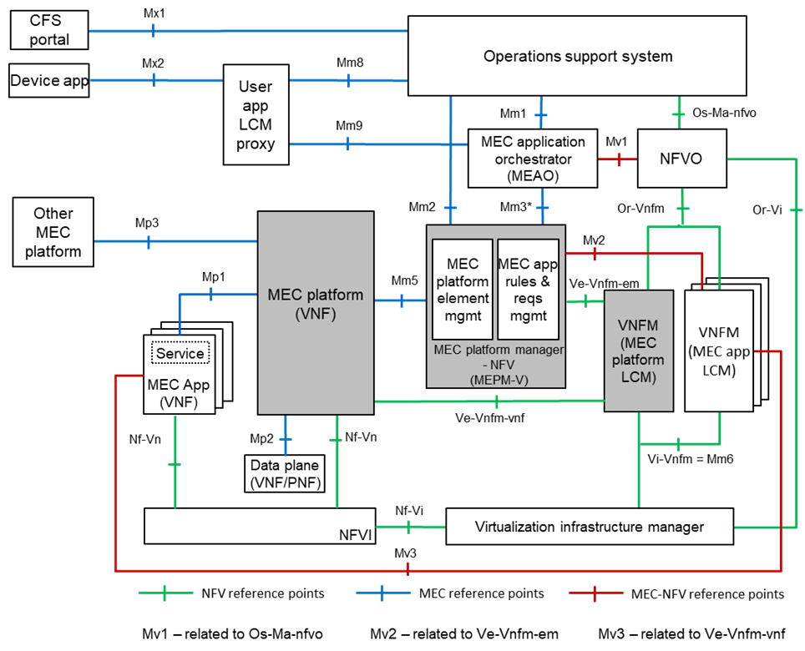
ISG MEC, A key part of ETSI Network Automation work
Inter-MEC &
MEC-Cloud
(MEC 035 Study)
Device-triggered LCM Enablement
(MEC 16)
Management of MEP
as a VNF
(MEC 10-1)
LCM Mgmt of 3rd party Apps
(MEC 10-2)
ZSM: overall approach
NFV, OSM: managing telco clouds
MEC: managing edge telco clouds

Slide 13
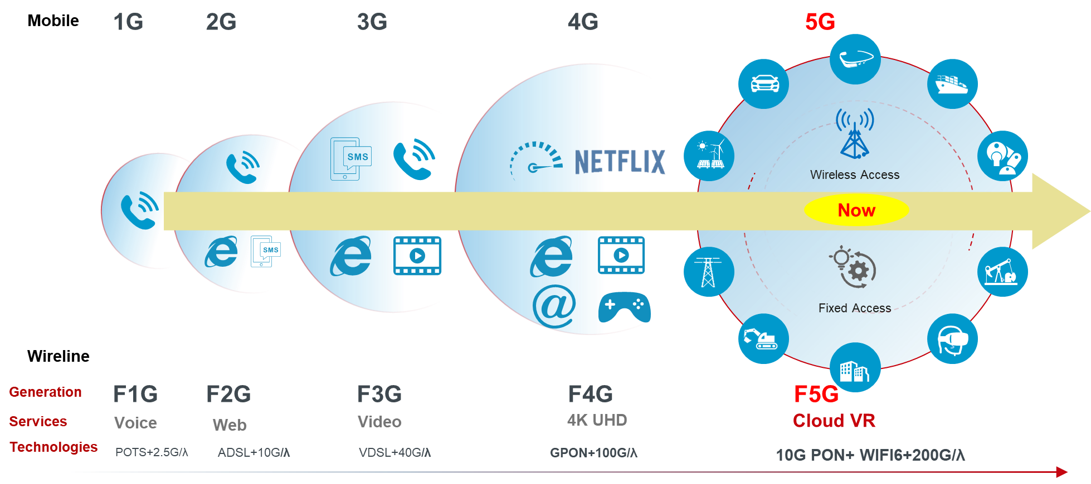


ISG F5G : ‘Fibre to Everywhere’
Assure another step in fixed networks evolution into the fifth generation F5G to allow fiber coverage become ubiquitous
Assure for fiber networks a coherent and automated/autonomous management in all segments
Increase flexibility, service experience, customer satisfaction and operators’ revenues
Full-fibre DC
Full-fibre Home
Full-fibre Campus
Fixed Network generations definition and mobile generations correspondence
The expected evolution of fixed network and services
End-user extending: 2Home, 2Room, 2Business, 2Comsumer, 2Mobile, 2Device, 2Machine, etc.
Last drop distance reducing: Km → 100m → 10m → 1m
Number of connections expanding: X3 (Room) →X10 (Desk) →X30 (Machine) →X100 (Smart city)
OTN to CO
→ to Site
Fibre to Home
→ to FTTRoom
Fibre to Enterprise
→ to FTTDesk
Fibre to Factory
→ to FTTMachine

Slide 14
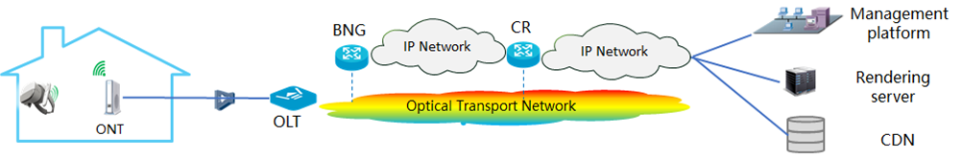
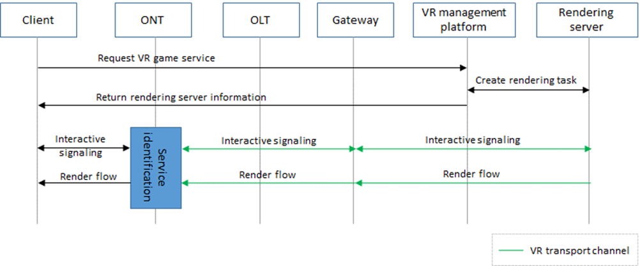
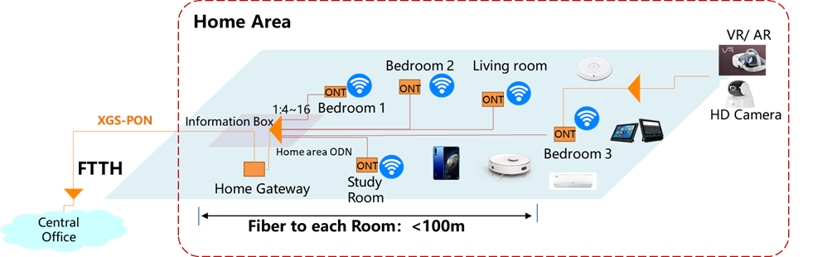
ISG F5G: Timeplan and UC examples
WI 1
UC: Cloud VR services
Generation Definition
WI 2
Use Cases and Business Scenario-1
Use Cases and Business Scenario -2
WI 3
Gap analysis and technical landscape -1
Gap analysis and technical landscape -2
WI 4
Architecture and Framework of F5G -1
WI 5
QoE -1
QoE -2
WI 6
End to end Management
WI 7
Industrial PoN-1
WP
F5G White Paper -1
Release
Release 1
Release -2
2020.2
2020.4
2020.5
2020.6
2020.7
2020.8
2020.9
2020.10
2020.11
2020.12
F5G Timeplan
UC: PON
on
User Premises

Slide 15
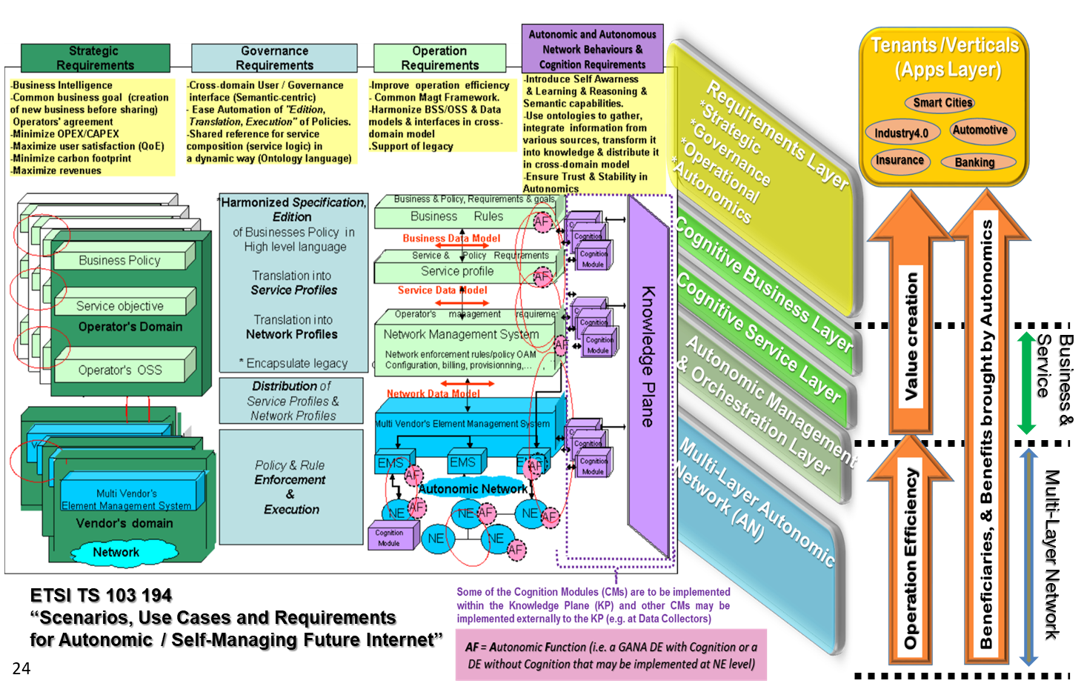
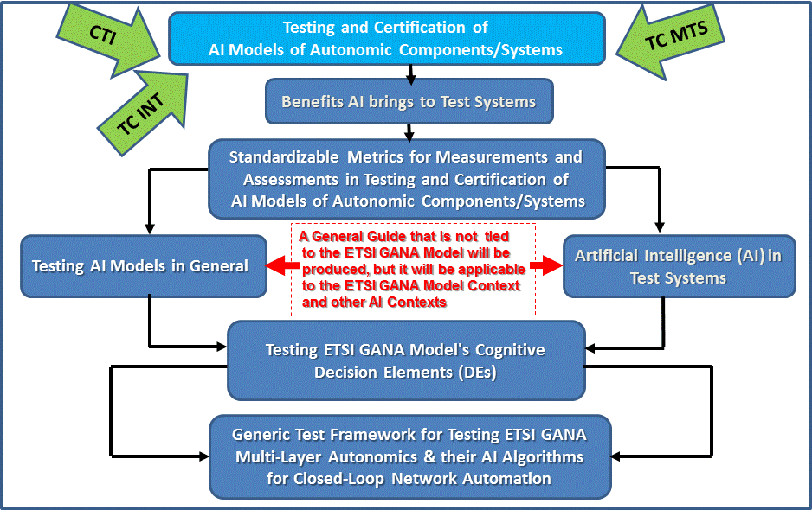
TC INT AFI - GANA : High Level Business & Integration Architecture and Testing AI-based Systems / Networks Framework
GANA Scenarios, Use Cases & Requirements
AI in Test Systems and Testing AI Models WI
https://portal.etsi.org/webapp/WorkProgram/Report_WorkItem.asp?WKI_ID=58442

Slide 16
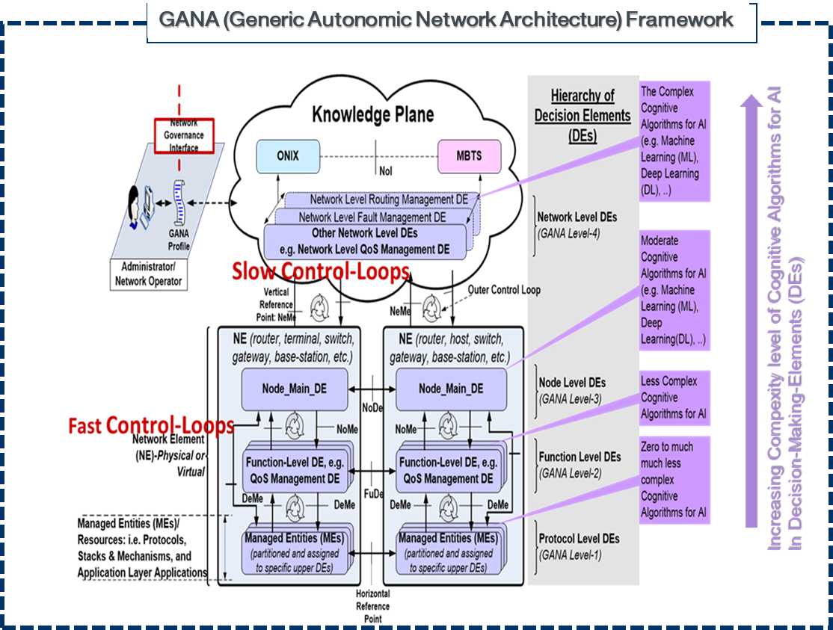
TC INT AFI - GANA (Generic Autonomic Networking Architecture)
Reference Model / Functional Architecture (ETSI TS 103 195-2)
GANA is Autonomic Management & Control (AMC/Autonomics) & Multi-Layer AI/ML for AMC
GANA Knowledge Plane (KP) Structure: Functional Blocks

Slide 17
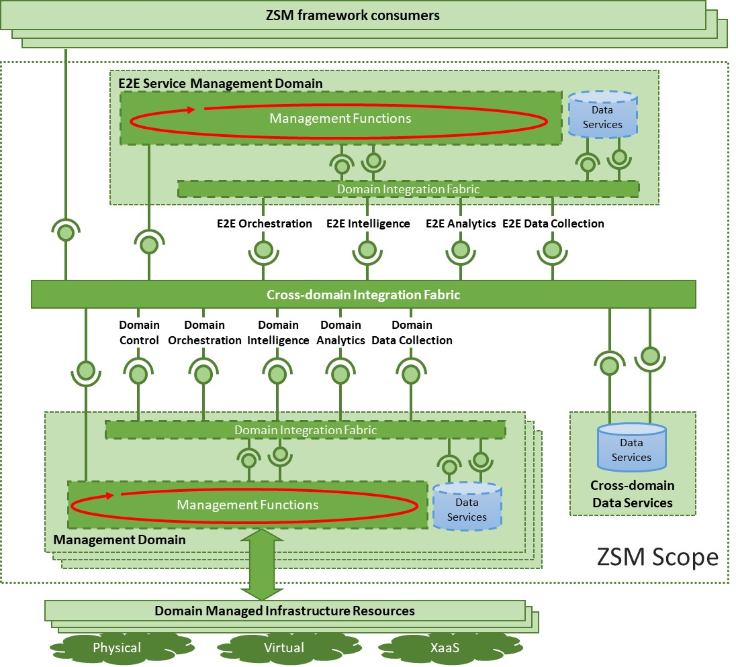
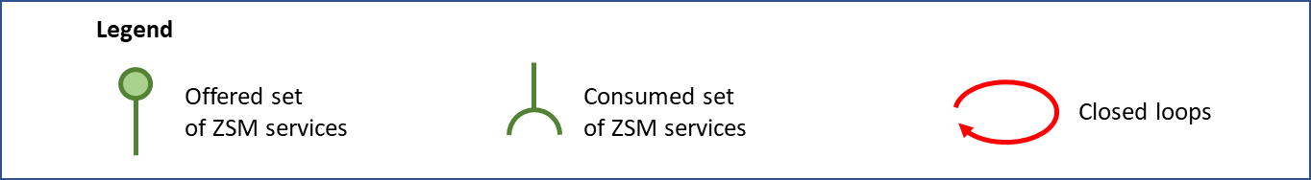
ISG ZSM architecture framework (ZSM 002)
Designed for closed-loop automation and optimized for data-driven machine learning and artificial intelligence algorithms
Architectural principles:
Modular, flexible, scalable and extensible service-based architecture
Separation of concerns: network domain management and end-to-end cross-domain service management, where each domain addresses its own sphere of expertise
Support of model-driven, open interfaces
Support of intent-based interfaces
Enablement of adaptive closed-loop management automation, where the automated decision-making mechanisms can be bounded by rules and policies
Support of stateless management functions
Design for resilience
Functional abstraction

Slide 18
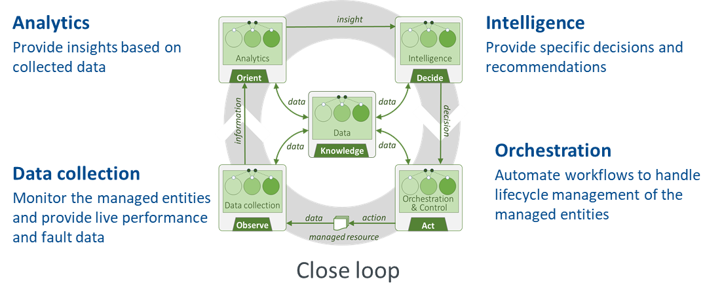
Closed-loop automation in the ZSM framework (ZSM 009 series)
Deployment view
    ZSM provides capabilities to manage the closed-loop models and lifecycle
    Closed-loop operation can happen at the management domain level, the end-to-end service management domain level and can span across multiple management domains; multiple closed loops can run simultaneously.
    ZSM provides means of coordination/delegation/escalation between closed loops as well as the ways in which their behavior can be steered

Slide 19
Conclusions
ETSI recognises the need for further coordination and collaboration both internally and externally
ETSI has organized an internal coordination activity for Autonomous Networks
ETSI is developing an overall framework to leverage the complementarity of the different ETSI AN activities
ETSI is open to further discussion with relevant SDOs and Open source initiatives on the topic of AN

