Slide 1
Muti SDO Autonomous Network Coordination Workshop Presentation
Introduction of Autonomous Networks works in TM Forum
28 ^{th} Sept 2020
TM Forum

Slide 2
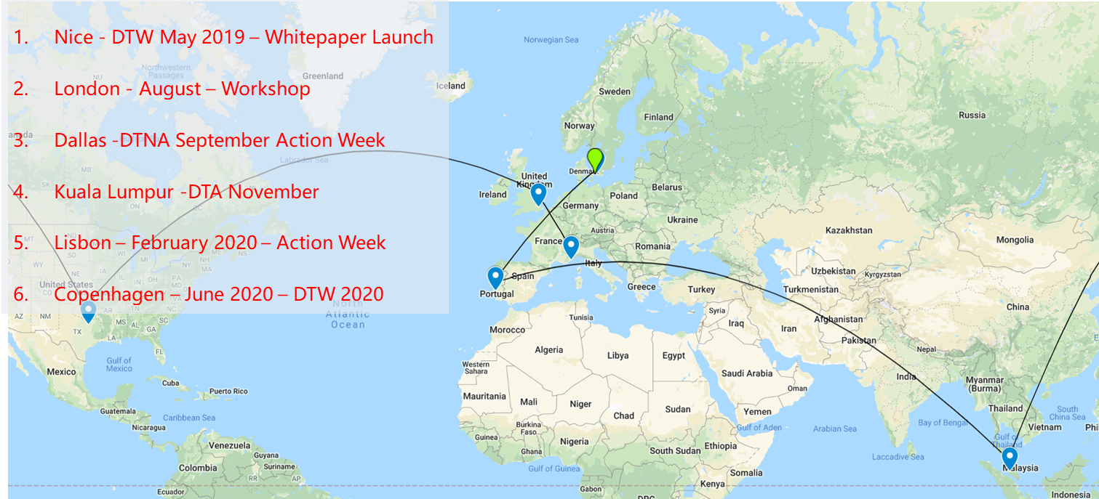
Overview of Autonomous Networks Initiative in TMF
Completed
  May 2019, Nice: 1st industry whitepaper & workshop
  July 2019, London: Kick off workshop
  August 2019: Establish the ANP (Autonomous Networks Project) officially
  October 2019: Publication of Vision document v1.0 – IG1193
  July 2020: Publication of Business requirement & architecture v1.0– IG1218
  February 2020~ now: start the catalyst (PoC) projects (10 projects, 60 companies)
  September 2019~ now: Multiple workshops/industry events
Ongoing
  AN Whitepaper Rel2 (Oct 2020)
  Business requirements & architecture v1.1 (Oct 2020)
  User stories/use cases (ongoing)
  Technical architecture (Oct 2020)
  Demo of Catalyst projects (Oct 2020)

Slide 3
SoW & Workflow
Vision:
- Cross Industry digital transformation (business growth and operation efficiency)
- Cross industry Collaboration (CSPs, IDOs/SDOs, verticals, suppliers etc.)
Vision
Digital ecosystem, Insight& intelligence, Experience…
User stories:
- Enabling verticals, e.g. Smart city, smart manufacture, self driving …
- Improving Telecom, e.g. network operations, production & services, customer experience…
User stories
Business requirements & architectures:
1) requirements
- AN Services: business growth, operations efficiency
- Zero-X: customer experience
- SLA: business metrics
2) Architecture
- Framework (3 layer, 4 closed loop)
- Key business capabilities & autonomous levels: Autonomous domain, closed loop, intent, simplified infrastructure, Self-X
DMM,
AI MM
Business requirement & Architecture
Autonomous Levels
Specs
eTOM, SID, ODA
Technical architectures:
1) High level architecture (per Business architecture)
  -Key technical capabilities (Operations) per Business capabilities
  - High level of Autonomous Levels of key technical capabilities
  -Interfaces & APIs
2) Solution scenarios (references/appendix)
Technical Architecture
(Operations)
Open APIs
PoCs/Catalyst projects:
- Demo of AN solution & capabilities
- One complete or partial AN services per user stories
PoCs
(Catalyst)
Testing & Verification
Autonomous Level Testing and verification:（TBD）
- Autonomous Level specs
- Measurement and certification of autonomous levels

Slide 4
Work status
 | Work items | SoW | Timeline | Remark
Blueprint | Whitepaper | Business need/value Framework Application scenarios Appendix: innovative ideas | Rel1:2019.05 Rel2: 2020.10 | Summary of the progress and key messages for publicity
 | Vision & Roadmap | Overall vision Roadmap Industry collaboration | V1.0: 2019.10 | High level general description
Business | User stories | 1. Select scenarios 2. Summarize user requirements | 2019.07 ~ | On going
 | Business Requirements & Architecture | 1. AN services requirements & metrics 2. Business architecture & operations models 3. Business capabilities & autonomous levels 4. Examples of business lifecycle operations usage | V1.0: 2020.07 | V1.1: 2020.10. Enhancement
Technical | Technical architecture & interface specs | 1. Technical reference architecture 2. Technical capabilities & autonomous levels 3. Mechanisms, interfaces and Open APIs (2/3: Mainly focus on business& service operations closed loops) | 2020.02~
 | Autonomous Levels Testing & verification | 1. Autonomous Network Levels specs 2.Testing and verification requirements & procedures 3. Qualitative and quantitative metrics for testing and verification of autonomous levels | TBD
PoCs | Catalyst projects | 1. Scenario Cases 2. Solutions 3. Demos | 2020.02~ 2020.10 (Phase 1) | Catalyst projects
Notes:
BA1.1 enhancement:
1. To enhance the key business metrics and capabilities:
- Zero-X experience
- Service metrics (SLA etc.)
- Self-X capabilities
2. To define autonomous levels for business metrics and capabilities
3. To apply use cases throughout the E2E lifecycle of operations

Slide 5
Concept of Autonomous Networks
Autonomous Networks aim to :
Provide fully automated Zero-X (zero wait, zero touch, zero trouble) innovative, critical network/ICT services for vertical industries users and consumers, and
Support Self-X (self-serving, self-fulfilling and self-assuring) network/ICT infrastructures and services for enabling digital transformation of vertical and telecom industries through full lifecycle of operations
Offer disruptive services for innovative user experience, mission critical services based on fully automated lifecycle operations and self-organizing, dynamic optimized resource
Comprise of simplified network architecture, virtualized components, automating agents and intelligent decision engines to create intelligent automated business/network operations for the closed-loop of new digital business

Slide 6
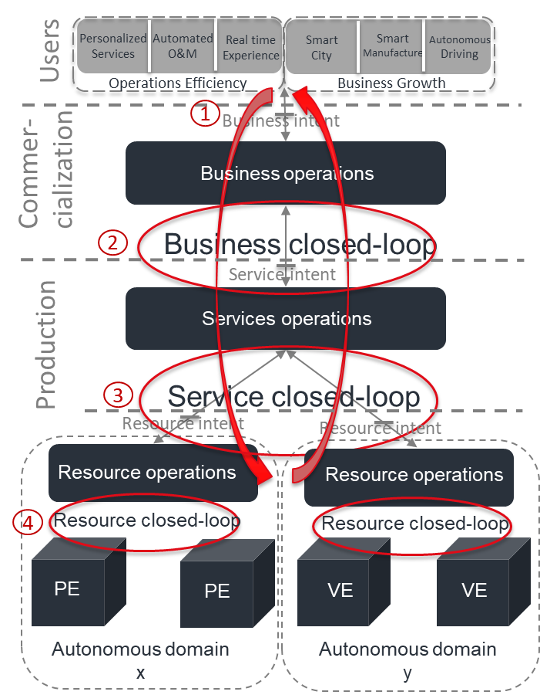
TMF AN Framework: 3-layers + 4-closed-loops with autonomous levels
Layers and closed-loops of Autonomous Networks
3-layers: Are common capabilities that can be utilized to support all scenarios and business need
Network resource layer
Network operations layer
Business operations layer
4-closed-loops: to fulfill the full lifecycle of the process
Resource closed loop
Service closed loop
Business closed loop
User closed loop
Key mechanisms: to enable closed loop
Autonomous domain
Intent driven interaction and open APIs
Metadata modelling and abstraction
Unique thread of the autonomy
6 levels of autonomous networks

Slide 7
Key technical topics
Simplified infrastructure
Advanced architecture with less hops, less layers and more intelligence and easy-to-use of operations e.g. AN enabled 5G, IP/Optical integration, next generation fixed networks, Network-Edge-Cloud synergy
Closed-loop
intelligent automation of full lifecycle of user/business/service/ resource operations with Self-X capabilities (e.g. self-ordering, self-marketing, self-healing, self-governing)
Autonomous domain
AD operations of key instances ( e.g. 5G, Edge, Cloud) for various AN services (Autonomous ICT service/Digital enabling service)
Intent driven interaction
Business/service/resource intent mechanisms and interfaces for various applications (enabling verticals/operational efficiency)

Slide 8
Cross SDO Collaboration
– Thoughts and proposal

Slide 9
Objective and principles of Cross-SDO collaboration
Motivation:
TM Forum has started the AN more than 1 year and published several documents that may be beneficial to the industry
Some SDOs also started the works in AN separately
AN requires a common baseline and interoperability across the whole industry e.g. framework, autonomous levels and key interaction mechanisms/interfaces
Objective:
Promote the AN industry consensus and collaborate on key topics across related SDOs
Basic Principles:
Start with focused groups
  Identify the initial team (shortlist) members that have been working on AN
  Leverage with TMF outputs (whitepaper, Vision/BA/TA publications)
  Reach consensus on the collaboration objective, topics and plan (e.g. regular joint workshop, joint whitepaper, joint Demo, joint Marketing events)
  Agree on key topics of discussion/development (e.g. concept, definition, framework, business requirement/architecture, autonomous levels, Intent mechanisms & interface spec)
Extend to large groups
  Open to more SDOs as audiences
  Welcome to join and open discussion per agreed plan with initial team
  Initially FYI, not RFP
  Later, more engagement and discussion (after understand and agree on the overall blueprint)

Slide 10
Cross-SDO collaboration
-Alignment and consensus on overall concepts, e.g. definition, framework, Autonomous Networks levels
Vision & ecosystem
User stories
-Focus on different aspect of common user stories: operational efficiency & business growth
Alignment on cross focused groups
-Use Business requirements & architectures to drive the collaboration: business metrics, capabilities, E2E lifecycle, closed loop, autonomous domain, intent, Zero-X, Self-X)
Business requirement & architecture
SoW of 1st step as commonality
-Interaction and Interoperability of Technical capabilities: key mechanisms (intent), and key interfaces of closed loops
Technical capabilities/specs
Collaborate on solution cross focused groups
Joint PoC projects: E2E demo across multi domain, layers and closed loops
PoCs
Testing and verification:（TBD）
- Measurement and certification of autonomous levels
Testing & Verification
Key areas of 2nd step for collaboration

Slide 11
Checklist of Cross SDO alignment and collaboration
SoW
Framework: 3 layers, 4 closed loop
Concepts, definition and terminologies
  Closed loop
  Autonomous domain
  Intent
  AN Levels
  AN services
  Zero-X
  Self-X
  …
Operations and next steps
  Non-official discussion on alignment of high level concepts, joint whitepaper/workshop/events
  Official collaboration on specific technical issues & specifications

Slide 12
Thank you

Slide 13
Supplementary

Slide 14
TMF Catalyst projects: Autonomous Networks
No | Name | Description | Participating companies
1 | 5G ride on! - Phase III | The third phase of this Catalyst focuses on supporting business continuity solutions for a number of actors within the electric vehicle (EV) charging infrastructure ecosystem, helping CSPs to go beyond connectivity. This is done by employing autonomous network capabilities and edge computing technologies. URN: C20.0.07 See Champions and Participants | Champions: BT, Orange, Telecom Italia Participants: Incognito, TEOCO, MDS Global, Huawei, AsiaInfo International
2 | Boosting AIOps for full hybrid NaaS | The Boosting AIOps for Full Hybrid NaaS Catalyst will enable the end-to-end lifecycle management of Network as a Service (NaaS) offerings for the B2B market. AIOps will be a key part of a NaaS platform, allowing telcos to manage and operate the underlying network infrastructure in a cost-effective way and to improve B2B customer experience. URN: C20.0.13 See Champions and Participants | Champions: Telefónica, American Tower Corporation Participants: Everis, Verbio, Vlocity
3 | AI for AN: Accelerating digital transformation in 5G era | This Catalyst project explores how Autonomous Networks (AN) can enable more intelligent and robust communication services to drive digital innovations. Artificial Intelligence (AI), as the critical enabling technology, is vital to fulfilling the paradigm of Autonomous Networks. URN: C20.0.18 See Champions and Participants | Champions: China Unicom Participants: Huawei, BUPT, CAICT, GuoChuang
4 | AIOps autonomous service assurance | AI is the driving force enabling autonomous networks, which are needed to meet speed, quality and capacity requirements at the same time as managing increasing infrastructure complexity and optimizing operational costs. This Catalyst will demonstrate how AI can drive closed-loop service assurance in network services, building the foundations for autonomous networks and service management processes. The project will also prove best practices for how to deploy and operate AI in complex contributing back to the TM Forum AIOps Collaboration initiative. URN: C20.0.22 See Champions and Participants | Champions: China Telcom, PLDT, Telecom Italia, LG Uplus, PCCW Solutions, Smart Communications, Cosmote Participants: BOCO, Huawei, Comarch, Intracom Telecom
5 | AI Empowered 5G Intelligent Operations | Autonomous networks are required to manage increasing complexity. This Catalyst will explore the application of artificial intelligence (AI) technology for network planning, construction and maintenance in order to improve: the utilization of network resources; network operation and maintenance efficiency; customer experience; and energy usage, and to optimize OpEx for telecom operators. URN: C20.0.26 See Champions and Participants | Champions: China Mobile Participants: Huawei, AsiaInfo Technologies, BOCO, Nokia
6 | Ready Telco One: Gamified customer journeys enabled by a dynamic partner ecosystem and marketplace | In this Catalyst project, personalized service bundles are dynamically created based on AI-driven customer context, incorporating 3rd party services enriched through 5G, and offered to customers with a single bill. By adopting a groundbreaking game-style user experience, customers can unlock premiere services, discounts and improve their loyalty status, whilst experiencing an optimized AI-driven journey. URN: C20.0.30 See Champions and Participants | Champions: KDDI Research, Ncell, Orange (Poland) Participants: Netcracker, Radisys, Comviva, Microsoft
7 | Smart networks for smart cities | Cities transforming their digital future require a network that can connect everything today and remain open for tomorrow as new 5G use cases emerge. This Catalyst demonstrates 5G use cases with autonomous networking through a digital transformation platform, enabled by an open architecture with TM Forum APIs and an ecosystem of partners. URN: C20.0.33 See Champions and Participants | Champions: City of Dublin, OH, USA Participants: DGIT, Quortus, Fujitsu, Federos, Microsoft, iGR
8 | Vertical Industry Telcos: a Federated DLT-based Marketplace | The keys to successful 5G network monetization will be collaboration and partnerships ranging from shared infrastructure to B2B2X offering distribution across the value chain. This Catalyst builds on previous phases of the project to create an ecosystem supporting a wide range of physical and digital assets from RAN resources, network slicing, edge clouds to eSIM-based products. It enhances the standard-defining approach by adding new levels of trust, confidence and transparency transparency as a foundation of the Business Assurance Framework. URN: C20.0.34 See Champions and Participants | Champions: Orange, BT, Rostelecom Participants: IOTA, Nokia, Nexign, RTC ARGUS
9 | The “EDGE” in Automation | This Catalyst demonstrates an automated zero-touch Edge solution in action, delivering an exceptional experience to event owners/developers (e.g. concert, sporting/gaming event, exhibition). It leverages standardized Edge Computing as a Service (ECaaS) when a crisis occurs, requiring automated and real-time reconfiguration of the edge to deliver public safety emergency services. URN: C20.0.44 See Champions and Participants | Champions: BT, Orange, Telecom Italia, Telenor, TELUS, Verizon, Videotron, Vodafone Participants: Blue Planet, Cerillion, IBM, Optare Solutions
10 | Autonomous network hyperloops | This Catalyst project is demonstrating how to enable a zero-X customer experience and improved operational efficiency for B2B companies and digital service providers in key Smart-X industries, such as cities, entertainment, manufacturing, healthcare and agriculture. They use disruptive “self operating” services and infrastructures based on an Autonomous Networks framework driven by business intent to resource intent. URN: C20.0.50 See Champions and Participants | Champions: NTT, Orange Participants: Futurewei, Cognizant, BearingPoint//Beyond; UBiqube

Slide 15
Review of ongoing activities on AN in related SDOs
Standard groups |  | Objectives/SoW | Planned Deliverables | Published Deliverables
TMF |  | E2E perspective -User stories -Business requirements/architecture -Technical architecture | WP: R2.0 BA: IG1218 1.1 TA: 1.0 | WP: R19 IG1139(Vision Roadmap) IG1218(BA 1.0)
3GPP SA5 |  | Autonomous Network levels 5G Service-Level Agreement Closed loop assurance Intent-driven management Self-organizing network Management data analytics | Autonomous Network levels: TR 28.810/TS 28.100 Intent-driven management: TR 28.812/TS 28.312 Management data analytics: TR 28.809 | Architecture: TS 28.533 closed loop automation: TS 28.535/536 Self-organizing network: TS 28.313 5G Service-Level Agreement TS 28.541
ETSI | AN initiative | E2E perspective with focus on network autonomous domain, key capabilities | AN Industry Whitepaper - framework, key capabilities and use cases in networks etc
 | ZSM | Closed loop of Network operations automation | GS ZSM 009-1 Closed-loop automation;Enablers GS ZSM 009-2 Closed-loop automation;Solutions GS ZSM 009-3 Closed-loop automation;Advanced topics | GS ZSM 002 Reference Architecture GS ZSM 005 Means of Automation
 | ENI | Closed loop of AI for Network operations automation | Rel 2 | Rel 1 on Use cases, architecture, Context-Aware Policy Management
 | F5G | transport networks with AN capabilities
GSMA |  | Future Networks; Automation in Network evolution (great China region) |  | Whitepaper: AI & Automation: An Overview
ITU-T |  | Initial proposal on study of AN; No official WI
CCSA TC7 |  | Network Management and Operation | TC7 WG1 Technical Specification for Intelligent level of Mobile Network Management and Operation
NGMN |  | Operator autonomous network related requirements | Initiative to Advance Cloud, Automation & Edge Computing？

