Slide 1
Muti SDO Autonomous Network Coordination Workshop Presentation
28 ^{th} Sept 2020
TM Forum

Slide 2
Workshop Objectives
Share information
and ideas on the vision, key points and activities of each organization developing AN solutions using their unique domain skills.
Discuss the common interests
and key topics in industry activities for reaching industry consensus and building the collaboration ecosystem for E2E AN blueprint.
Establish the collaboration proposal mechanism and technical topics of common interest
as the basis for subsequent multi-SDO discussions for Autonomous Networks.
Focus: Identify areas of common interest for discussion in subsequent meetings

Slide 3
Autonomous Networks
– Challenges and motivations (Multi SDO Workshop）

Slide 4
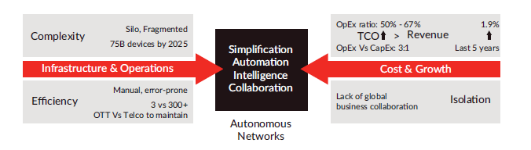
Challenges of Telecom/ICT Industry
-Architectural innovation to solve the structural problems
The whole Telecom/ICT industry is facing the challenges of revenue growth, business collaboration, operations efficiency and TCO, which led to the reduction of profit margin, sales and innovation

Slide 5
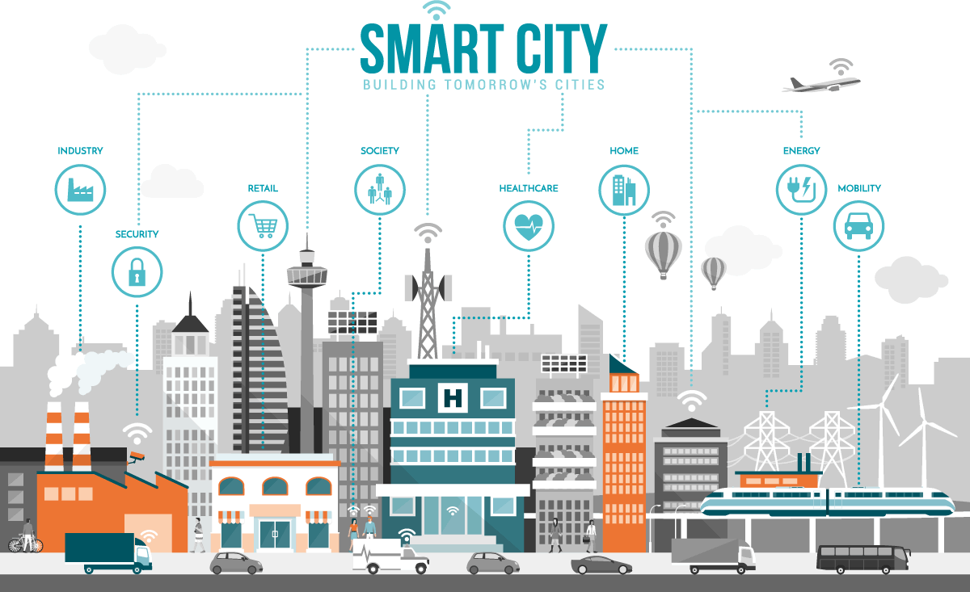



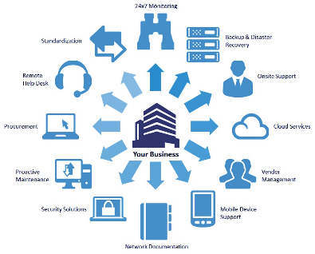

Opportunities to Telecom/ICT Industry --- “Zero X” Experience
- Autonomous Networks/ICT Services for Intelligent Society
Smart city
Smart industry
Smart government
Smart xxx…
As a Service
As a Platform
“Zero X” Experience
One stop, real-time, on demand, automated，E2E full lifecycle network/ICT services
Enablement of business collaboration & ecosystem between verticals and network/ICT service providers
Make the simplicity to the users
Leave the complexity with the providers
ICT
Zero Wait
Zero Touch
Zero Trouble
Launch
Delivery
Care
Simplified
Operating
Development
Maintenance
Self-healing
Business
Services
Infrastructure
Swift
Autonomous
  Network
Agile
  Operations
All-inclusive
Services

Slide 6
Objectives of AN: Enabling cross industries’ digital transformation through autonomous networks/ICT services & infrastructure
Objectives
As-is
To-be
Network/ICT services:
Fully automated, intelligent
Hard-to-use,
Lack of key capabilities
Easy-to-use,
Meets all business needs
Production & commercialization:
Flexible, Collaborative
Predefined, static,
silo, commodity
Flexible, dynamic, collaborative, customized
Architecture & Operations:
Simplified, Automated
Complicated, Fragmented, Manual, Inefficient
Simplified, Integrated, Automated, Intelligent

Slide 7
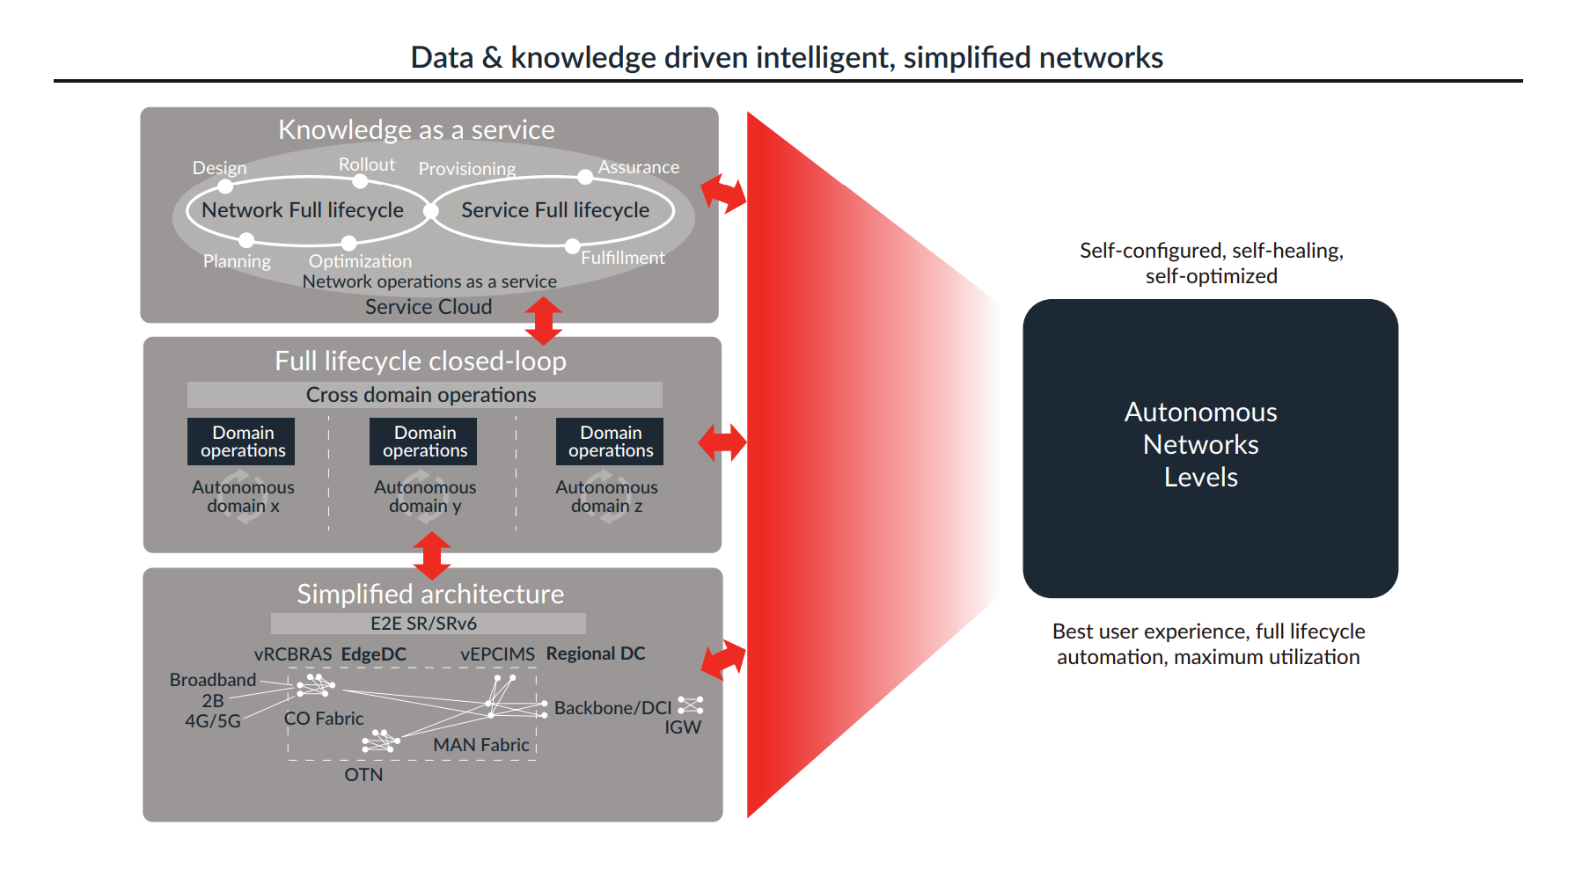
Enabling new collaboration & ecosystem models by Autonomous Networks
Self-operating
(self-serving, self-fulfilling, self-assuring)
• Digital partner collaboration and ecosystem model
Collaborative production model
Knowledge-as-a-service operations model
Dong

Slide 8
Takeaways: The success of AN requires the collaboration across the industry
Existing siloed solutions have not yet demonstrated enough business value
  Fragmented point solutions, only solve the problems of specific segments
  Lack of E2E view/framework, no interoperability, too complicated/costly integration
  Lack of common metrics to measure and verify the outcome, not attractive/cool to the end users (compared to autonomous vehicles)
  Lack of industry ecosystem and collaboration as digital partners to make win-win solution
The key issues to be addressed by the industry
  Commonality and alignment on key concepts (e.g. definition, framework, autonomous networks levels and key capabilities (e.g. closed-loop, autonomous domain, intent))
  Collaboration on the development of key technical mechanisms, interoperability of the interfaces e.g. between network domain and operations domain, testing and verification of autonomous networks levels, and use cases/PoC

Slide 9
Workshop Agenda:
TIME BST ( GMT+1) CET-1 | Topic | Lead
09:00 | Introduction and welcome | TM Forum representative
09:05 | Round table attendee introductions | All
09:15 | Overview of workshop and objectives | TMF Forum
09:30 | Share information on current Autonomous Network activities TM Forum Presentation 20 mins ETSI Presentation 30 mins 3GPP Presentation 20 mins | All
10:40 | Open discussion on areas of common interest | All
11:30 | Discussion of next steps | All
11:50 | Summary and review next steps | All
12:00 | Close
Google Jam Board URL: tba

Slide 10
Thank you

Slide 11
Supplementary

Slide 12
Concept of Autonomous Networks
Autonomous Networks aim to :
Provide fully automated Zero-X (zero wait, zero touch, zero trouble) innovative, critical network/ICT services for vertical industries users and consumers, and
Support Self-X (self-serving, self-fulfilling and self-assuring) network/ICT infrastructures and services for enabling digital transformation of vertical and telecom industries through full lifecycle of operations
Offer disruptive services for innovative user experience, mission critical services based on fully automated lifecycle operations and self-organizing, dynamic optimized resource
Comprise of simplified network architecture, virtualized components, automating agents and intelligent decision engines to create intelligent automated business/network operations for the closed-loop of new digital business

