Slide 1
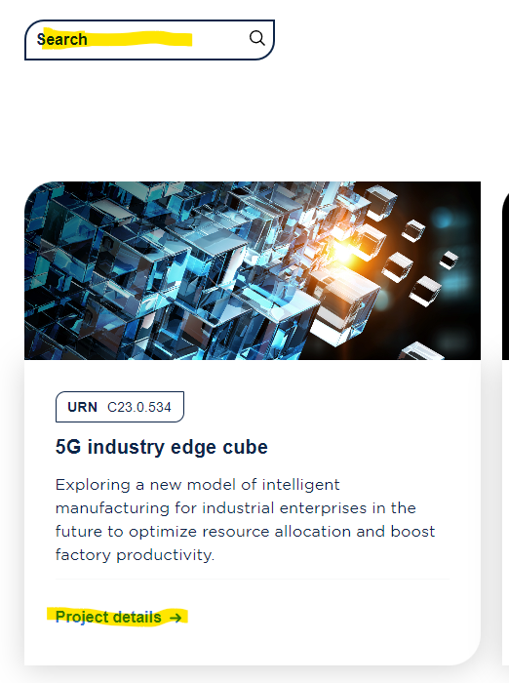
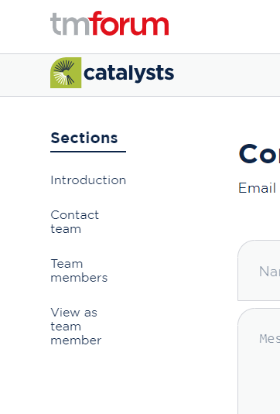
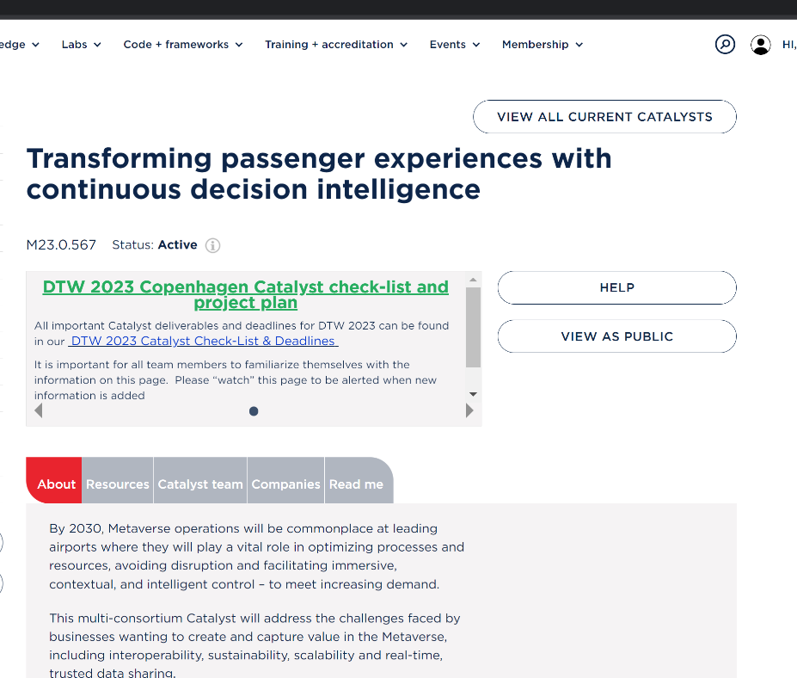



Accessing project page backend "Team member view"
You need to be logged in to www.tmforum.org to access and listed as a team member to access a project page’s backend
Find and select your Catalyst on the Projects page
Select “View as team member” from left navigation menu.
TIP: This link only shows for logged in Team members for that Catalyst project
You will then be brought to the back end to make any edits.
You may have to login again as this is a separate platform.
Use this link to login if you are redirected back to frontend
Select “View as Public” to return to the front end

