Slide 1
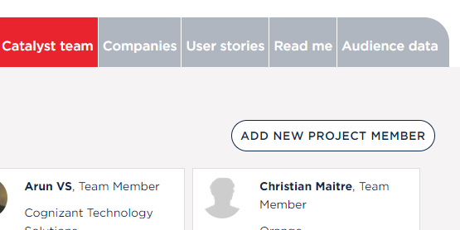

Adding a new project team member to your Project page
REMINDER: Always make sure you are logged in to TMForum.org before starting
Click on “Catalyst team” tab to see current list of project members and verify person is not already there (Alphabetical order by first name)
Select “ADD NEW PROJECT MEMBER”
Enter in person’s corporate email address
Select “Search”

Slide 2
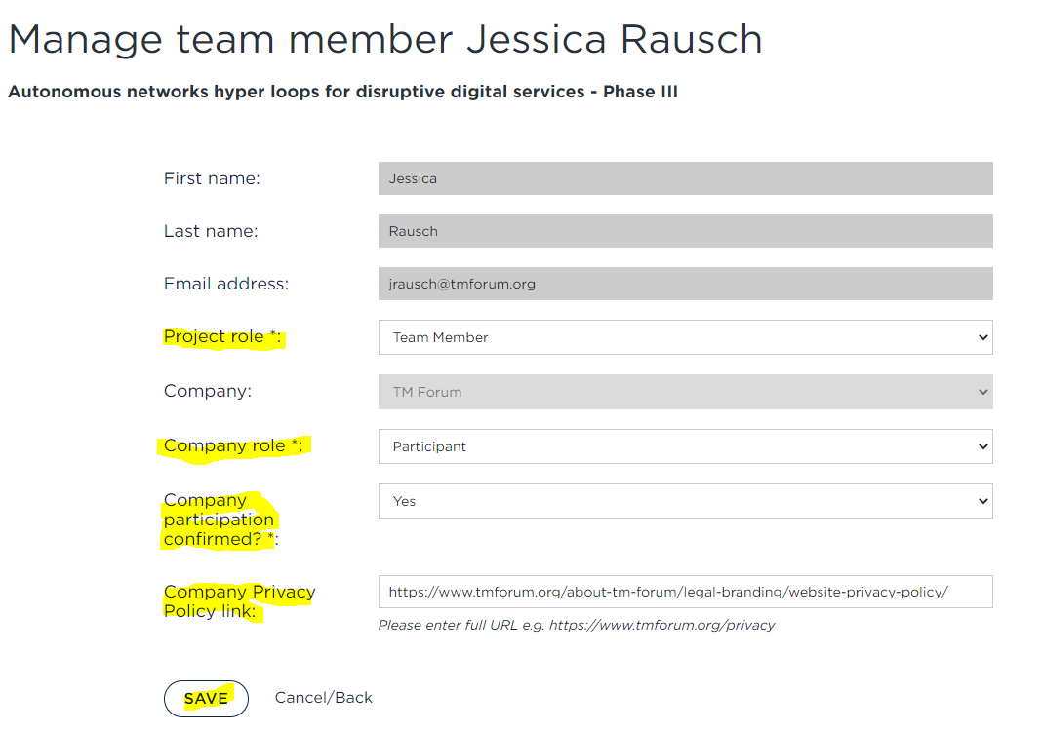
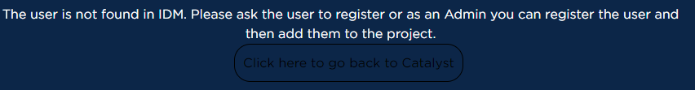
Adding a new project team member to your Project page cont…
Form will be pre-populated with person’s name and company
Select “Project Role” - Default should be ‘Team Member’ unless they are in a leadership role
Select “Company Role” – Champion or Participant
Select Yes or No for “Company Confirmed Participation”
TEAM TIP: Selecting no will add person to your Space as Tentative and they will not be shown in the “Public view”. You can edit their profile to update them to ‘Confirmed’ later.
Enter in “Company Privacy Policy link” as is is required for data protect law. This may be pre-populated if it has already been added to another Catalysts Space.
Hit “Save”
An email will be sent to the person you added
You will get this notification when a person’s email is not in our system. They will need to create an account at https://myaccount.tmforum.org/register
before you can add them.

Slide 3
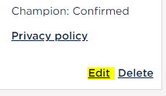
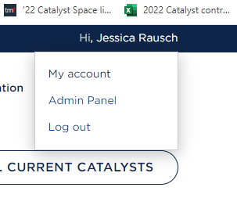
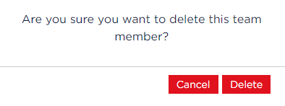
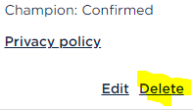
Editing/Deleting a person in your Project page
Editing a team member’s listing
Click on “Catalyst team” tab
Find person in the list (Alpha order by first name)
Select “Edit”
Follow previous “Add a team member” instructions for making edits, please note you will only be able to edit the highlighted fields
TEAM TIP: People can add a profile photo, edit their name, title, etc by going to their TM Forum “My Account”
Deleting a team member
Find person in the list (Alpha order by first name)
Select “Delete” and the “Delete” again
You can always add a person back in if you accidently delete them

