Slide 1

HOW-TO:
Add Videos, Documents, and other collateral to your Project page
The “Resources” tab is where teams should add documentation you want accessible to the public - nothing proprietary
The Resource tab acts as the “showbag” for your project
TEAM TIP: Catalyst teams are strongly encouraged to create and upload Presentations, Videos, White Papers, etc before the start of DTW or other live events
Content uploaded will remain available after to project is completed for visitors to always be able to access.
Large videos files may need to be converted to video links to be posted
Any text added into the resources page will only show up on the project page when at least one resource file has been added.
PLEASE NOTE: It takes 1-3 hours for the front end of the website to refresh and show new resources added to the backend, Especially if there have been large files added.
HOW-TO Tutorial: Adding collateral to your Resource tab in your Catalyst Space (Duration: 9:30 mins)

Slide 2
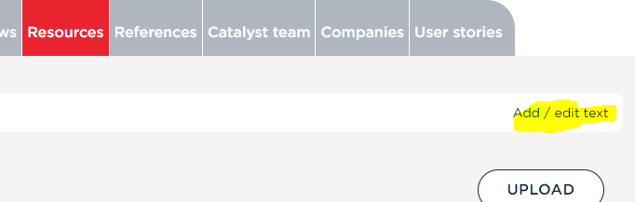
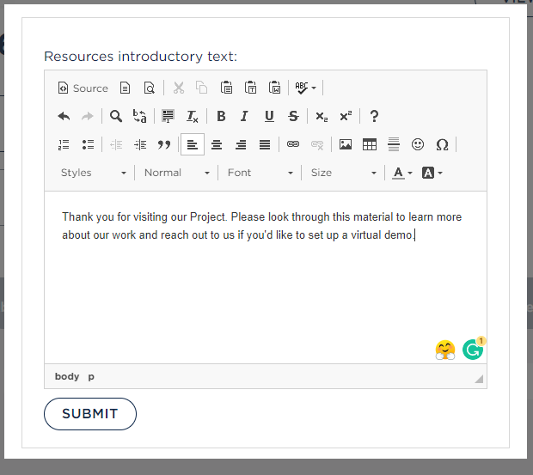
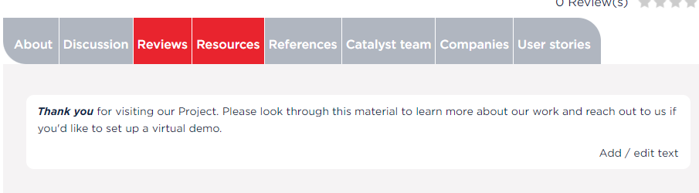


Adding collateral to your Project page
REMINDER: Always make sure you are logged in to TMForum.org and you are in “Team View” before starting
Currently, we do not have the functionality to add images or hyperlinks in the Resouces 'text' area, even though the backend looks like you can. This is in a queue for future development but will not be available for DTW 2023.
Please upload and images, documents and/or video links using the “upload” function.
We apologize for any inconvenience this may cause and I am happy to have a call to discuss what are the best alternatives to get the information you are trying to share posted.
Click on “Resource” tab
Click “Add/Edit if you want to provide some header copy
In pop-up add text that you want to appear at the top of area.
Hit “SUBMIT”
The Catalyst Space will refresh to show your text

Slide 3
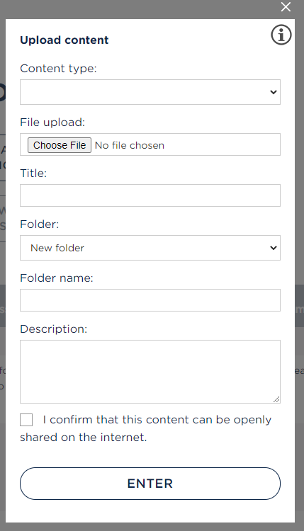
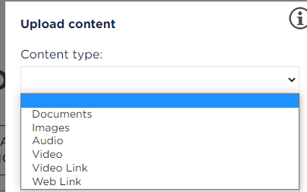
Adding collateral to your Project page continued…
To add files to the Resources tab
Click on “Resource” tab
Click “UPLOAD”
From pop-up:
Choose appropriate “Content type” from drop down menu.
Depending on the Content type a few fields may appear

Slide 4
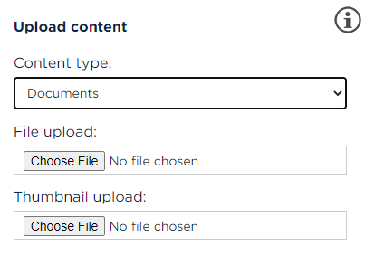
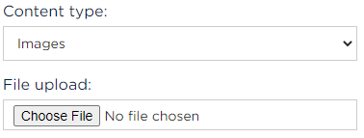
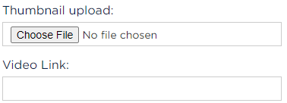
Adding collateral to your Project page continued…
To add files to the Resources tab
Content Types: Document and Video
File upload: Hit “Choose File” to find and upload document
Thumbnail upload: “Choose File” to find and upload thumbnail image for file
TEAM TIP: The Thumbnail is the image that will appear in your tab linking it to the file. We strongly encourage you to use images or screen captures for each file to differentiate amongst the files you add and make your resource space more visually interesting. A default image will appear if no thumbnail is added.
Content Types: Images and Audio
File upload: Hit “Choose File” to find and upload related file
Content Types: Video Link and Web Link
Thumbnail upload*: “Choose File” to find and upload thumbnail image for file
#Video / Web Link: Paste link into field
#Only links to IBM, YouTube and Vimeo are supported, for other video links please use the Web Link content type

Slide 5
Adding collateral to your Project page continued…
Enter in the “Title” of the file you want to add
Folder: Select “new folder” or an existing folder name from the drop-down list. Files in the same folder will appear grouped together on your tab
Name your folder
TEAM TIP: Folders will appear in the space in alphabetical order. Use numbers before the folder name to customize the order they appear in. Example: 0. Intro Documents and videos
Optional Description: This copy appears under the Title of the file
Check the confirming content permission box
Hit “Enter”
Your Catalyst Space will refresh with your file will be posted
TEAM TIP: View this previous Catalyst Project Digital Business Marketplace - Phase 4 for an example of a well-organized Catalyst Resources tab
PLEASE NOTE: It takes 1-3 hours for the front end of the website to refresh and show new resources added to the backend, Especially if there have been large files added.

Slide 6
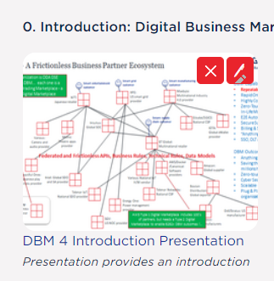

Editing and deleting collateral in your Project page
Hover over the image of the file you wish to edit or delete until two red boxes appear
To DELETE select the and hit “OK” in the pop up. Your Catalyst Space will refresh with the file removed
To EDIT select the and make the desired edits in the popup (follow steps on previous slide). Your Catalyst Space will refresh with the file updated

Slide 7
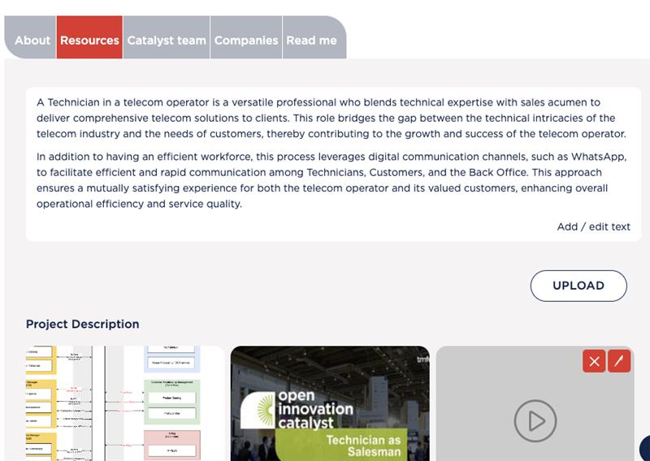
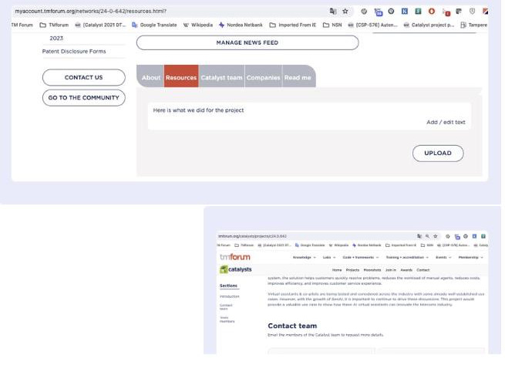
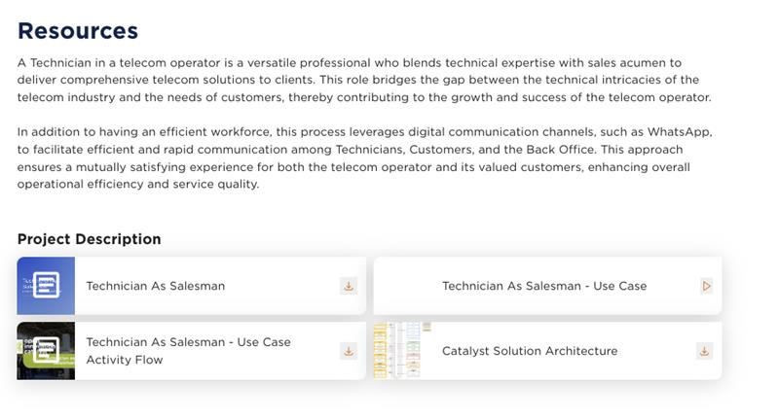
Please note
Any text added into the resources page will only show up on the project page when at least one resource file has been added.
Plain text by itself will only show in the team view and not the public view

