Slide 1

Presentation by:
Mahima Khurana
Head of Catalysts, TM Forum

Slide 2





agenda
Award Categories
Judging process & criteria
Awards submission form
Live Tutorial
Judging onsite
Timelines
Best practices & tips
Post-event
Q&A
11
moonshot catalysts
73
unique companies
unique
team
members
280+

Slide 3

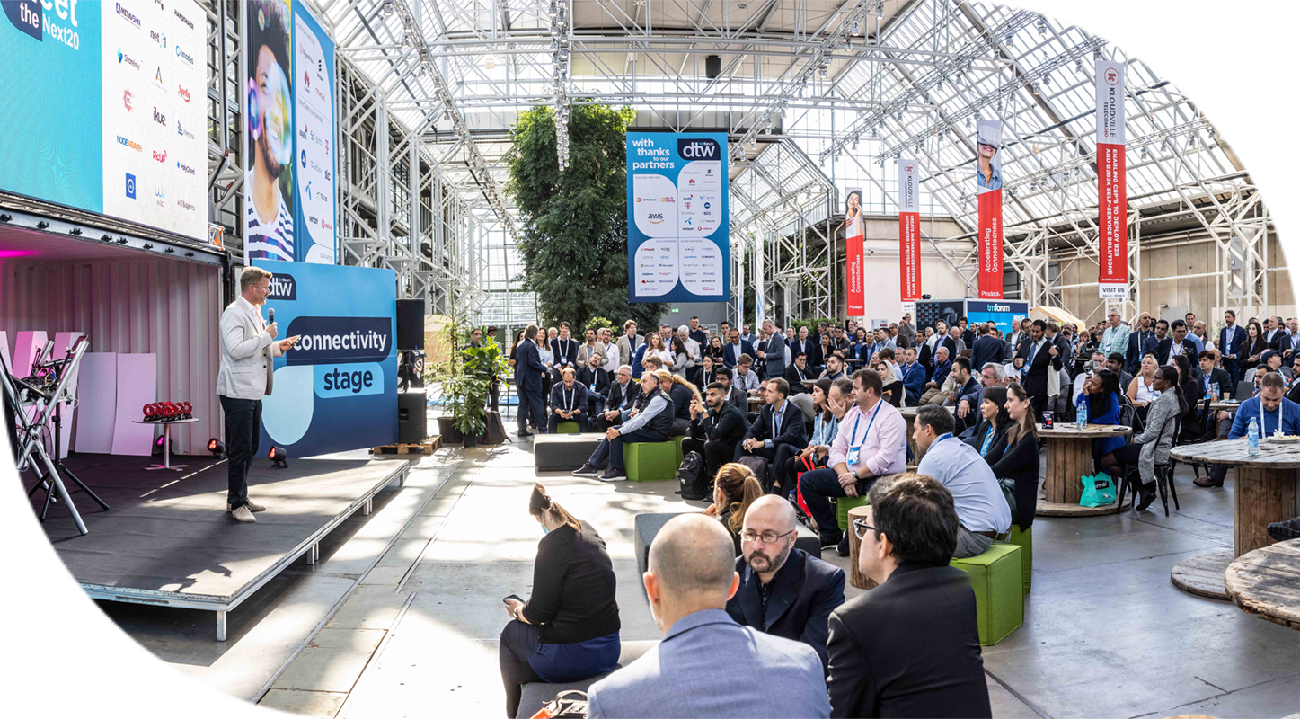

Moonshot
Recognize catalysts which best solves the set Moonshot Challenges offering innovative & commercially viable technology solutions to the key industry challenges.
Applicable only for Moonshot Catalysts.
Promotion & gaining industry feedback.
Judged by the executive panel of industry specialists.
Recognition through TM Forum wider media exposure, and social media.
Winners announced live at Awards Ceremony on 21st Sept at 1:15pm CEST.
catalyst awards
3

Slide 4
award categories

Slide 5
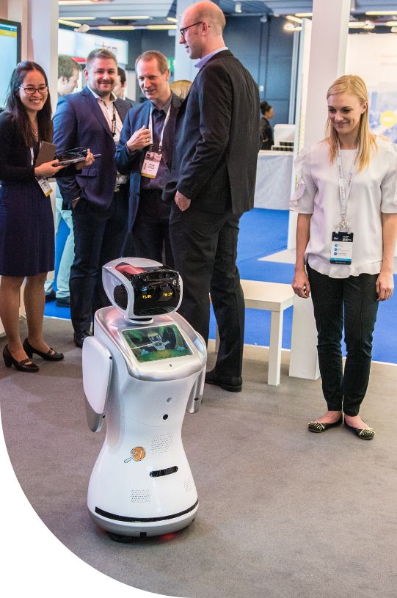
Award
categories
Best Moonshot Catalyst – The Energy Challenge
Best Moonshot Catalyst – The Metaverse Challenge
Catalyst that demonstrates best answer to the Metaverse Challenge offering innovative & commercially viable technology solutions using Metaverse capabilities to unlock the benefits for connectivity providers.
Catalyst that demonstrates best answer to the Energy Challenge offering innovative & commercially viable technology solutions towards our sustainability goals of carbon neutrality & reduced energy consumption.

Slide 6
judging process & criteria

Slide 7

Judging
process
Each award category would be judged against 6 parameters or judging criteria:-
Judges review teams based on:
  Awards Submission form entries (Pre-read)
  Catalyst Spaces/URL/Resources shared on spaces etc (Pre-read)
  Onsite team interactions/demos at their booths (Onsite)
Each Catalyst will be allocated a panel of Executive Judges/Coaches to review & score the teams.
Teams would require submitting their Awards submission forms.
Each Catalyst team will be allocated a common Username & Password to access the Awards portal and for submitting their Awards Submission Forms.

Slide 8
Judging criteria
QUANTIFIED RESULTS
TEAM COLLABORATION
SOLUTION
POTENTIAL IMPACT ON INDUSTRY
PITCH
Is the Catalyst able to quantify with proof points, the business outcomes (in terms of number, dollar, %age)?
How well the Catalyst demonstrates their solution and help the team to achieve the moonshot ambition?
What is the potential impact of the Catalyst solution in revolutionizing & solving the moonshot challenge?
How well did the team pitched their Catalyst idea & solution to Judges?
How well has the participants & champions contributed & collaborated towards catalyst success?
MOONSHOT CHALLENGE
How well the team defined problem statement for their moonshot challenges?
(1=Did not define correctly,
10=Super clear & precise definition of the problem statement/Moonshot goals)
(1=Did not correctly, 10=Most innovative solution to their moonshot ambitions)
(1=Not engaging/boring,
10= Most engaging, interactive & engrossing demo/pitch)
(1=Vague results, 10=Clear & precise quantifiable business outcomes)
(1=Not much impact, 10=Potential to create a ripple effect & solving the industry challenge completely)

Slide 9
awards submission form

Slide 10
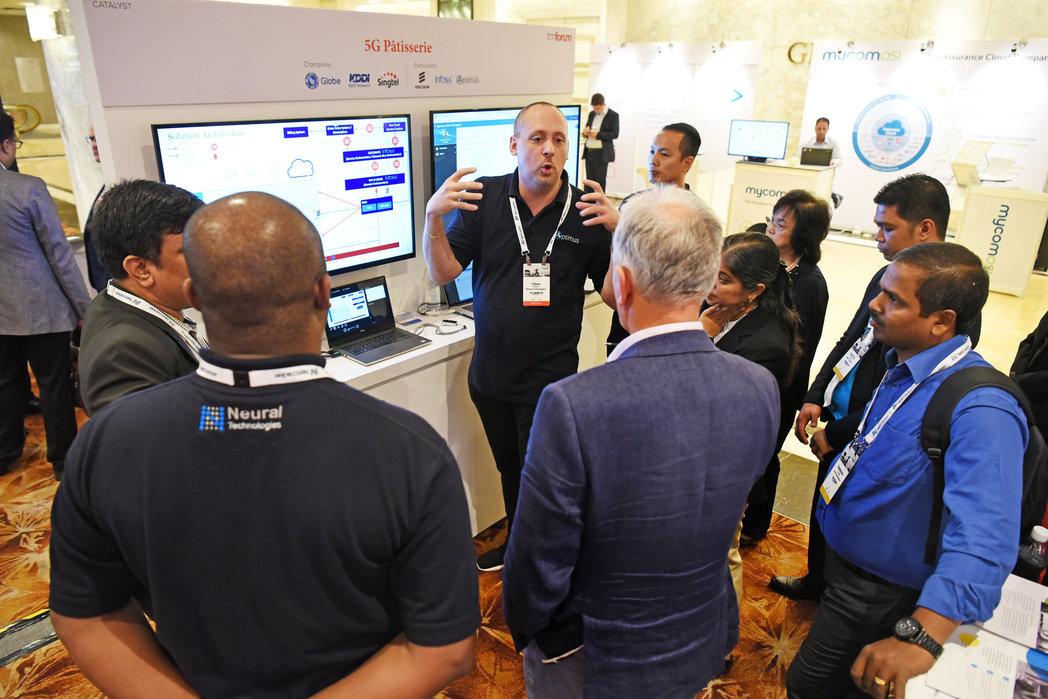
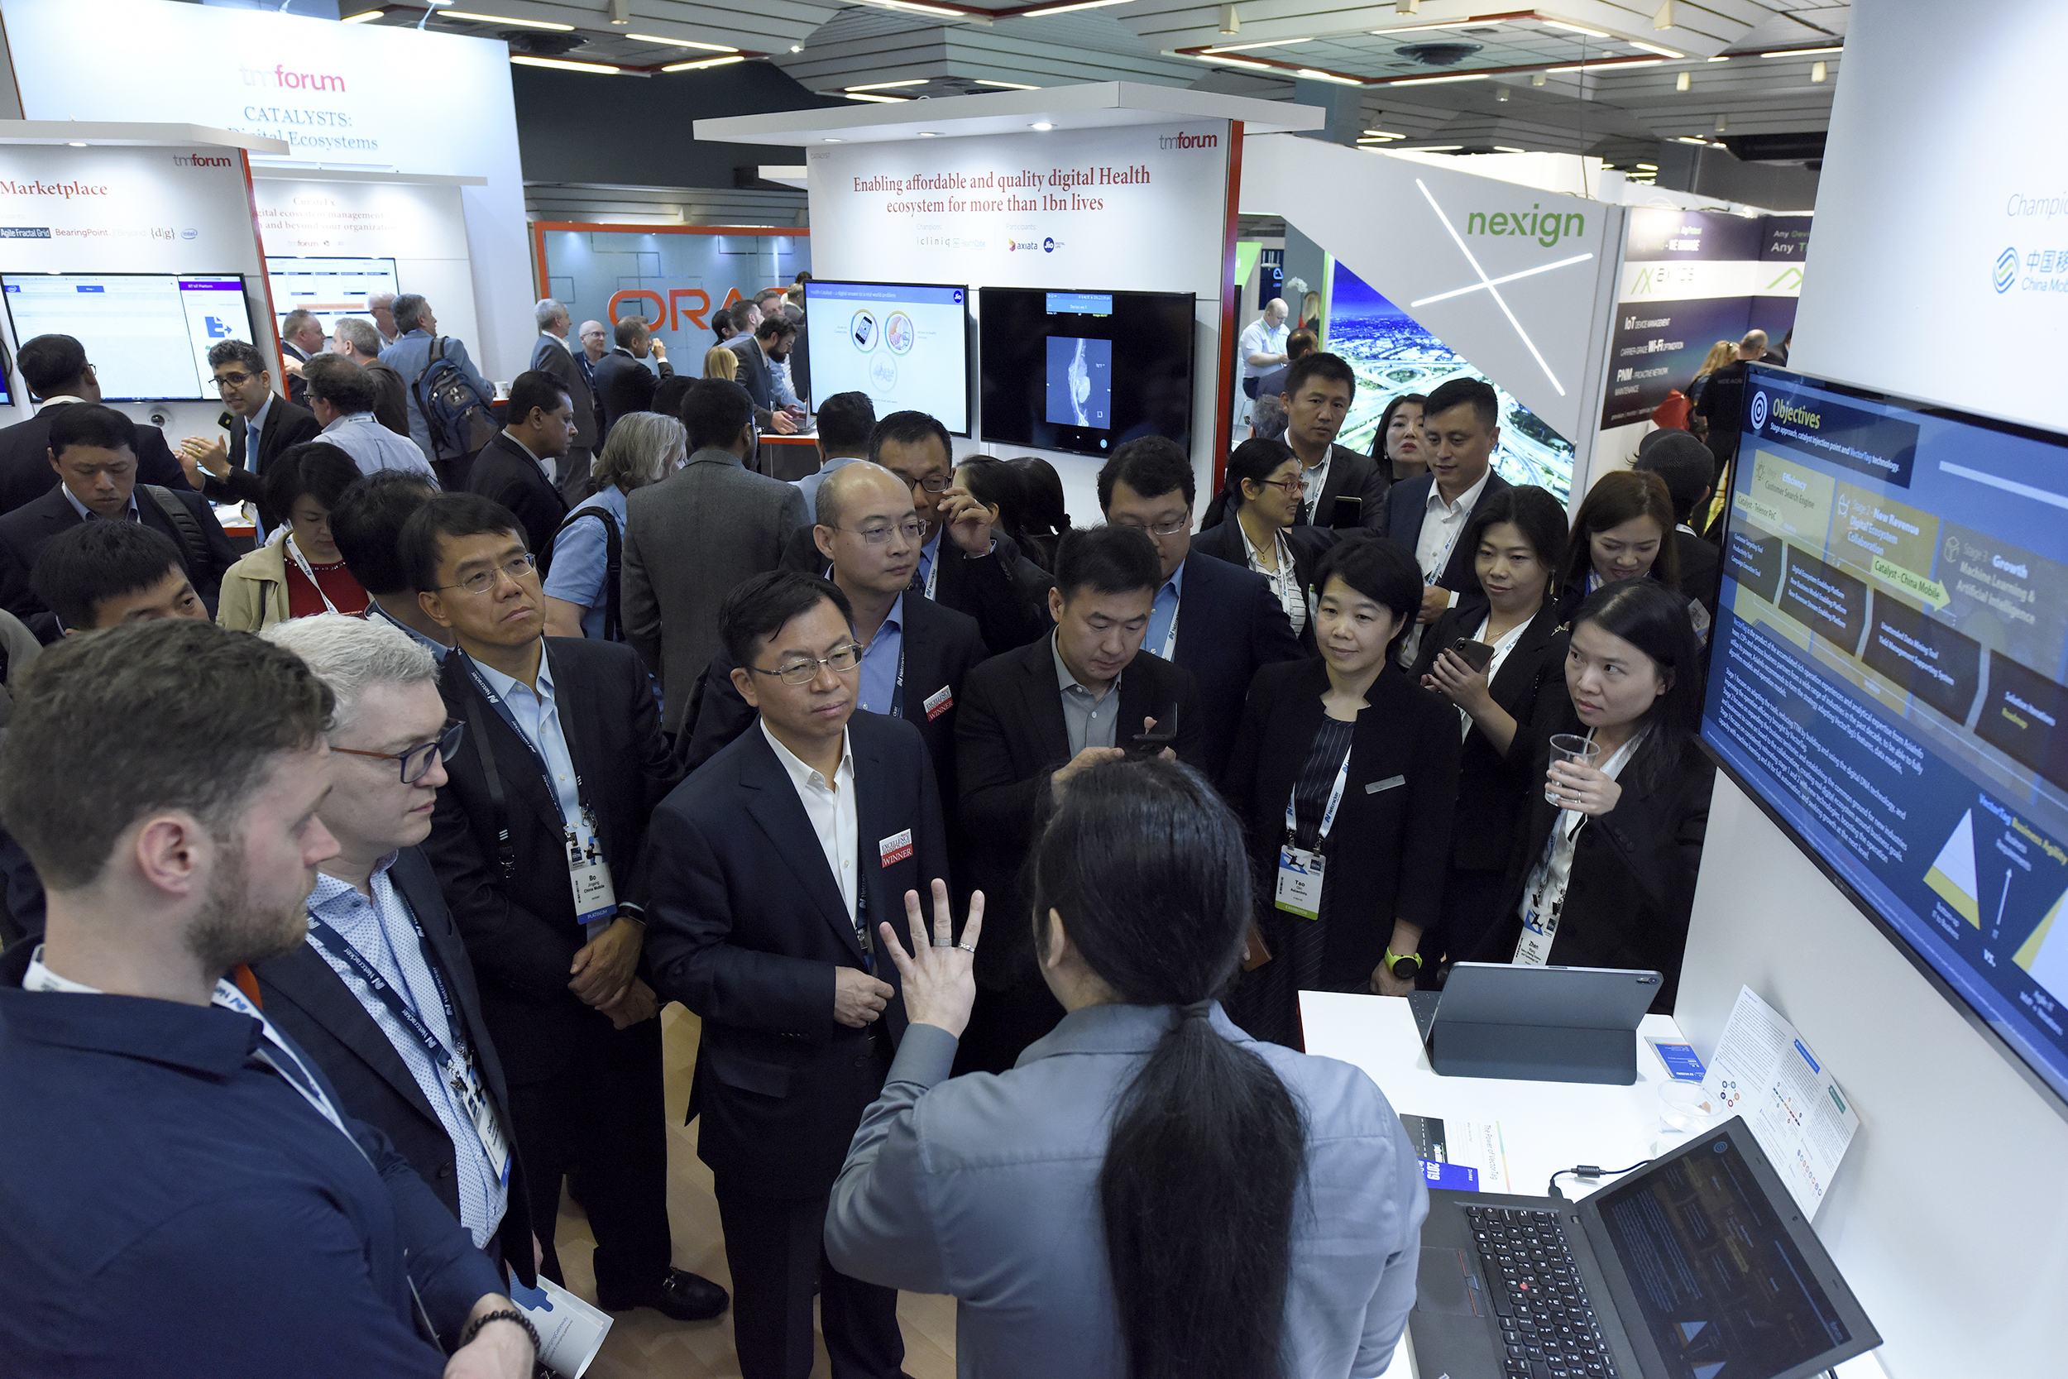
Awards submission form
Before submitting online, download the Awards Submission form template and discuss with your team.
Each team is required to fill in ONLY ONE FORM.
Entry deadline: 25th August 2023 (midnight - EST)
Please submit before deadline, as system will automatically close the entry submission after the deadline.
Notes:
So for Awards submission form, before online application – please download the template

Slide 11
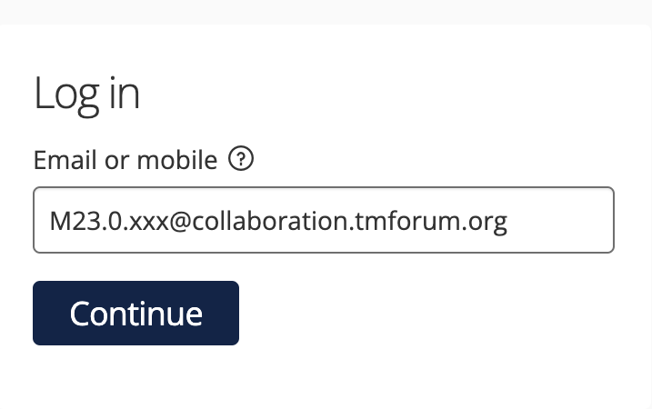
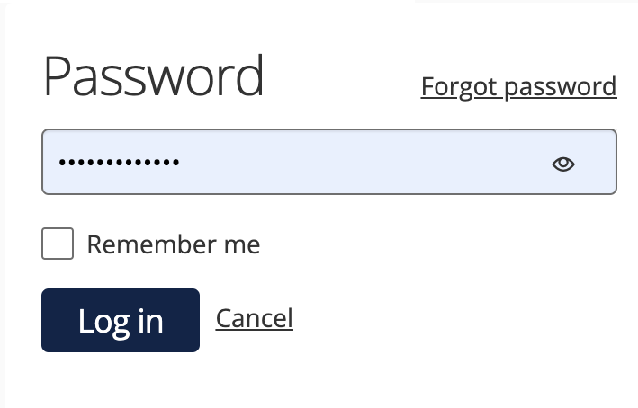
Awards submission form
For online submission, go to URL: https://awards.tmforum.org/
Login credentials emailed to each project lead or co-lead. Please reach out if not received or any issue.
Buttons on form:
  START ENTRY‘ to start the entry form first time.
  'SAVE+NEXT' to save & proceed to the next tab.
  ’SAVE+CLOSE’ to save & return to form later. Also, to save form after submission (but before deadline).
  ‘PREVIEW’ to preview the entire form at anytime. Use this button specifically when filling tables.
  ‘SUBMIT’ when all tabs filled & team satisfied with their entry.
Scroll down online form completely to view & fill in all contents.
Preview the submission form before submitting.
  Even after submission, team can edit before 25th August & submit by using ‘SAVE+CLOSE’ button instead.
Notes:
To start the entry for first time, click on 'Start Entry' button and initiate the form. Thereafter, link available on home page for accessing the form later.

Slide 12
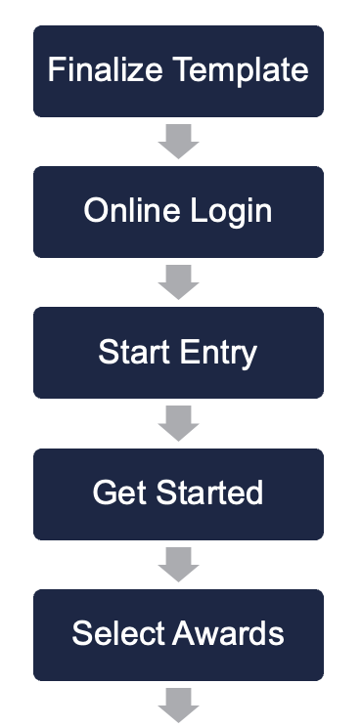
Submit before deadline
Live
tutorial
Save & edit later
TMF Assets & Additional Info
Best Moonshot – The Energy Challenge OR The Metaverse Challenge

Slide 13

Do’s &
Don'ts
Select ‘Moonshot Catalyst Awards’ only.
Select the respective ‘Award Category’ based on the corresponding Moonshot Challenge.
Do not select ‘Forgot Password’ to reset. If any access issues, please reach out.
Single member accesses at given time.
For ‘Entry Name’ – enter your final Catalyst Title (if changed). Logins were created based on the current titles.
You can edit the form multiple times BEFORE DEADLINE – even after submission.
Submit before deadline → to avoid last minute technical glitches & delays.

Slide 14
judging onsite

Slide 15

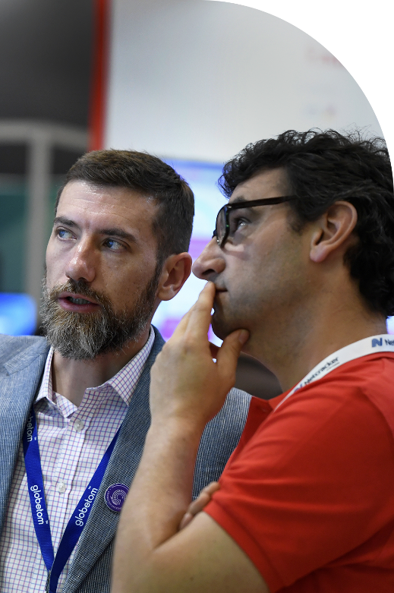
Onsite Judging
JUDGING SLOTS
  Executive Coaches/Judges will visit teams at their stands to interact & score.
  Most judging slots will be focused on 19th Sept.
  Although most judges visit together in slot, some may visit based on their availability.
  Details of allocated judges & slots will be available to teams by first week of September.
  Ensure presence of your key team member at kiosk.
  Judging slots different from presentation slots.
AWARD CEREMONY
  Winners will be announced at Awards Ceremony
  21st Sept at 1:15pm.
BEST INNOVATION & FUTURE TECHCO

Slide 16






Timelines
Awards & Judging
Awards Submission Forms
3rd July to 25th August
Judging at DTW Copenhagen
19th September
Catalyst Awards Webinar
12th July
Update Catalyst Spaces
by 4th Sept (recommended)
Catalyst Awards Ceremony
21st September
* TBC
16

Slide 17
best practices & tips

Slide 18





Best
Practices
focus
update
on highlighting the goals & how Catalyst solution addressed the Moonshot Challenge. Use template to discuss with your team and submit the Awards Submission form online.
Catalyst Spaces with all resources & content to illustrate the Catalyst in clear, concise & presentable way, by deadline.
follow
present
our Confluence page for latest information about Moonshot Catalyst Awards. Also recommend to promote catalyst using marketing toolkit.
to judges onsite - clearly expressing the how best the Catalyst addressed & achieved the set Moonshot challenge, focussing on proof points.

Slide 19
post event

Slide 20
Post-event award
Outstanding Contribution to TM Forum Assets
Judged & Awarded Post-Event to Catalyst team that uses the program to make most substantial contribution to TM Forum’s assets.
All submissions reviewed by TM Forum Staff & judged by TM Forum’s Collaboration Sub-committee.
Catalysts assessed based on
  Overall impact to collaboration projects
  Number of contributions
  Quality of contributions
20
Notes:
Each Catalyst project is associated or related to a collaboration project or basic theme.

Slide 21
Post-event award
To do contribution, you must be part of the TM Forum Collaboration program (free to all members).
Please find and join the right program https://myaccount.tmforum.org/joinproject
In confluence find the correct project & in Project space side bar, you can navigate to "Contributions" page
Click on "Submit Contribution” & select issue type as ”Catalyst Contribution”
Email list of contribution with project URN to Shengfan Hou.
Last date to submit contribution: 3rd November’23.
More details about contribution-here
More details about process - here
Application
Process
21
Notes:
Each Catalyst project is associated or related to a collaboration project or basic theme.

Slide 22
Post-event activity
Judges’ Feedback
Judges’ feedback comments will also be accessible through the Awards platform, using the same login credentials.
Will be available from 2nd October & will stay accessible till 31st December.
Post-event promotions
Catalyst promotions & inform articles will continue to be published post-event as well.
22
Notes:
Each Catalyst project is associated or related to a collaboration project or basic theme.

Slide 23




Stay
Latest information available on confluence Catalyst Awards page.
Recording & presentation will be uploaded
Important Catalyst webpages:
  TM Forum website
  Catalyst Spaces
  Catalyst Awards webpage
Weekly check-in emails
Contact us:–
  TM Forum Service Desk, or
  Email us:-
    Catalyst Operations
    Mahima Khurana (for awards)
    Shengfan Hou (for contributions)
informed!
Notes:
https://projects.tmforum.org/wiki/display/CS/Open+Innovation+Catalyst+Awards+-+DTW%2723

Slide 24
Any Questions?

Slide 25
Thank
You!

Slide 26


Award Specific
judging criteria
Outstanding Catalyst – Sustainability & Impact On Society
Outstanding Catalyst – Business Impact
Business Impact
How well does the project team quantify and explain the business impact of their solution?
Commercial Viability
To what extent is the catalyst solution relevant, commercially viable & credible to the business?
Societal Impact
What degree of societal impact is the project likely to have in the next 1 year?
Sustainability
How well does catalyst align with United Nations Sustainable Development Goals (SDGs)?

Slide 27

Award Specific
judging criteria
Outstanding Catalyst – Showcase
Outstanding Use of TM Forum Assets
Demonstration
How well is the demonstration presented to showcase the solution's innovation and commercial viability ?
Regional Concerns
How well does the demonstration highlight their solution's relevancy to regional industry concerns?
Use of TMF Assets
How deeply rooted are the team’s solution with TM Forum’s best practices and standards?
New Thinking
How well has the team tested or developed new thinking / requirements for TM Forum’s best practices & standards?

Slide 28
Award Specific
judging criteria
Outstanding Business Growth ^{NEW}
Best Innovation & Future Techco
Growth Potential
How well does the Catalyst demonstrate top line revenue growth potential including adjacency / attractiveness of its solution to the telecoms industry?
Adaptability
How well does the Catalyst hold an ability to stay ahead of the curve to adapt with change in market conditions?
Innovation
How original, innovative & futuristic is the team’s business idea and/or technology solution?
Future Potential
How would the Catalyst solution potentially impact future technology developments in industry?

Slide 29

Best
Practices
invest
login
time on understanding judging criteria & filling Awards Submission forms. Use template to discuss with your team before submission.
using URL https://awards.tmforum.org/. Username / Password emailed to project lead or team member. Credentials can be shared. Create entry form & submit before deadline.
ensure
judges
single team member accesses the online form at a particular time. Form can be updated even after submission, by clicking on ‘save + close’ button.
will visit each team onsite during a ’judging slot’ to interact with the team. Express the rationale & significance of the Catalyst, clearly focussing on proof points.

