Slide 1
Catalyst Team Awards
(DTW-2022)
          Mahima Khurana
          Agile Project Manager
          (CATALYST PROGRAM)

Slide 2
Award categories
Judging criteria (General & Award specific)
Judging Process & Timelines
  Awards Choice Form
  Awards Submission Form – Template & Demo
  Judging Phases
  Online Voting
Today’s agenda

Slide 3
Outstanding Catalyst – Business Impact
Outstanding Catalyst - Impact on Society and Sustainability
Outstanding Catalyst – Innovation
Outstanding Use of TM Forum Assets
Best Ecosystem Design
Best New Catalyst in Show
^{For Phase-I Catalyst only}
Future Techco
^{New}
Catalyst People's Choice Award
^{Default}
Outstanding Contribution to TM Forum Assets
^{Post DTW}
2022
Catalyst
Award Categories

Slide 4
Awards at DTW’22
Outstanding Catalyst – Business Impact
Demonstrates impact on business (performance, cost, customer engagement etc.)
Outstanding Catalyst - Impact for Society and Sustainability
Potential to improve society & contribute towards SDG goals.
Outstanding Catalyst – Innovation
Most innovative solution to advance digital business
Outstanding Use of TM Forum Assets
Display the use in their solution and quantify benefits of TMF assets
Best Ecosystem Design
Best utilization of CurateFx throughout Project Lifecycle
Best New Catalyst in Show ^{Phase-I or New Catalyst only}
Collaborative behavior towards compelling solutions
Future Techco ^{New}
Catalyst People's Choice Award ^{Default}
Explores futuristic/ emerging technology & quantify a disruptive business model
Best Catalyst based on audience votes and unique views to Catalyst spaces.

Slide 5







a successful
General
Judging Criteria
Catalyst:
How compelling is project’s storyline and technology solution?
How well does the project achieve its key outcomes?
How well developed is the proof of concept demo?
How well has the team used TM Forum’s best practices, standards & assets?
To what extent has the team demonstrated true collaborative behaviour?
How actively engaged were the Champions?

Slide 6


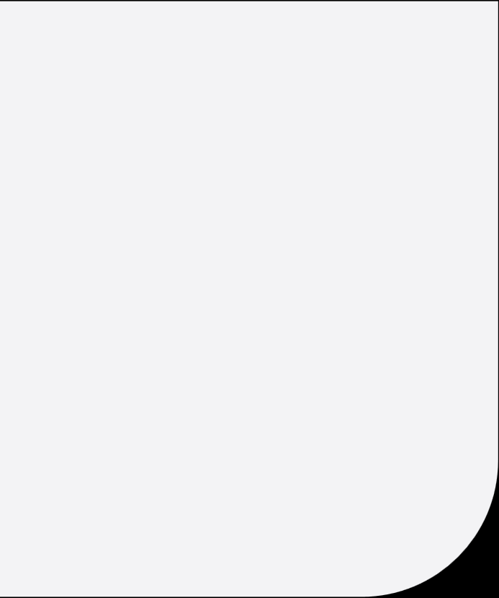
a successful
Award Specific Judging Criteria
Catalyst:
OUTSTANDING CATALYST – BUSINESS IMPACT
OUTSTANDING CATALYST – IMPACT ON SOCIETY AND SUSTAINABILITY
OUTSTANDING CATALYST – INNOVATION
How well does the project team quantify and explain the business value of their solution?
How likely is it that the concept will have a commercial impact within 12 months?
How much impact is the project likely to make in society in next 1 year?
How well does catalyst align with SDG goals?
How original and innovative is the team’s business idea and/or technology solution?
How big is the potential impact of the work on the business or technology area that it is exploring?

Slide 7
a successful
Award Specific Judging Criteria
Catalyst:
OUTSTANDING USE OF TM FORUM ASSETS
BEST NEW CATALYST IN SHOW
[For Phase-I Catalyst only]
BEST ECOSYSTEM DESIGN
How deeply rooted are the team’s solution with TM Forum’s best practices and standards?
How well has the team developed new thinking / requirements for TM Forum’s best practices & standards?
How well does the team use CurateFx to tell their story as a key part of how they present their project results?
How many companies in the team are new to the Catalysts program?
How well does the catalyst express & measure results -business impact / innovation/sustainability / TMF assets usage?

Slide 8
a successful
Award Specific Judging Criteria
Catalyst:
CATALYST PEOPLE'S CHOICE AWARD
[All Teams considered]
OUTSTANDING CONTRIBUTION TO TM FORUM ASSETS [Post DTW]
FUTURE TECHCO
[New]
How well did the team apply the new technology in their Proof of Concept?
How disruptive / impactful would the Catalyst solution potentially have on the Business/Technology field in upcoming 2 years?
Online voting open for all from 12th Sept to 22nd Sept
Based on online votes & unique viewership of catalyst spaces.
Value, variety and volume of the contributions submitted by the deadline
Contributions submitted in Jira

Slide 9





Judging Process & Timelines
Judging Phase II: Onsite teams
&
Awards Ceremony
20th Sept to 22nd Sept
Awards Choice form
Deadline : 15th July 2022
Judging Phase I: Virtual teams
7th Sept to 14th Sept. 2022
Awards Submission form
18th July to 29th Aug 2022
Online Voting
(for People Choice Award)
12th Sept to 22nd Sept (11am)
9

Slide 10

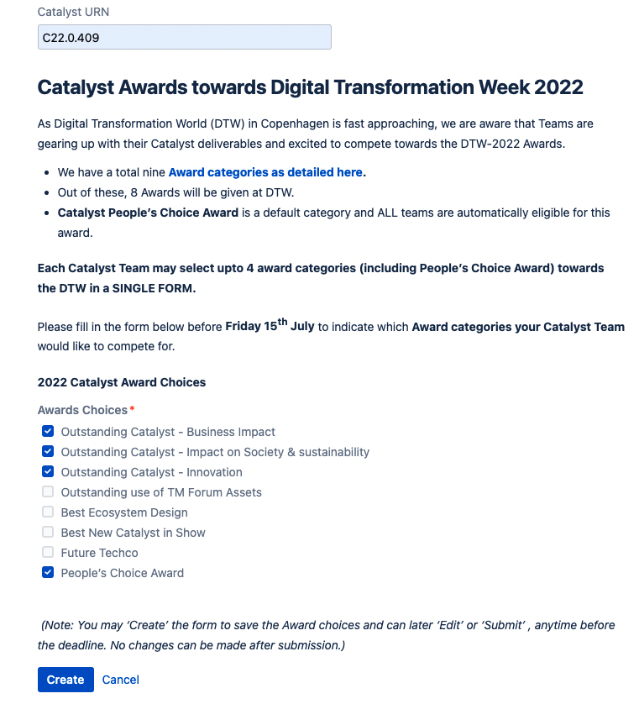
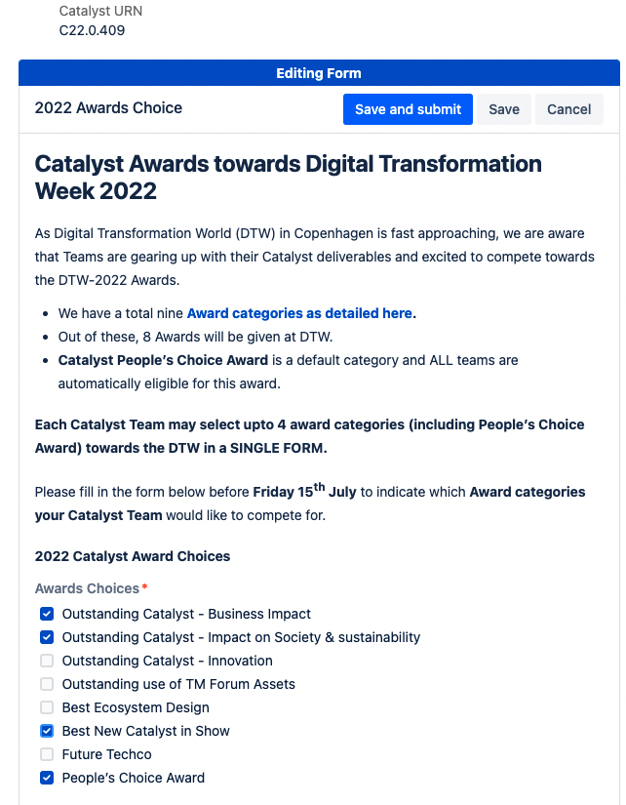
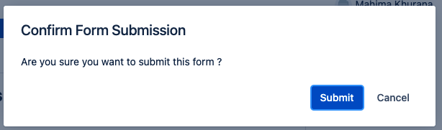
Create & submit the Catalyst Awards Choice form
Each team to consult & chose upto 4 awards (incl. People’s choice award)
  Consult your CSM before submission.
  Cannot edit after team submits or deadline (15th July).
  Only team member who creates the form can submit.
  Ensure Catalyst URN entered as C22.0.xxx format.
Awards Choice Form
CREATE
SUBMIT

Slide 11
  Upcoming (18th July onwards)
  Create & save the Catalyst Awards Submission form.
  This information would be used for judging purpose primarily.
    Teams can create/edit/save form anytime before submission/deadline.
    Teams to submit the form before deadline (29th Aug).
    Cannot edit after team submits or after deadline (29th Aug).
    Indicative form Template & latest information on Awards available HERE.
    Ensure to indicate the SAME award choices which were selected earlier by the team (refer next slide).
Awards Submission Form
^{(upcoming)}
  Best Practices
    Consult Awards submissions with CSMs, prior to submission.
    Keep the information concise, crisp and clear; detailing with proof points.
    Use bullet points for long answers.
    Use social media to promote & attract viewers.
    Upload videos / files / resources on Catalyst spaces – by 5th Sept.

Slide 12
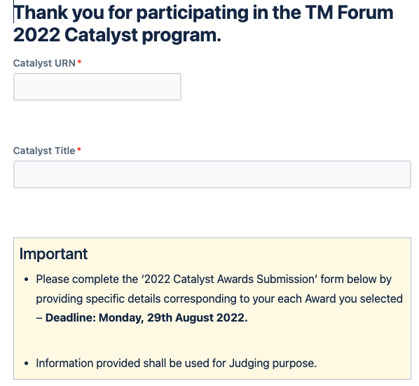

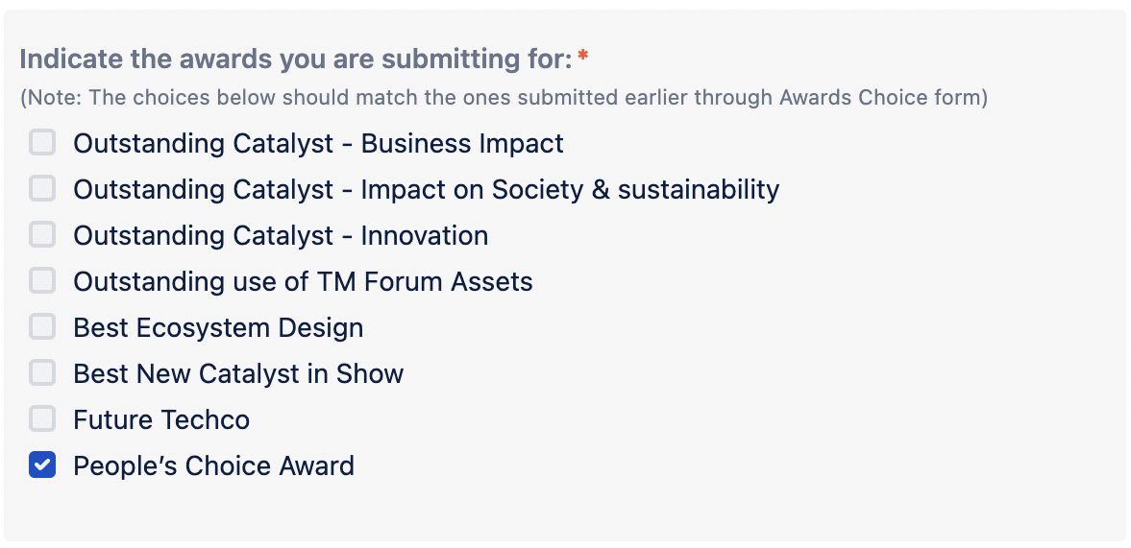
URN in format C22.0.xxx
Awards Submission Form
^{(Indicative snapshot & Demo)}
Approved Project Title
Indicate the SAME Award Choices which were selected earlier by the team
Indicative Awards Submission Form

Slide 13
JUDGING PHASES
  Each Catalyst award category will be judged by 3 Judges.
  Judging will be divided into two phases to cater to all 41 Catalyst teams.
  PHASE I : Virtual Teams
  (7th Sept to 14th Sept 2022)
  Judges will score the Virtual teams.
  If they would like to discuss more, Judges will reach out to Teams through CSMs.
  PHASE II : Onsite Teams at DTW
  (20th Sept to 22nd Sept 2022)
  Slots will be allocated when Judges will visit the kiosk.
  Team members to ensure their presence at kiosk.
  All onsite team members to ensure presence.
  Scores of all teams will be collated & winners assessed.
  Awards Ceremony on 22nd Sept (1:30pm)
Judging Phases- I & II

Slide 14
Online
Voting
(For People’s Choice Award)
For Catalyst People’s Choice Award:–
Category is default & all teams eligible for the award.
Will be based on voting & viewership counts.
Online voting shall open on 12th September 2022.
Will be active till 22nd September 2022 (11am CET).
[Online votes + Unique views to catalyst spaces] will be considered for the final count.
Encouraged to update their Catalyst Spaces with presentable information by 5th September.
Notes:
Voting will open for TMF registered members

Slide 15

Catalyst Awards
Awards Choice form
  Create & save the award choices (upto 4 incl. People choice)
  Refer the template to assess your catalyst.
  Consult team & CSM before final submission.
  Submit by 15th July.
Awards Submissions (18th July onwards)
  Create & save the Awards submission details in the form.
  Select the same choices as submitted earlier.
  Refer the template to assess your answers.
  Submit only when all finalized by 29th August.
  Consult with CSM at least week before final submissions.
  If team fails to submit choices or submission form, implies only competing for People’s Choice.
Judging
  Will commence in phases from 7th Sept.
  All teams advised to update Catalyst spaces by 5th Sept.
  Slots for teams at DTW will be shared in due course.
Online voting for People’s Choice award
  Invest time in Marketing activities
  Attract viewers to your Catalyst spaces.
  Update the spaces with easy & presentable information.
Summary

Slide 16
THANK YOU
For any further information/questions, please contact:
Mahima Khurana mkhurana@tmforum.org or your Catalyst Success Manager.

