Slide 1



Active
Catalyst
Deep Dive
into
Innovate Asia’24

Slide 2



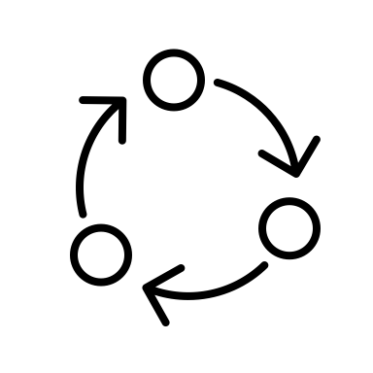

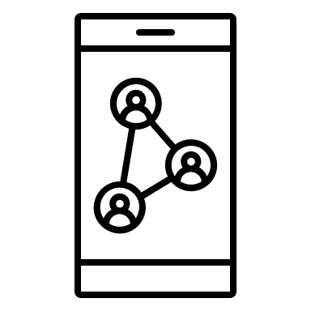

the brightest and best
unite with
to drive innovation and business results
Catalyst projects at the heart of innovation at DTW24 - Ignite
50
208
Forge new industry relationships and opportunities for success.
Accelerate innovation at scale with an R&D cycle typically 5x faster than in-house proof-of-concept projects
Thrive in a safe space to collaborate across competitive boundaries
Map out your route to market in parallel with proof-of-concept
Showcase your solution to senior executive members and influential industry peers at Innovate Asia 2024
Catalyst
projects
unique companies
1100+
72
unique
team
members
unique service providers

Slide 3

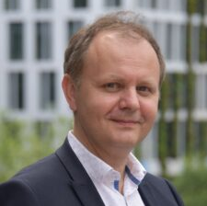


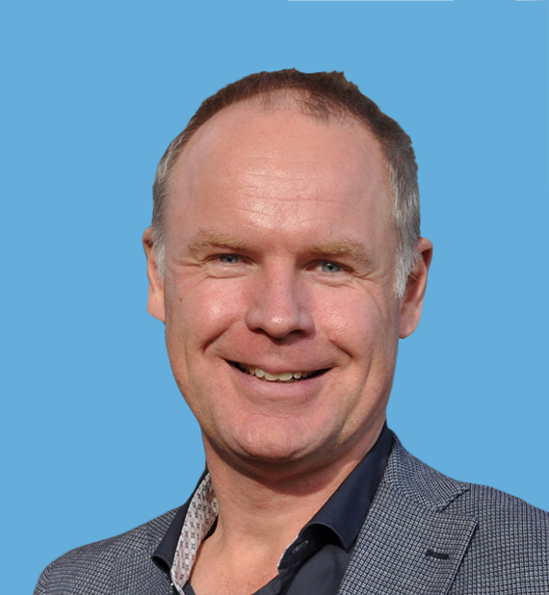

open innovation Catalysts
Identify your opportunity to co-create a solution that
can be readily adopted by businesses and is in line
with TM Forum best practices and industry standards.
Demonstrate your proof-of-concept including its
scalability and reuse potential.
Solve challenges behind real business needs
Share the cost of innovation and reduce the time
required to create new solutions
Prove new ideas (and work with new suppliers) quickly and cost-effectively
Accelerate development of TM Forum industry standards and best practice by leveraging the Open Digital Architecture
We believe that participation in collaboration accelerates our R&D and
enables us to work with key business stakeholders. We also consider
participation in Catalyst projects a very efficient way to showcase new initiatives.”
Laurent Leboucher
Group CTO & Senior Vice President, Orange Innovation Networks
TM Forum Catalyst projects are open-innovation rapid fire proof-of-concept projects
which offer unique collaboration opportunities. An essential experience for telecom executives shaping the future in a 5G / Platform Economy driven world.”
Erik Meijer
Senior Vice President Europe and Global Customer Specialist, MACH49

Slide 4


moonshot Catalysts
Moonshot Catalyst projects are a new way to meet the
ultimate challenges of our industry head-on, as we strive
for truly sustainable growth.
In addition to the advantages of joining an Open Innovation Catalyst, your project team will receive enhanced backing every step of the way, and solutions with the most significant impact.
Create innovation at scale and
sustainable growth with a fail-fast
philosophy and the guidance of top
industry figures
Executive Coaching: Each team will receive exclusive access to an executive coach before the event, enabling them to refine their messaging for maximum impact.
Win Moonshot awards for technically excellent solutions with game-changing innovations
Innovate Asia 2024 Moonshot Challenge:
AI Challenge -
1
Leverage GenAI to drive a 30% increase in EBITDA and operational efficiency.

Slide 5
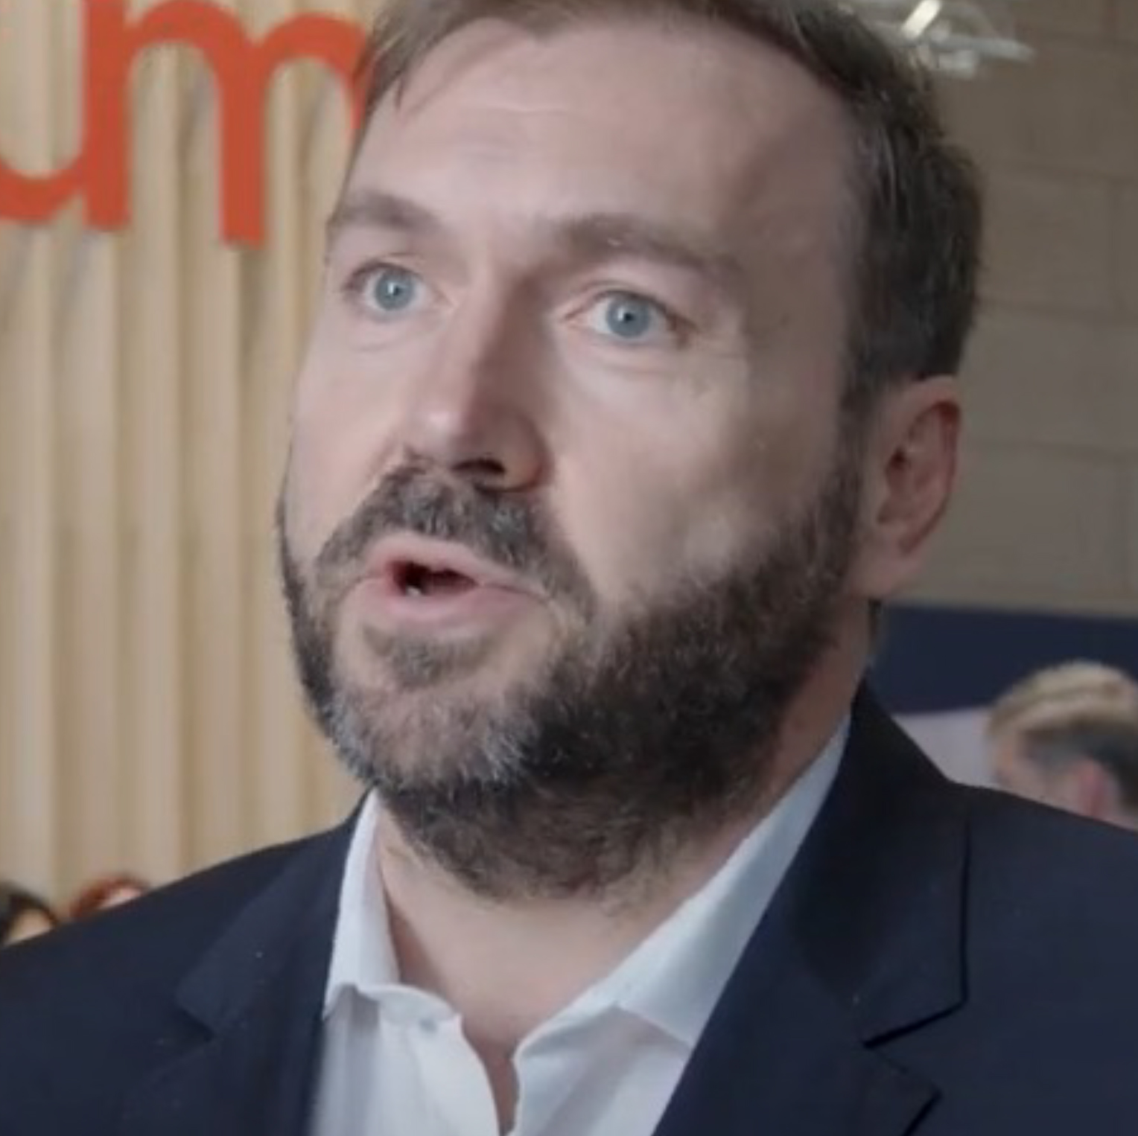


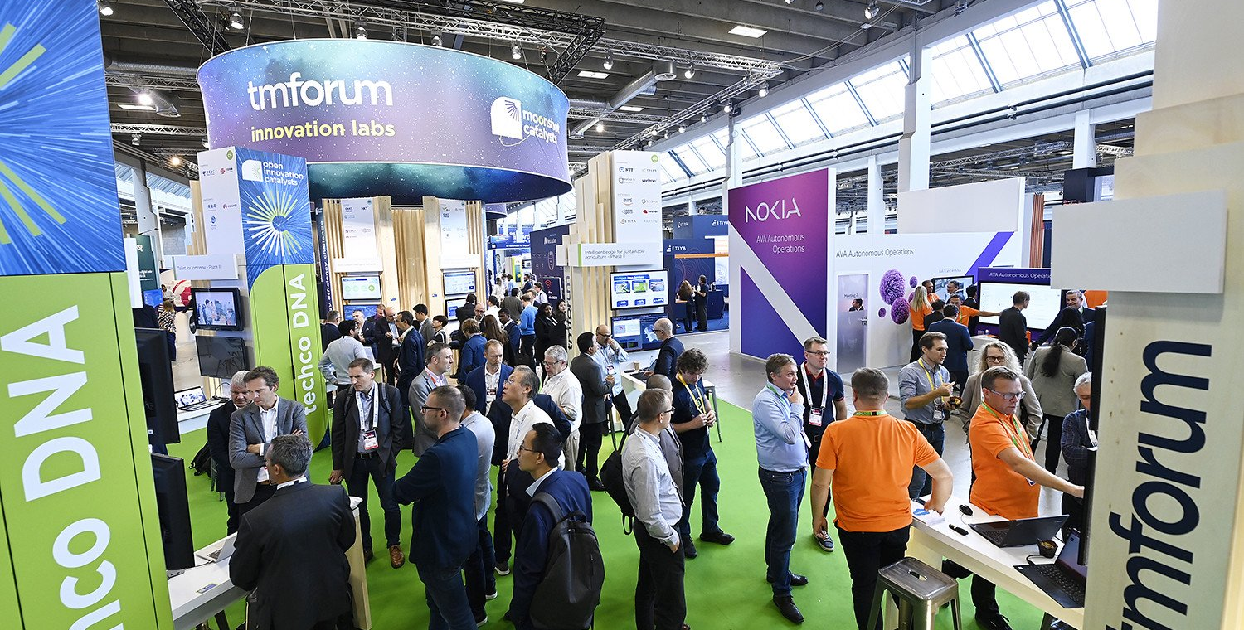
The main benefit that Ubiqube has got
from participating in Catalysts is being able
to work with experts in the industry, to partner
together, share knowledge, put competition aside,
and try to envision the future of the industry to
help our customers with their transformation
journey. It’s a great place to innovate!
get onboard
Herve Guesdon
CTO, Ubiqube
Become a Project Champion*
As the potential customer for the solution, a Champion:
Innovate as a Project Participant**
As the potential supplier of the solution, a Participant:
Defines the problem statement and validates
the commercial significance to the industry
Inspires, contributes to the requirements, and curates the development for a proposed solution
Provides feedback, on proposed
solutions
Is the backer and business
sponsor for the team
Pays no fee
*Min 2 Champions per project.
Develops the solution and designs
and delivers a proof-of-concept demonstration
Defines and leads project plans and
timelines
Explores & develops the solution and
designs and delivers a proof-of-concept demonstration
Documents learnings and
contributes these back to the industry
Pays fee (see fee scale, exclusions may apply)
**Min 3 paying Participants per project.

Slide 6



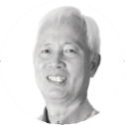

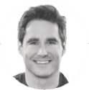


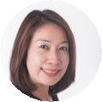
find the
motivation
Champion
Participant
Leverage the industry to accelerate innovation
Know the industry (relationship building)
“I want to prove new ideas (and new suppliers) quickly and cost-effectively.”
“I want to develop new client relationships and gain deep understanding of customer requirements and partner and competitor capabilities.”
CTIO
Product Management
Influence the industry towards common approaches
Excite the industry with innovation (marketing)
“I want to demonstrate
alignment between technical initiatives & business strategy.”
“I want to get recognition for my company’s innovation and show how our products help the industry.”
VP Strategy
& Innovation
CMO

Slide 7
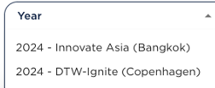
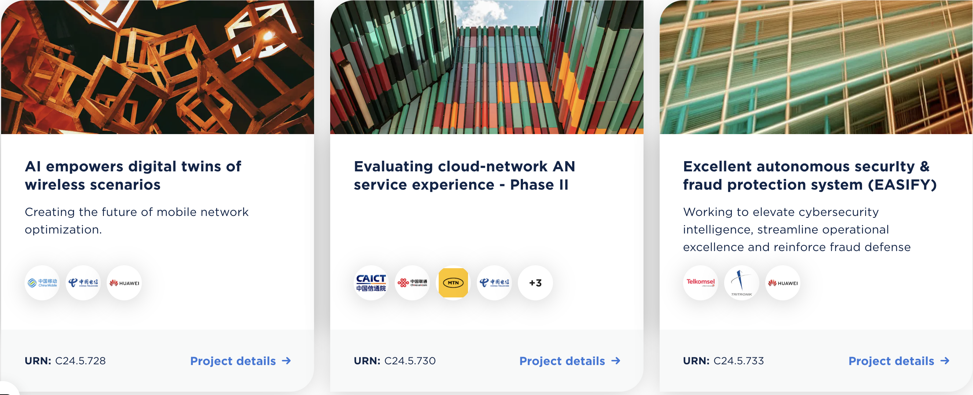
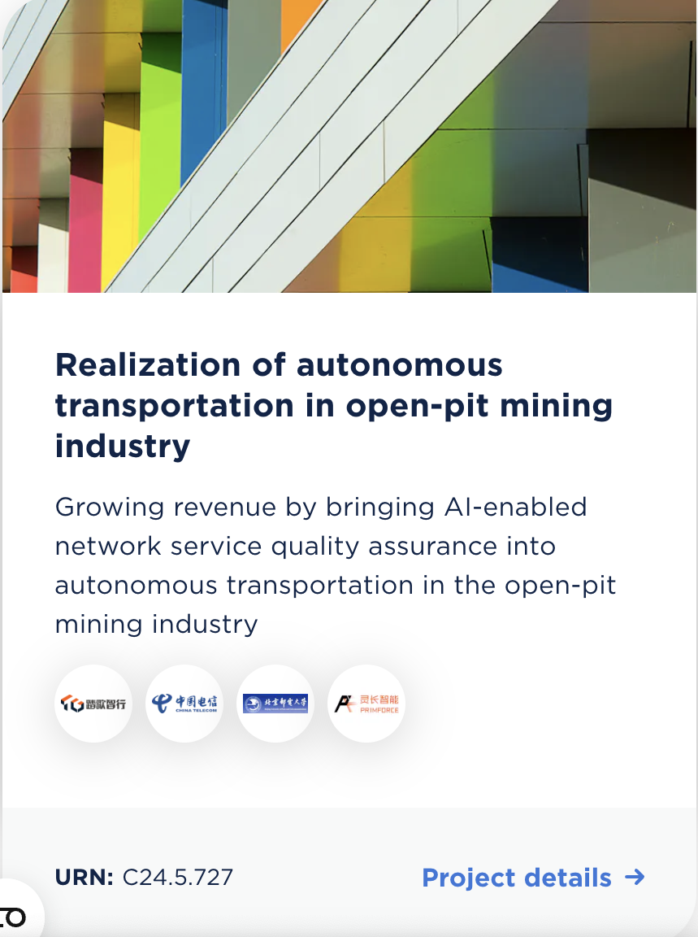
Find Matchmaking Catalysts
to join
https://www.tmforum.org/catalysts/projects

Slide 8
key topics
for Catalysts
  Autonomous network and Operations
    Autonomous Networks
    Closed-loop automation
    Zero touch
    Autonomous operation for 5G-Advanced
    Satellite communications, 5G over satellite
    Computer force network
Data & AI, Sustainability
  AIGC, LLM
  Data driven automation
  Customer centricity
  AI-IoT/edge
  Distributed ledger technology
  Talent, culture organizational transformation
  Composable IT & ecosystem
    ODA transformation
    ODA component implementation
    API-based service operations
    Plug & play Architecture
    Drone, VR, XR
    EV requirements for telecoms
    Smart verticals

Slide 9
timeline Asia 2024
and milestones
Mar 2024
APR
MAY
JUN
JUL
AUG
SEP
OCT
NOV 2024
Mar 4
Call for Catalyst
(Open Innovation &
Moonshot Catalysts)
July 19
Call for
Catalyst closes
Matchmaking continues
Aug 16
Deadline to become viable / join
Catalyst projects
Nov 5-7
Innovate Asia
event
Call for Catalysts
Aug 30
Deadline to get all contracts signed
Aug - Oct
Marketing webinars
Catalyst awards webinars
Matchmaking & Teams forming
Trailer videos
Inform articles
Marketing activities / Awards Submissions / Webinars etc.
Design / implement / test / ready for demo
GO
LIVE!
Viable: Minimum 2 Champions & 3 paying participants confirm their participation in the Catalyst.
Active: Minimum 2 Champions & 3 paying participants sign their contracts

Slide 10
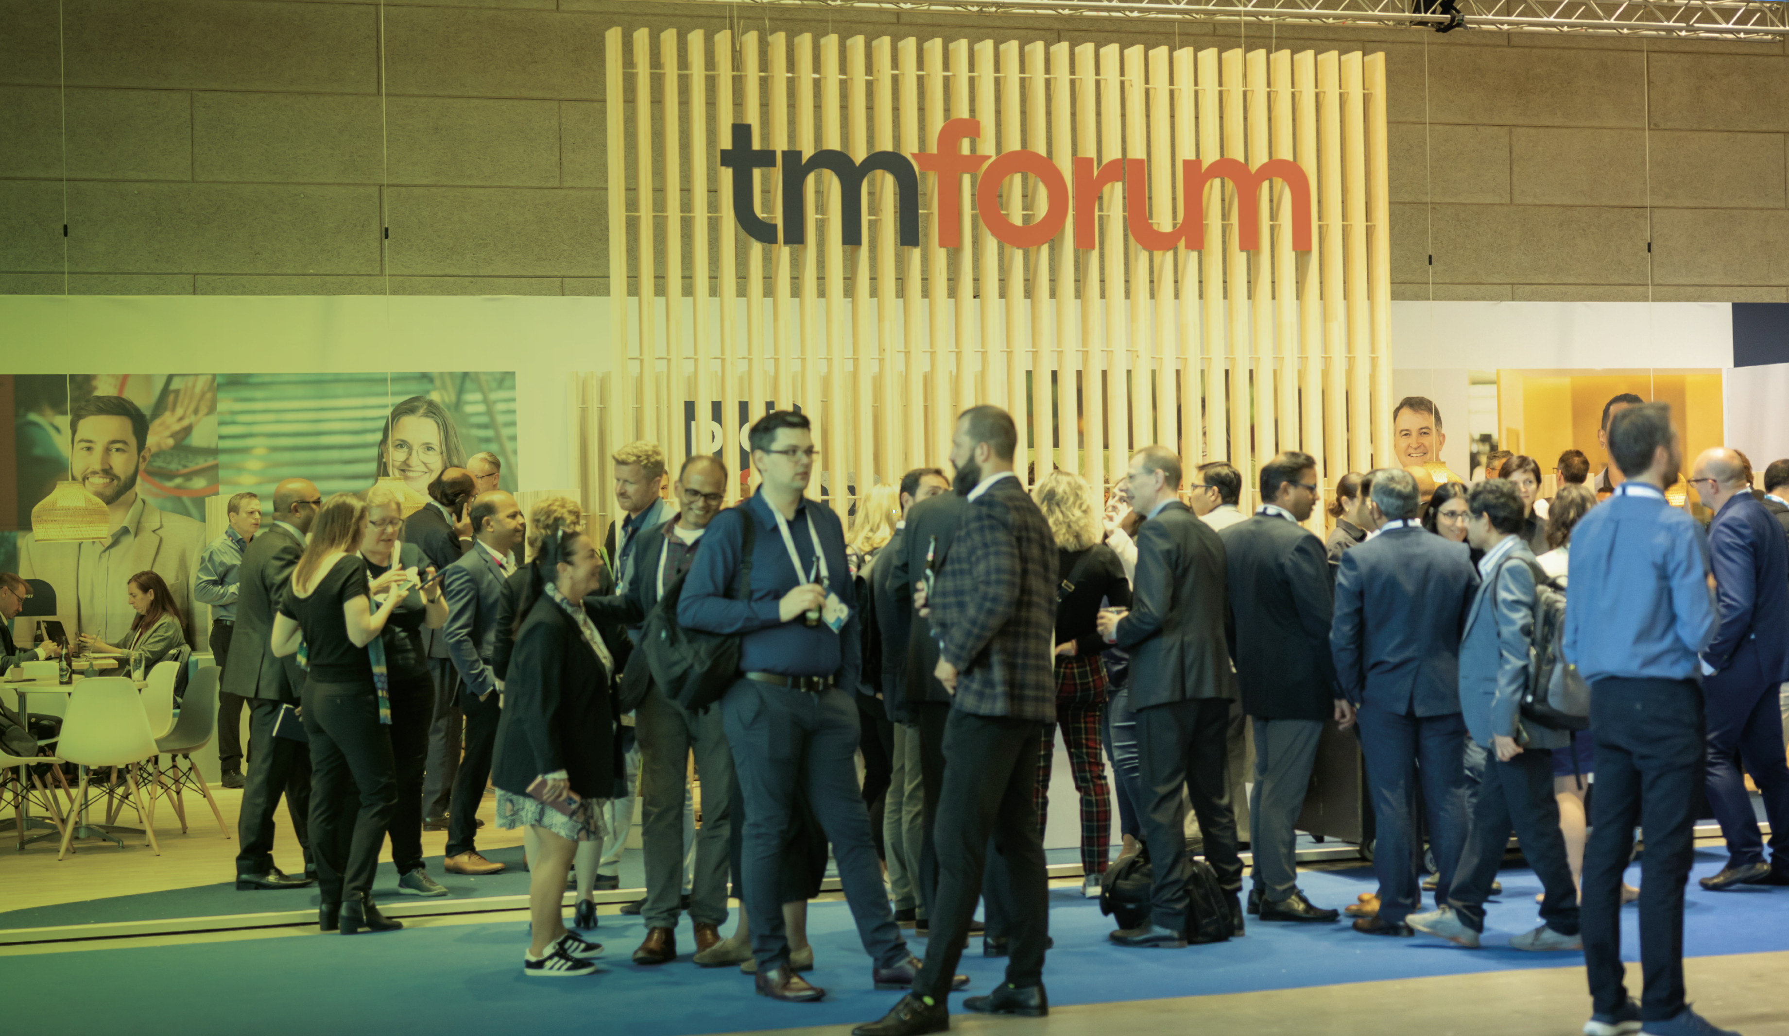

Participant
entry fees
for Open Innovation Catalyst projects
and Moonshot Catalyst projects 2024
CATALYST PARTICIPANT
FEES MEMBERSHIP CATEGORY
ANNUAL REVENUES
INNOVATE ASIA 2024 *
Corporate A1/ Subsidiary F
Corporate A2/ Subsidiary F
Corporate A3/ Subsidiary G
Corporate B1/ Subsidiary H
Corporate B2/ Subsidiary I
Corporate C/ Subsidiary J
Corporate D/ Subsidiary K
Corporate E
> $40 billion USD
$25 billion to $40 billion USD
$10 billion to $25 billion USD
$1 billion to $10 billion USD
$100 million to $1 billion USD
$25 million to $100 million USD
$1 million to $25 million USD
less than $1 million USD
IN USD
16,300
14,800
10,500
10,250
10,000
7,500
5,000
1,250
* Multiply prices x 2.5 for non-members
* Member Champions do not pay fees
* Phase 2+ Participant discount: Participants involved in the previous phase of a continuing Catalyst project receive a 25% discount off the participation fee for the current phase (applicable to TM Forum members only).

Slide 11
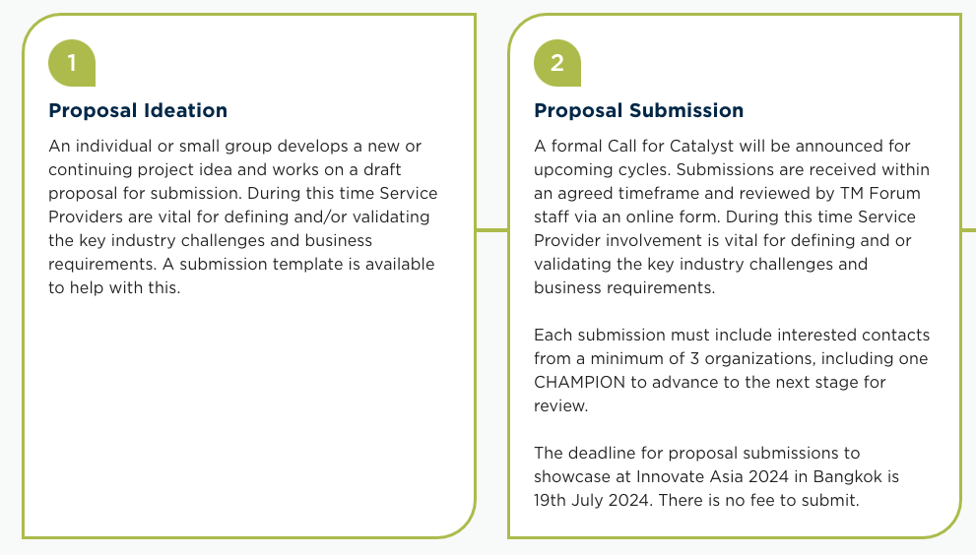
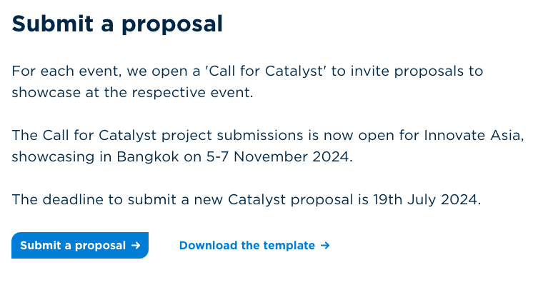
Next steps – ideation & submit proposal
Submission requirement minimum of 3 unique organizations, including one Champion (CSP/vertical enterprise)
https://www.tmforum.org/catalysts/join-in

Slide 12
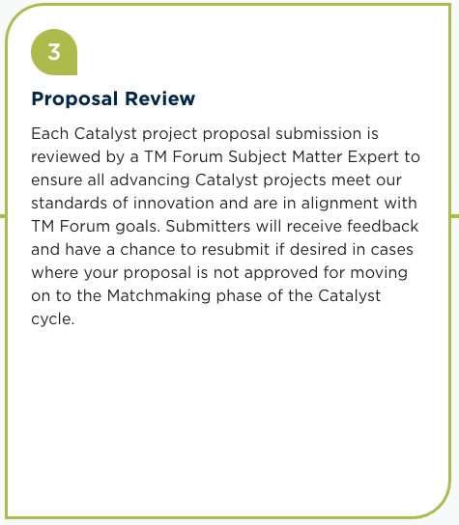







Proposal review
Process
Operations, CSM & Subject matter expert review
Submit
Passed
Rejected with Feedback
Common rejection reasons
Not detailed enough
Doesn’t meet minimum required companies of 3 (1 being a CSP)
Fake email addresses
Moonshots only – Missing business Champion impact statement
Not all parts of the form are filled in
We already have another submission similar
Edit

Slide 13

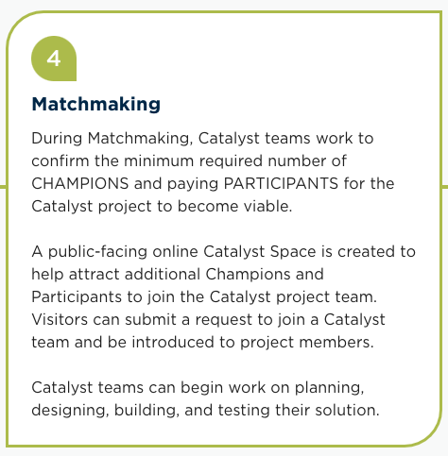




Matchmaking
Show your network!
Your network
Catalyst Success Manager
Engage with your CSM
Catalyst team
Build your online showcase
What makes a good team
Regionally diverse teams
Multiple Champions and Participants
Vertical enterprise to show the B2B2X value
Strong online presence
Structured team: Designated Marketing lead, project lead etc
Project page
Build & strengthen your team !
Engagement manager
Join a Catalyst team !

Slide 14
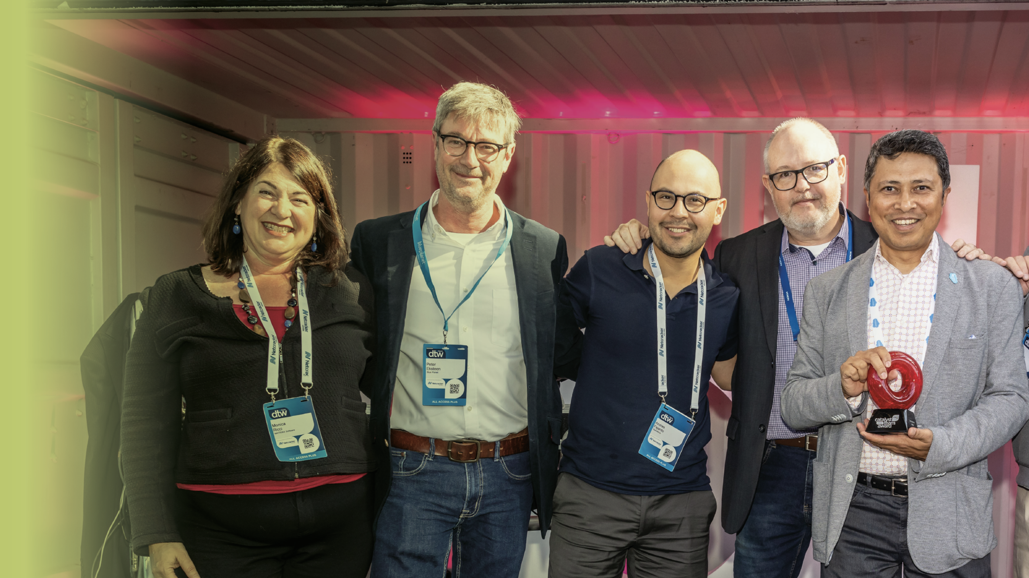
what’s
included?
for Champions & Participants
for Open Innovation Catalyst projects
and Moonshot Catalyst projects 2024
MARKETING
ASSETS
AT EVENT
Creation of 1 promotional video
Article about the project published on Inform
Email and newsletter exposure
Logo and company exposure Innovate Asia event
TM Forum social media posts pre-& post
event published and promoted via TM Forum
channels
Full promotional pack for Award winners
Moonshot exclusive
Project overview infographic
Interactive Catalyst space on tmforum.org
Lead generation data from project followers
Eligibility for Open Innovation Catalyst Awards
Support from subject matter experts
Self-promotion marketing toolkit
Moonshot exclusive
Access to an Executive Coach to mentor, offering feedback and inputs to the team
Eligibility for highly competitive and prestigious Moonshot Catalyst Awards
Moonshot Award winners’ post-ceremony video
Branded showcase stand at Innovate Asia event in the Catalyst area
Catalyst Arena presentation
On-site TM Forum support
Two All ACCESS+ passes plus 25% discount on
additional All ACCESS+ event passes
Meet senior executive attendees
Social activities including food and beverages
to meet and network with participants
Moonshot exclusive
Panel discussion on the main event agenda
(the team will select one participant per team)
per project)
No fee for Champions. Entry fee applies for Participants

Slide 15



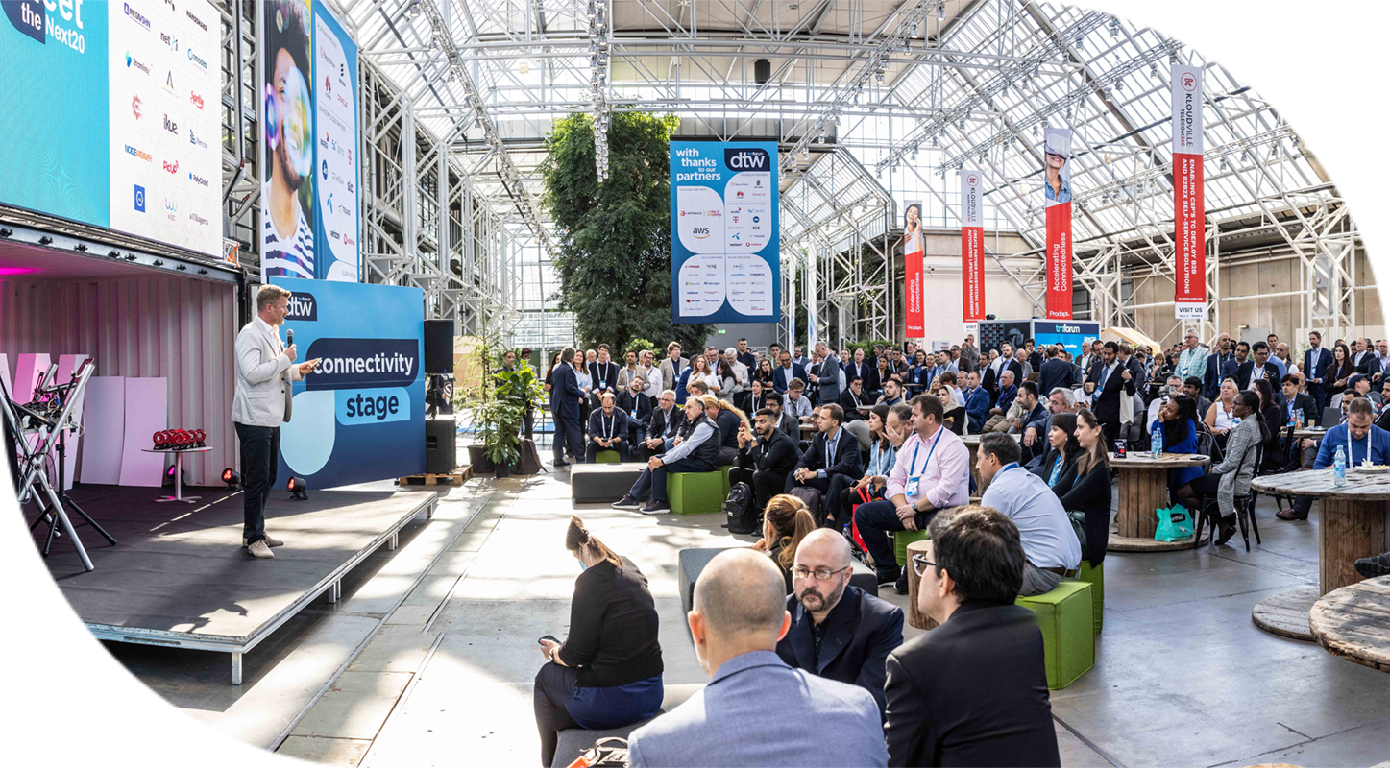

Catalyst
Drive Catalysts to promote their work and seek industry feedback on their projects
Judged by highly qualified panel of industry specialists
Winners announced live during the prestigious ceremony at DTW events.
Recognition through TM Forum wider media exposure, and social media
team awards
15

Slide 16
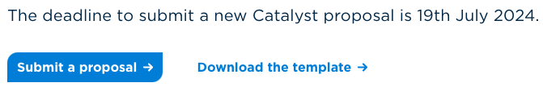
What's your next Steps
Submission deadline 19th July
Submitting a new submission -
https://www.tmforum.org/catalysts/join-in
Download the template
Build your team (minimum 3 unique companies 1 of which CSP)
Build your submission
Sumit proposal via the catalyst website
Continuing a previous catalyst (Phase + Submission)
Download the template
Work with your team to build new submission
Show a clear new iteration of innovation
Sumit proposal via the catalyst website & your current CSM will be in touch
Please note : Your EM will be in touch to confirm your participation and that you have budget approval where necessary

Slide 17
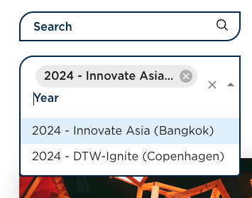
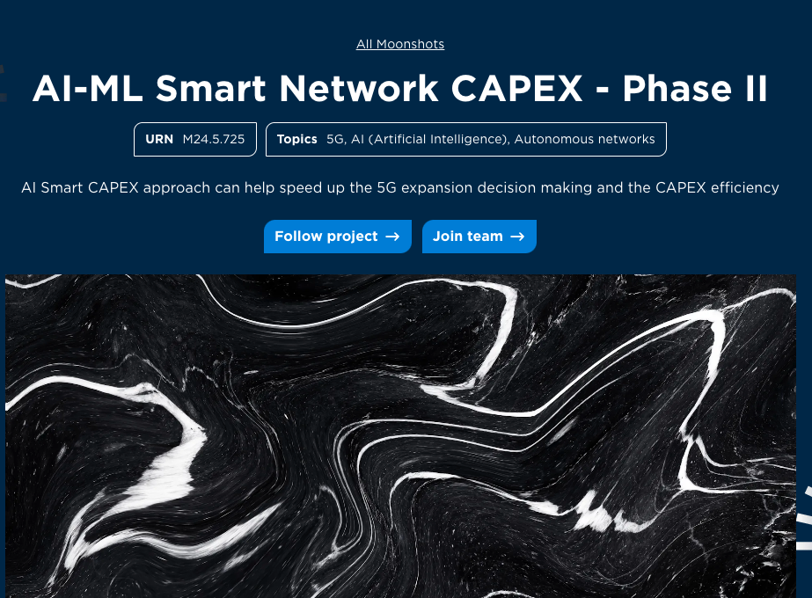
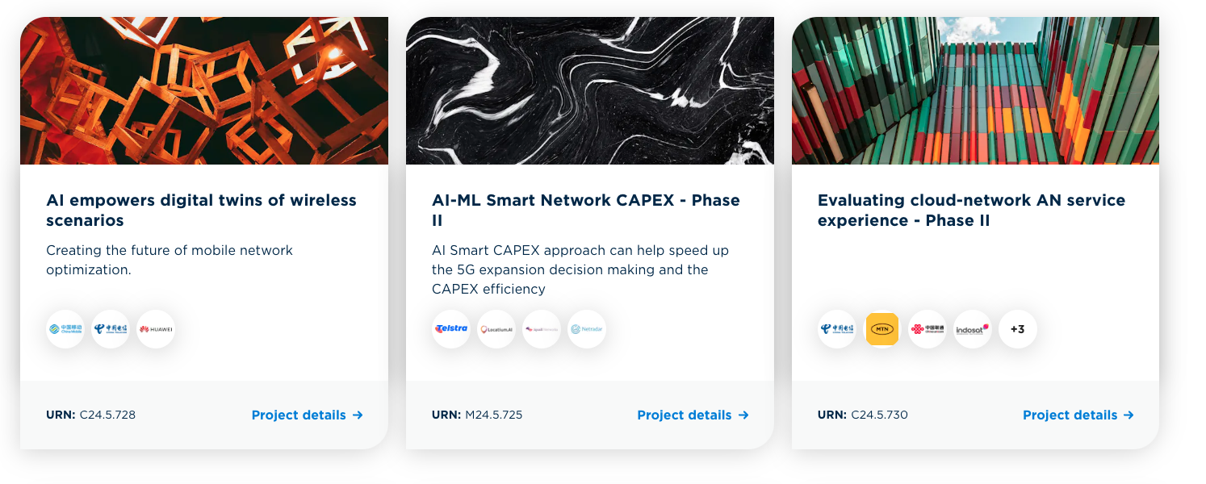
What's your next Steps
Looking to Join an existing catalyst
https://www.tmforum.org/catalysts/projects
Head to the Catalyst projects page
Select the Asia year
Browse our current projects
Hit the Join Team button
Ops team will be in contact to facilitate matchmaking
Please note : Your EM will be in touch to confirm your participation and that you have budget approval where necessary

Slide 18
Any questions?
Please post your questions in the Q&A chat.

Slide 19
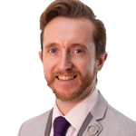
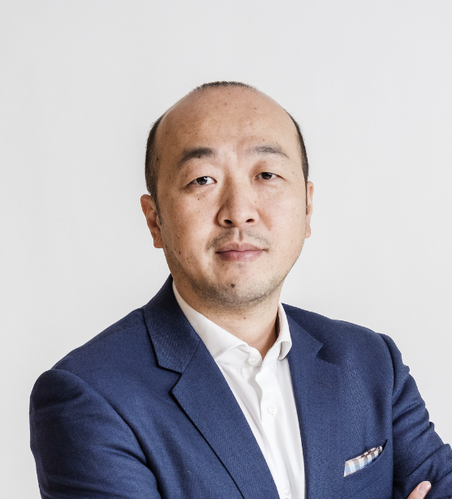
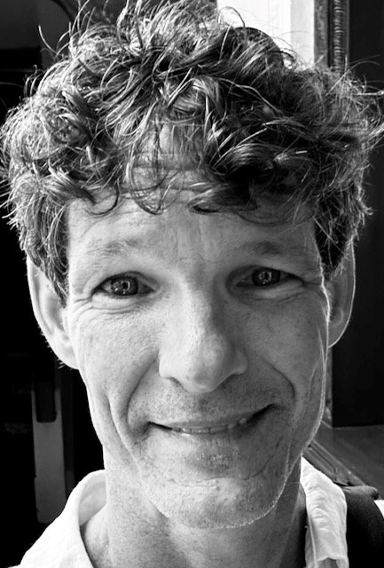
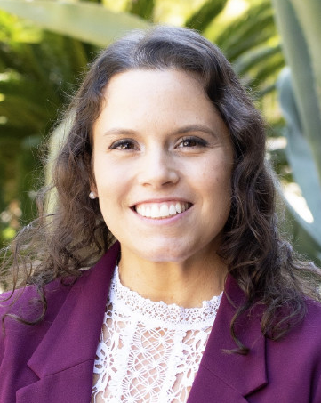
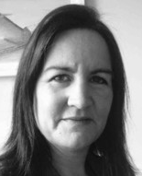
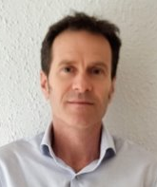
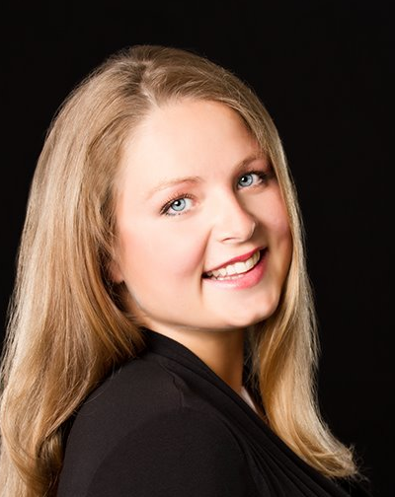
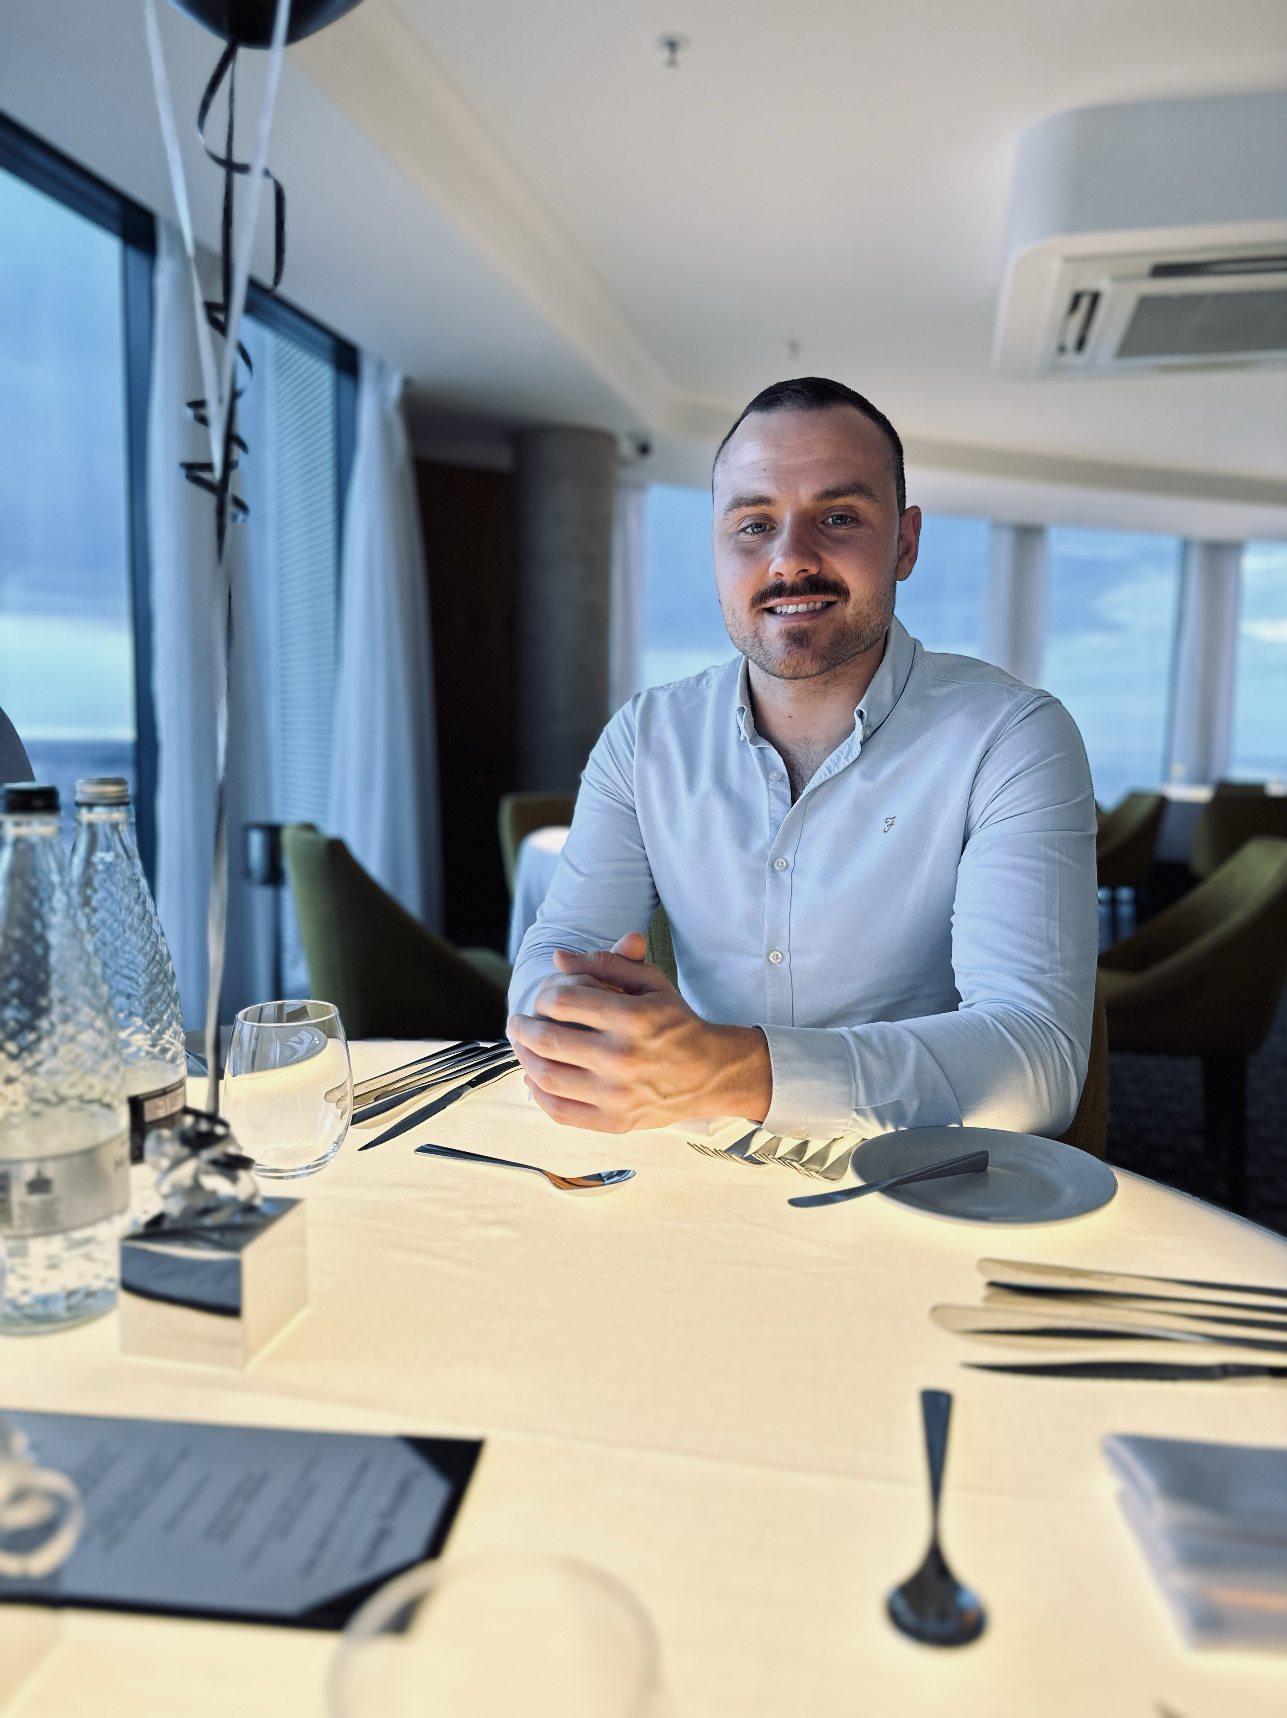
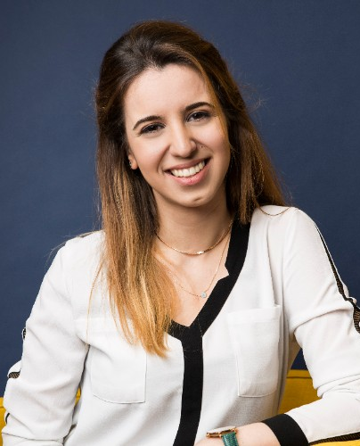
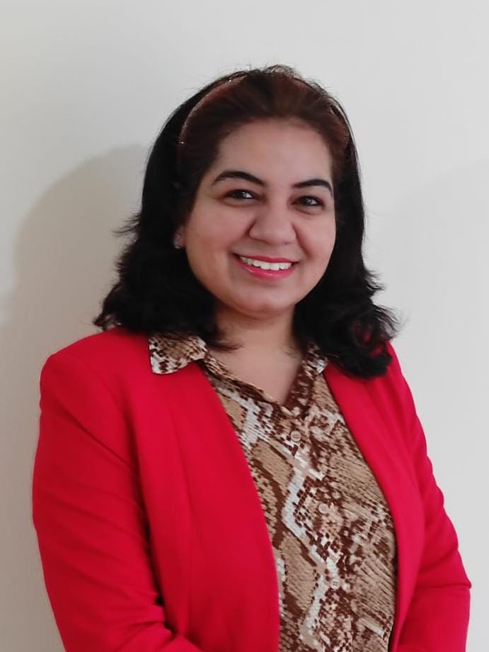
Catalyst team
VP (AI, Labs & Innovation)
Catalyst Success Managers
Operations
Marketing
Aaron Boasman-Patel aboasman@tmforum.org
Shengfan Hou shou@tmforum.org
Alex Bruce
abruce@tmforum.org
Jessica Rausch
jrausch@tmforum.org
Ailis Claassen
aclaassen@tmforum.org
Head of Catalyst
Mahima Khurana
mkhurana@tmforum.org
Hugues Bardin hbardin@tmforum.org
Ashlee Kiel
akiel@tmforum.org
Graham Hughes
ghughes@tmforum.org
Mila Vodenitcharova
mvodenitcharova@tmforum.org

Slide 20



Let’s create the future
- together
To find out more
and join an
Open Innovation
or Moonshot Catalyst
visit: tmforum.org/catalysts

