Slide 1




DTW Asia’23
Catalyst
Team Awards
Webinar 1
11th Jan’23

Slide 2



Agenda
Catalyst Team Awards
Award categories
Judging criteria
    General
    Awards Specific
Process
Timelines
Best practices
Stay tuned
Q&A

Slide 3

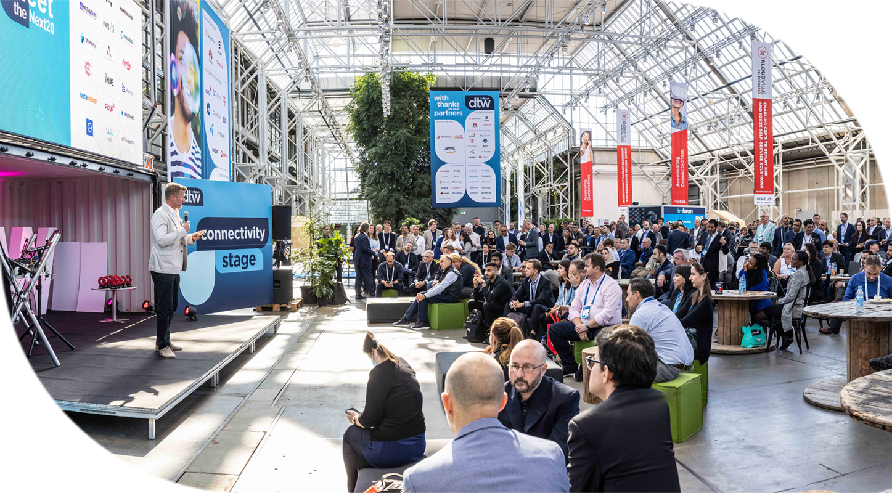

Catalyst
Drive Catalysts to promote their work and seek industry feedback on their projects
Judged by highly qualified panel of industry specialists
Winners announced live during the prestigious ceremony at DTW Asia
Recognition through TM Forum wider media exposure, and social media
team awards
3

Slide 4








Catalyst
award categories
Outstanding Catalyst
– Business Impact
Outstanding Catalyst – Sustainability & Impact on Society
Outstanding Catalyst – Showcase
Best Innovation & Future Techco
Outstanding Contribution to TM Forum Assets
POST EVENT
Catalyst that demonstrates most compelling business impact & potential
Catalyst that demonstrates greatest potential to positively impacts society and contributing towards UN's Sustainable development goals
Catalyst that displays the most powerful showcase demonstration
Catalyst that demonstrates most innovative & futuristic technology solution aimed towards bringing digital transformation to industry
Catalyst team that uses the program to make most substantial contribution to TM Forum’s assets

Slide 5

Judging
Criteria
Each award category would be judged against two sets of criteria:-
General Criteria
  Set of 5 parameters common for all award categories.
  Each general criteria would be scored on scale of 10 points
  Total points for general criteria - 50 points
Award specific criteria –
  Set of 2 parameters unique to each award category.
  Each award specific criteria would be scored on scale of 25 points.
  Total points for award specific criteria
  - 50 points.

Slide 6
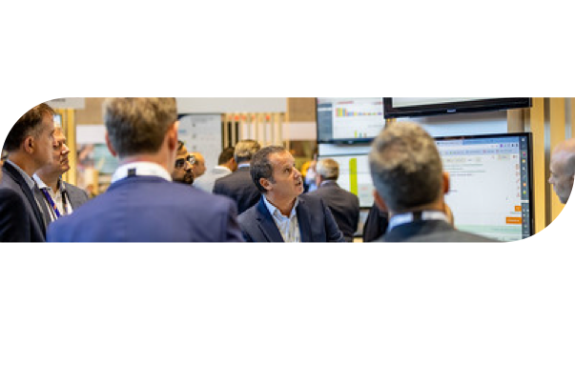




Judging
General
Criteria
criteria
STORY
&
SOLUTION
TEAM COLLABORATIONS
TM FORUM ASSETS
How well has the participants & champions contributed & collaborated towards catalyst success ?
How interactive, engaging & well-presented is the Catalyst’s solution & deliverables?
How well has the team used TM Forum’s assets, best practices & standards?

Slide 7
Judging
General
Criteria
criteria
PROOF OF CONCEPT
VALUE POTENTIAL
How well developed is the proof-of-concept?
(1 = 'Just an idea’, 10 = 'Credible working solution’)
How valuable is the Catalyst to the industry in the long term?
(1 = 'Redundant’, 10 = ‘Potential to revolutionize’)

Slide 8
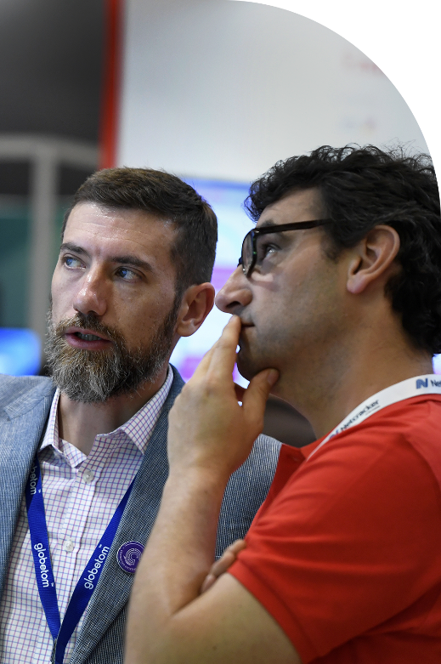

Judging
Award Specific
Criteria
OUTSTANDING CATALYST – IMPACT ON SOCIETY AND SUSTAINABILITY
BEST INNOVATION & FUTURE TECHCO
OUTSTANDING CATALYST – BUSINESS IMPACT
BUSINESS IMPACT
How does the project team quantify and explain the business impact of their solution?
COMMERCIAL VIABILITY
To what extent is the catalyst solution relevant, commercially viable & credible to the business?
SOCIETAL IMPACT
What degree of societal impact is the project likely to have in the next 1 year?
SDG ALIGNMENT
How well does catalyst align with United Nations Sustainable Development Goals (SDGs)?

Slide 9

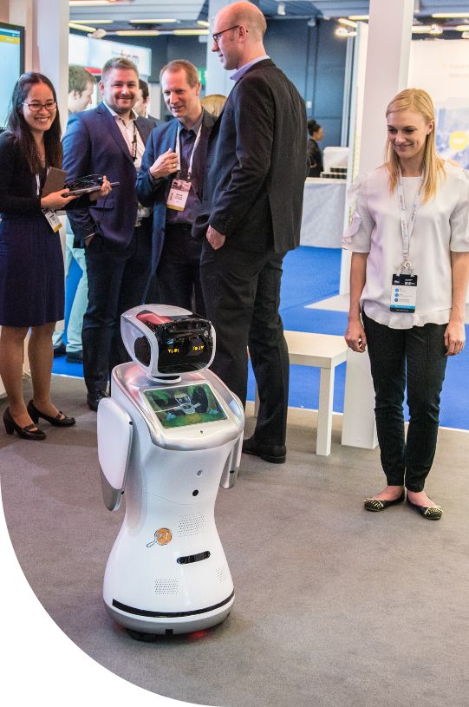
Judging
Award Specific
Criteria
BEST INNOVATION & FUTURE TECHCO
OUTSTANDING CATALYST – SHOWCASE
DEMONSTRATION
How well is the demonstration presented to showcase the solution's innovation and commercial viability ?
REGIONAL CONCERNS
How well does the demonstration highlight their solution's relevancy to regional industry concerns?
INNOVATION
How original, innovative & futuristic is the team’s business idea and/or technology solution?
FUTURE POTENTIAL
How would the Catalyst solution potentially impact future technology developments in industry?

Slide 10
Process
Awards
& Judging
Teams eligible for ALL award categories by default.
Each Catalyst team would require to fill in the ‘Awards Submission Form’ (one form per team).
Judges would assess each team based on:-
  Awards Submission Forms
  Catalyst Spaces & resources provided.
  Onsite interaction with teams at kiosk during judging.
Scoring based on above criteria questions:-
  General (5 criteria – 10 points each)
  Award specific (2 criteria – 25 points each)

Slide 11





Timelines
Awards & Judging
Awards Submission Forms
6th February* to 3rd March
Judging at DTW Asia
14th & 15th March
Catalyst Awards Webinars
11th January
&
15th February
Update Catalyst Spaces
by 8th March (recommended)
Catalyst Awards Ceremony
16th March
* TBC
11

Slide 12




Best
Practices
update
invest
Catalyst Spaces with all resources & content to illustrate the Catalyst in clear, concise & presentable way, by deadline.
time on understanding judging criteria & filling Awards Submission forms. Use template to discuss with your team before submission.
follow
present
our Confluence page for latest information about Catalyst Awards Catalyst using marketing tools and attracting audience to online Catalyst Space & at kiosk on site.
to judges onsite - clearly expressing the rationale & significance of the Catalyst, focussing on proof points for why it deserves to win.

Slide 13




Stay
Latest information available on Confluence page
Recording & presentation will be uploaded
All Catalyst program information available on TM Forum website
  Catalyst Spaces
  FAQs
Weekly check-in emails
Contact us:–
  TM Forum Service Desk, or
  Email us:-
    Catalyst Operations
    Mahima Khurana
    Shengfan Hou
tuned!

Slide 14
Next
February 15th
Awards Submission form
  Template
  Online form
Onsite judging
Post-Event
  Contribution Award
  Judges feedback
Webinar

Slide 15
DTW Asia’23
Any
Questions

