Slide 1

Presentation by:
Mahima Khurana
Head of Catalysts, TM Forum

Slide 2





agenda
Award Categories
Judging process & criteria
Awards submission form
Live Tutorial
Judging onsite
Timelines
Best practices & tips
Post-event
Q&A
44
open innovation catalyst projects
153
unique companies
unique
team
members
700+

Slide 3

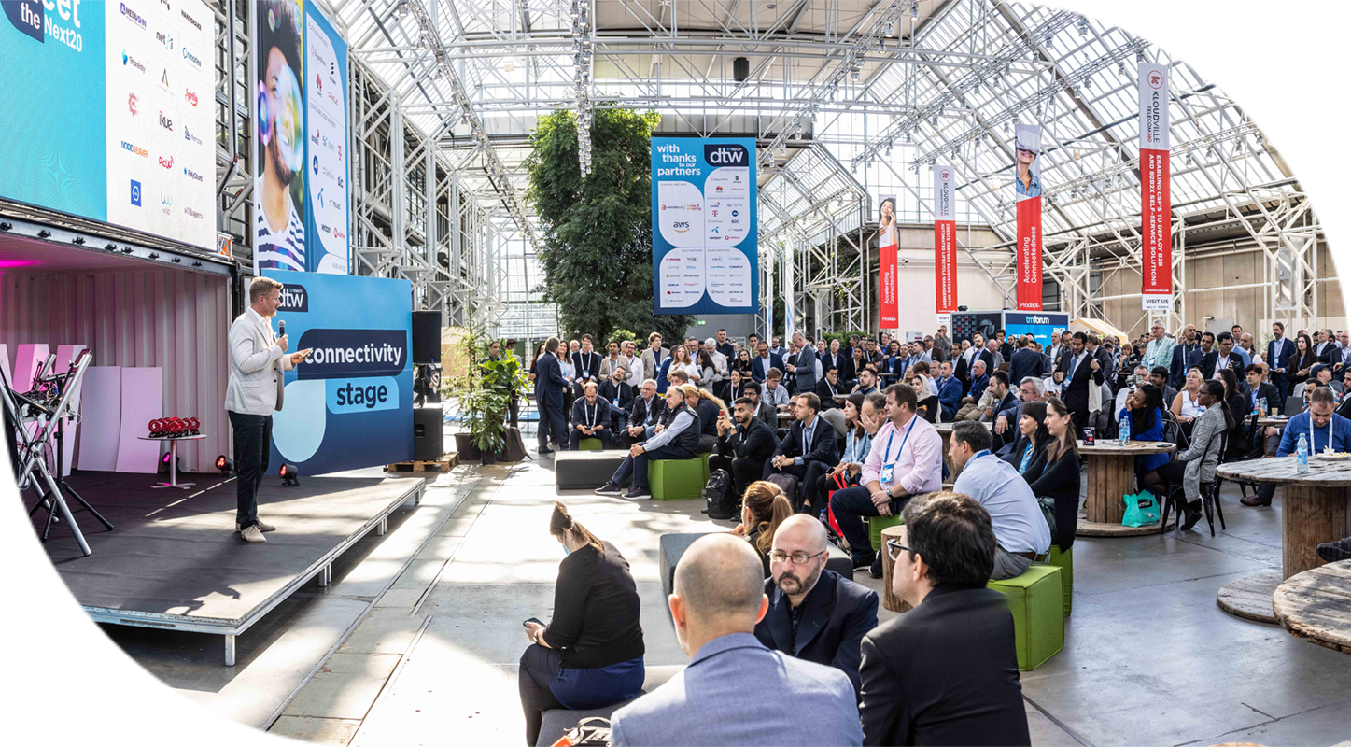

Open innovation
Recognize Catalysts addressing key industry challenges through most engaging, innovative & impactful solutions.
Promotion & gaining industry feedback.
Judged by highly qualified panel of industry specialists.
Recognition through TM Forum wider media exposure, and social media.
Winners announced live during the prestigious ceremony at DTW on 21st Sept at 1:15pm CEST.
catalyst awards
3

Slide 4
award categories

Slide 5








Open Innovation Catalyst
award categories
Outstanding Catalyst
– Business Impact
Outstanding Catalyst – Sustainability & Impact on Society
Outstanding Catalyst – Showcase
Outstanding Use of TM Forum Assets
Catalyst that demonstrates most compelling business impact & potential
Catalyst that displays the most powerful showcase demonstration
Catalyst that demonstrates most powerful use of TM Forum assets in their Catalyst project and quantify the benefits of using these assets
Catalyst that demonstrates greatest potential to positively impacts society and contributing towards UN's Sustainable development goals

Slide 6




Open Innovation Catalyst
award categories
Outstanding Business Growth ^{NEW}
Best Innovation & Future Techco
Excellence in the application of AI & Automation ^{NEW}
Best New Catalyst ^{Phase-I only}
Awarded to the Catalyst that demonstrates outstanding new growth potential, beyond building upon traditional connectivity offerings and demonstrates reuse of digital enablers (CaaS/ZTP etc).
Catalyst that demonstrates most innovative & futuristic technology solution aimed towards bringing digital transformation to industry
Phase-I Catalyst team that demonstrates the most collaborative behavior and the most compelling and innovative solution.
Awarded to the Catalyst that demonstrated best use of AI & Automation to drive efficiency & growth.

Slide 7
judging process & criteria

Slide 8

Judging
process
Each team selects MAXIMUM 3 award categories to compete.
Each award category would be judged against two sets of criteria:-
General Criteria
  Set of 6 parameters common for all award categories.
Award specific criteria
  Set of 2 parameters unique to each award category.
For each award category, winner & finalists will be reviewed based on the weighted averages of ‘General + Award Specific’ scores of all the Judges’.
Up to 3 Judges will be allocated to teams to review & score them.
Judges review teams based on:
  Awards Submission forms
  Catalyst Spaces
  Onsite Judging

Slide 9
General
judging criteria
Storyline
Team Collaborations
Catalyst Spaces
Use of TM Forum Assets
Proof of concept
Value & Potential
How clear, engaging & strong is the Catalyst’s storyline, solution & deliverables?
How well has the participants & champions contributed & collaborated towards catalyst success?
How well has the team used or planning to contribute to TM Forum’s assets, best practices & standards?
How well developed is the proof-of-concept?
How valuable is the Catalyst to the industry in the long term?
(1 = 'Redundant’,
How descriptive, interactive, informed & well-presented are their Catalyst Spaces?
(1 = 'Just an idea’,
10 = 'Credible working solution’)
10 = ‘Potential to revolutionize’)

Slide 10
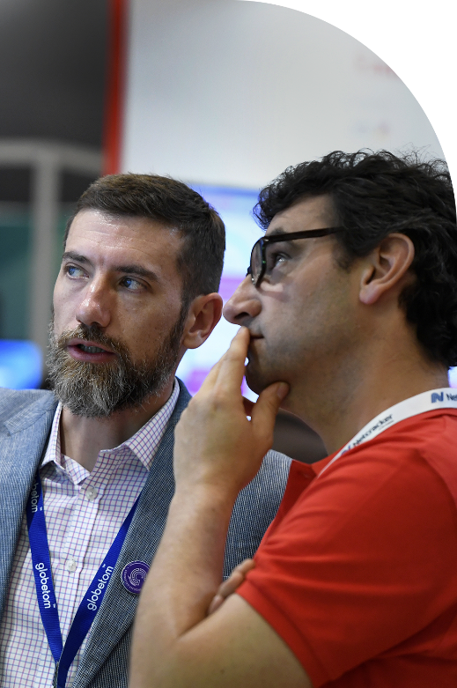

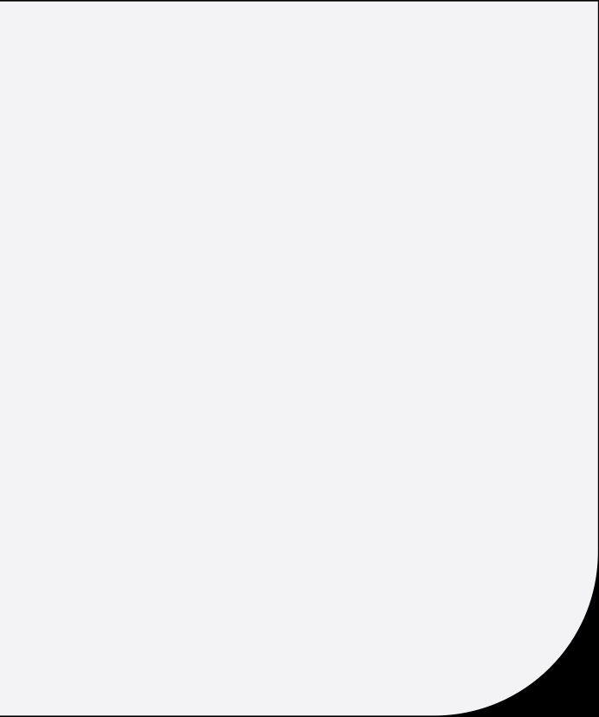
Award Specific
judging criteria
Outstanding Catalyst – Sustainability & Impact On Society
Outstanding Catalyst – Business Impact
Business Impact
How well does the project team quantify and explain the business impact of their solution?
Commercial Viability
To what extent is the catalyst solution relevant, commercially viable & credible to the business?
Societal Impact
What degree of societal impact is the project likely to have in the next 1 year?
Sustainability
How well does catalyst align with United Nations Sustainable Development Goals (SDGs)?

Slide 11
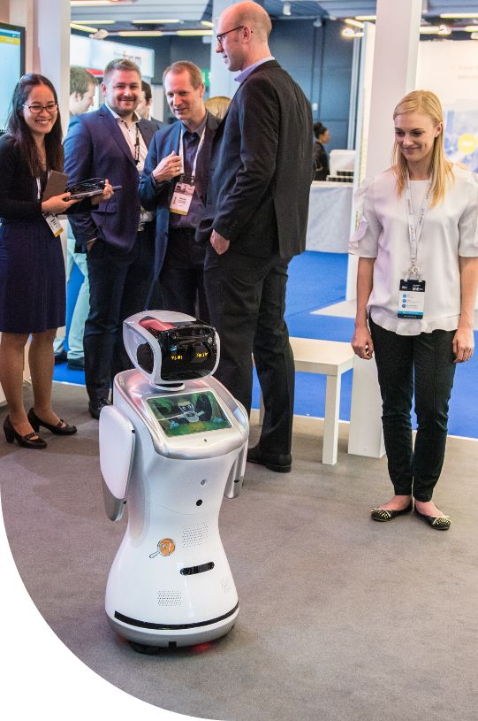

Award Specific
judging criteria
Outstanding Catalyst – Showcase
Outstanding Use of TM Forum Assets
Demonstration
How well is the demonstration presented to showcase the solution's innovation and commercial viability ?
Regional Concerns
How well does the demonstration highlight their solution's relevancy to regional industry concerns?
Use of TMF Assets
How deeply rooted are the team’s solution with TM Forum’s best practices and standards?
New Thinking
How well has the team tested or developed new thinking / requirements for TM Forum’s best practices & standards?

Slide 12
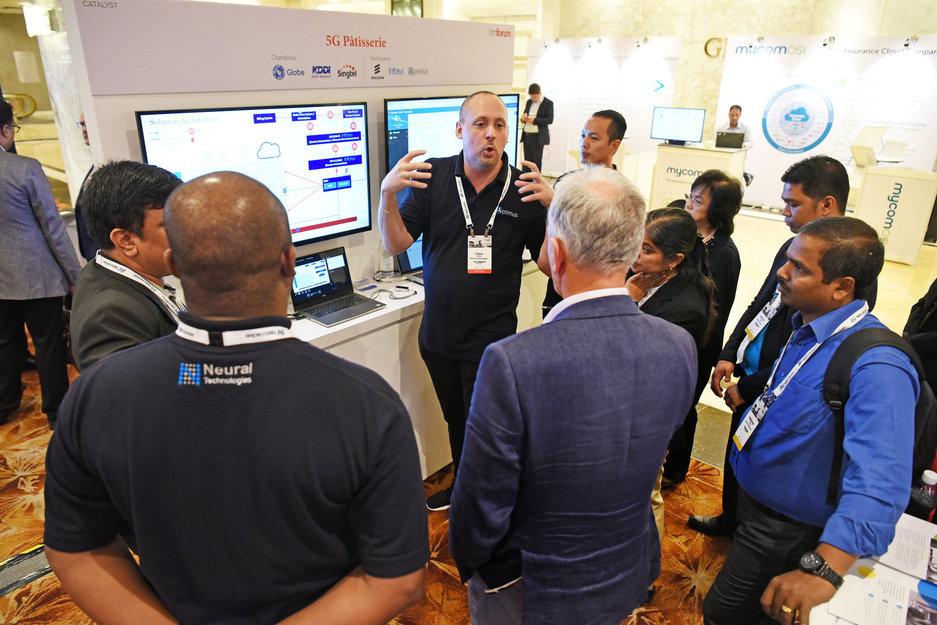
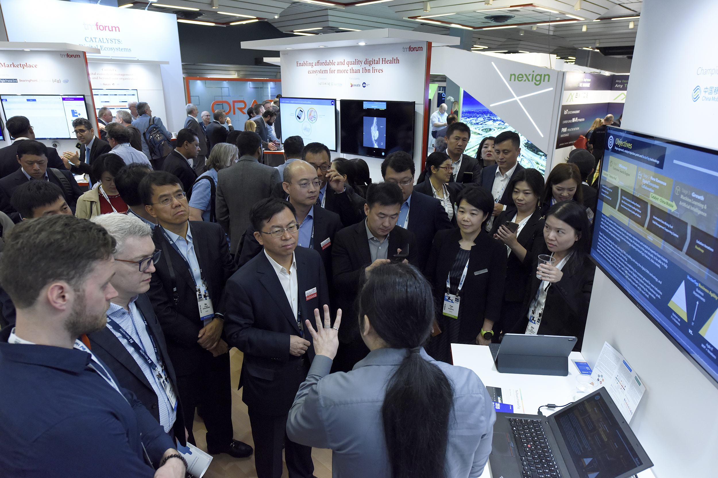
Award Specific
judging criteria
Outstanding Business Growth ^{NEW}
Best Innovation & Future Techco
Growth Potential
How well does the Catalyst demonstrate top line revenue growth potential including adjacency / attractiveness of its solution to the telecoms industry?
Adaptability
How well does the Catalyst hold an ability to stay ahead of the curve to adapt with change in market conditions?
Innovation
How original, innovative & futuristic is the team’s business idea and/or technology solution?
Future Potential
How would the Catalyst solution potentially impact future technology developments in industry?

Slide 13
Award Specific
judging criteria
Best New Catalyst ^{Phase-I only}
Excellence in the application of AI & Automation ^{NEW}
Sustainable Scalability & Impact:
  How well does the Catalyst demonstrate the AI system or technology that is sustainable and scalable, ensuring long-term viability and impact on the business and customer experience in the rapidly evolving field of AI?
Ethical and responsible use:
  How well does the AI system or technology should adhere to ethical and responsible principles, such as transparency, fairness, accountability, privacy, and human-centric design?
Solution:
  How well has the new Catalyst addressed the key industry challenge & offered most innovatively compelling technology solution?
Impact on Industry:
  What level of impact will the Catalyst have on transforming telco industry?

Slide 14
awards submission form

Slide 15
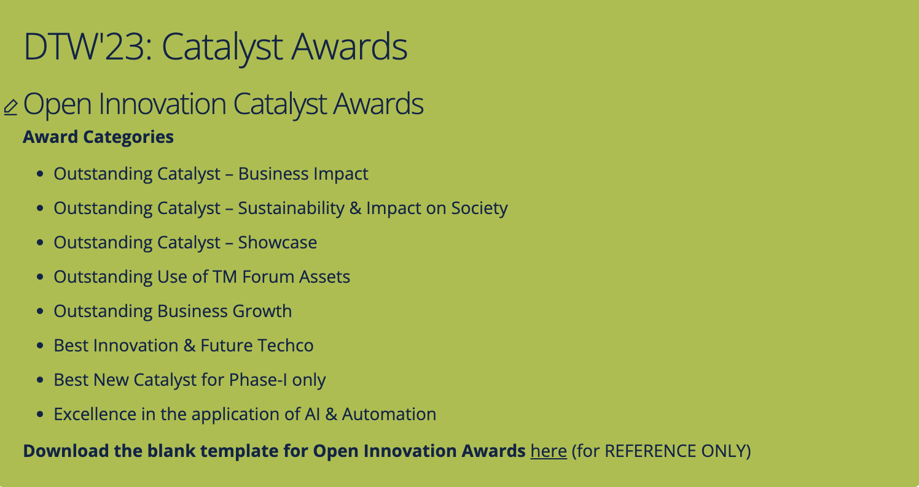
Awards submission form
Before submitting online, download the Awards Submission form template and discuss with your team.
Each team is required to fill in ONLY ONE FORM valid for ALL 3 opted award categories.
Entry deadline: 25th August 2023 (midnight - EST)
Please submit before deadline, as system will automatically close the entry submission after the deadline.
Notes:
So for Awards submission form, before online application – please download the template

Slide 16
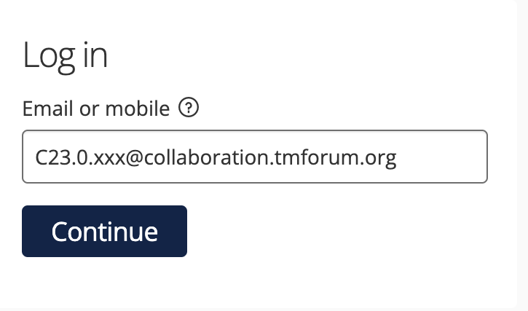
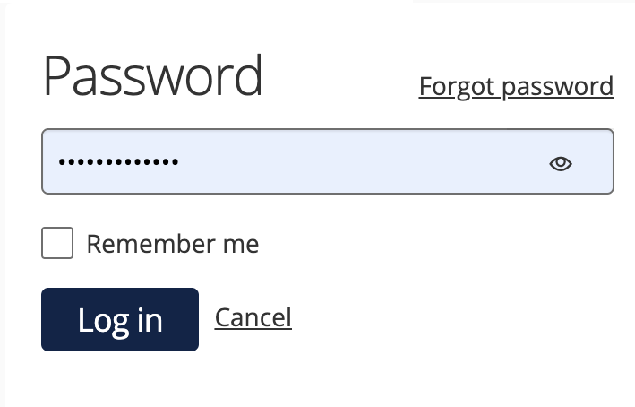
Awards submission form
For online submission, go to URL: https://awards.tmforum.org/
Login credentials emailed to each project lead or co-lead. Please reach out if not received or any issue.
Buttons on form:
  START ENTRY‘ to start the entry form first time.
  'SAVE+NEXT' to save & proceed to the next tab.
  ’SAVE+CLOSE’ to save & return to form later. Also, to save form after submission (but before deadline).
  ‘PREVIEW’ to preview the entire form at anytime. Use this button specifically when filling tables.
  ‘SUBMIT’ when all tabs filled & team satisfied with their entry.
Scroll down online form completely to view & fill in all contents.
Preview the submission form before submitting.
  Even after submission, team can edit before 25th August & submit by using ‘SAVE+CLOSE’ button instead.
Notes:
To start the entry for first time, click on 'Start Entry' button and initiate the form. Thereafter, link available on home page for accessing the form later.

Slide 17
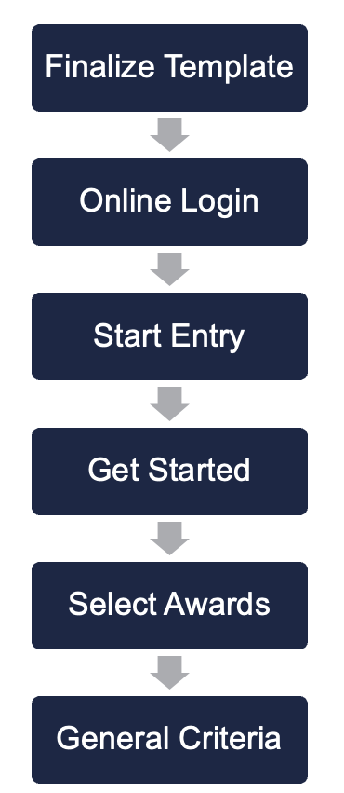
Submit before deadline
Save & edit later
Live
tutorial
Additional Info
Award Specific tab 3
Award Specific tab 2
Award Specific tab 1

Slide 18
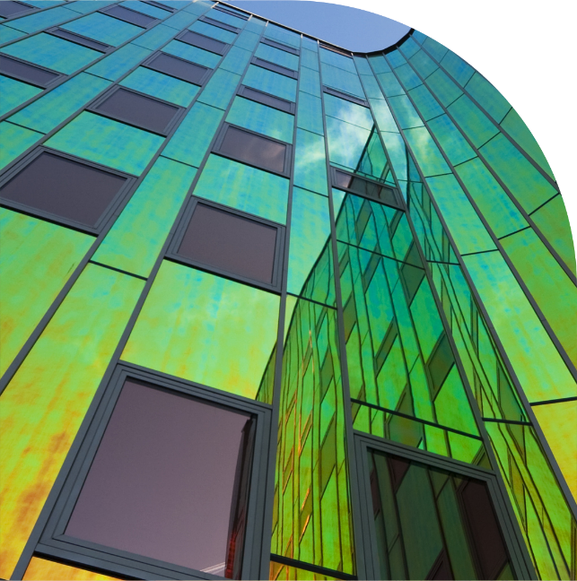
Do’s &
Don'ts
Select MAXIMUM 3 Award Categories, else submission form will become INVALID – requiring resubmission.
Do not select ‘Forgot Password’ to reset. If any access issues, please reach out.
Single member accesses at given time.
Select ‘Open Innovation Catalyst Awards’ only.
For ‘Entry Name’ – enter your final Catalyst Title (if changed). Logins were created based on the current titles.
You can edit the form multiple times BEFORE DEADLINE – even after submission.
Select the choices based on your Catalyst’s strengths.
Submit before deadline → to avoid last minute technical glitches & delays.

Slide 19
judging onsite

Slide 20

Onsite Judging
JUDGING SLOTS
  Judges visit teams at their stands to interact & score.
  Each team will be allocated 3 Judges.
  Most judging slots will be focused on 19th & 20th Sept (up to 2pm).
  Although most judges visit together in slot, some may visit based on their availability.
  Details of allocated judges & slots will be available to teams by first week of September.
  Ensure presence of your key team member at kiosk.
  Judging slots different from presentation slots.
AWARD CEREMONY
  Winners will be announced at Awards Ceremony
  21st Sept at 1:15pm.
BEST INNOVATION & FUTURE TECHCO

Slide 21





Timelines
Awards & Judging
Awards Submission Forms
3rd July to 25th August
Judging at DTW Copenhagen
19th & 20th September
Catalyst Awards Webinar
5th July
Update Catalyst Spaces
by 4th Sept (recommended)
Catalyst Awards Ceremony
21st September
* TBC
21

Slide 22
best practices & tips

Slide 23





Best
Practices
invest
update
time on understanding categories, judging criteria, choosing options & filling online Awards Submission forms. Use template to discuss with your team before submission.
Catalyst Spaces with all resources & content to illustrate the Catalyst in clear, concise & presentable way, by deadline.
follow
present
our Confluence page for latest information about Open Innovation Catalyst Awards. Also recommend to promote catalyst using marketing toolkit.
to judges onsite - clearly expressing the rationale & significance of the Catalyst, focussing on proof points for why it deserves to win.

Slide 24
Tips from
Judges’ feedbacks
Choose wisely
Be clear & concise
Engaging demo
Address criteria points
Know your strengths
Share ‘What’s new’
Share impact & importance
Proof! Proof! Proof!

Slide 25
post event

Slide 26
Post-event award
Outstanding Contribution to TM Forum Assets
Judged & Awarded Post-Event to Catalyst team that uses the program to make most substantial contribution to TM Forum’s assets.
All submissions reviewed by TM Forum Staff & judged by TM Forum’s Collaboration Sub-committee.
Catalysts assessed based on
  Overall impact to collaboration projects
  Number of contributions
  Quality of contributions
26
Notes:
Each Catalyst project is associated or related to a collaboration project or basic theme.

Slide 27
Post-event award
To do contribution, you must be part of the TM Forum Collaboration program (free to all members).
Please find and join the right program https://myaccount.tmforum.org/joinproject
In confluence find the correct project & in Project space side bar, you can navigate to "Contributions" page
Click on "Submit Contribution” & select issue type as ”Catalyst Contribution”
Email list of contribution with project URN to Shengfan Hou.
Last date to submit contribution: 3rd November’23.
More details about contribution-here
More details about process - here
Application
Process
27
Notes:
Each Catalyst project is associated or related to a collaboration project or basic theme.

Slide 28
Post-event activity
Judges’ Feedback
Judges’ feedback comments will also be accessible through the Awards platform, using the same login credentials.
Will be available from 2nd October & will stay accessible till 31st December.
Post-event promotions
Catalyst promotions & inform articles will continue to be published post-event as well.
Next Phase preparations
Catalyst cycles are continuous, so continue planning for next phase, if interested in joining.
28
Notes:
Each Catalyst project is associated or related to a collaboration project or basic theme.

Slide 29




Stay
Latest information available on confluence Catalyst Awards page.
Recording & presentation will be uploaded
Important Catalyst webpages:
  TM Forum website
  Catalyst Spaces
  Catalyst Awards webpage
Weekly check-in emails
Contact us:–
  TM Forum Service Desk, or
  Email us:-
    Catalyst Operations
    Mahima Khurana (for awards)
    Shengfan Hou (for contributions)
informed!
Notes:
https://projects.tmforum.org/wiki/display/CS/Open+Innovation+Catalyst+Awards+-+DTW%2723

Slide 30
Any Questions?

Slide 31
Thank
You!

Slide 32

Best
Practices
invest
login
time on understanding judging criteria & filling Awards Submission forms. Use template to discuss with your team before submission.
using URL https://awards.tmforum.org/. Username / Password emailed to project lead or team member. Credentials can be shared. Create entry form & submit before deadline.
ensure
judges
single team member accesses the online form at a particular time. Form can be updated even after submission, by clicking on ‘save + close’ button.
will visit each team onsite during a ’judging slot’ to interact with the team. Express the rationale & significance of the Catalyst, clearly focussing on proof points.

