Slide 1




DTW Asia’23
Catalyst
Team Awards
Webinar 2
15th Feb’23

Slide 2






Agenda
Overview
  Award Categories
  Judging Process
Awards Submission form
  Template & Online submission
  Live tutorial
  Sections (for reference)
Onsite judging
Timelines
Best Practices
Post-Event
  Contribution to TMF Assets award
Stay informed
Q&A
Notes:
We start off the session, with brief overview of our previous webinar detailing about Award categories for DTW Asia cycle & judging process.
Further divulging deeper into – Awards Submission Forms / Steps involved / Template / Online Submission & a live tutorial run through of filling the form.
Also, we would touch base on what to expect onsite, the timelines & best practices to ensure your team grabs a place in finalist/winners list
I would conclude the session with the post-event contribution awards

Slide 3








Overview
award categories
Outstanding Catalyst
– Business Impact
Outstanding Catalyst – Sustainability & Impact on Society
Outstanding Catalyst – Showcase
Best Innovation & Future Techco
Outstanding Contribution to TM Forum Assets
POST EVENT
Catalyst that demonstrates most compelling business impact & potential
Catalyst that demonstrates greatest potential to positively impacts society and contributing towards UN's Sustainable development goals
Catalyst that displays the most powerful showcase demonstration
Catalyst that demonstrates most innovative & futuristic technology solution aimed towards bringing digital transformation to industry
Catalyst team that uses the program to make most substantial contribution to TM Forum’s assets

Slide 4

Overview
Teams eligible for ALL award categories by default.
Judges would assess each team based on:-
  Awards Submission Forms
  Catalyst Spaces & resources provided.
  Onsite interaction with teams at kiosk during judging.
Each Catalyst team would require to fill in the ‘Awards Submission Form’ detailing proof points around the above general & award specific criteria.
Form & Scoring based on 2 sets of criteria questions:-
  General (5 criteria – 10 points each)
  Award specific (2 criteria – 25 points each)
Judging process

Slide 5
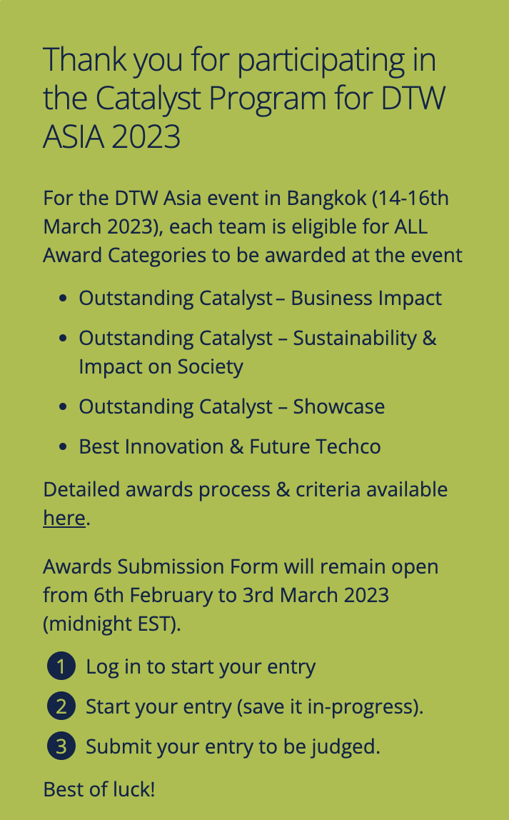
Awards submission form
Before submitting online, download the Awards Submission form template and discuss with your team.
Each team is required to fill in ONLY ONE FORM valid for ALL CATEGORIES.
Entry deadline: 3rd March 2023 (midnight - EST)
Please submit before deadline, as system will automatically close the entry submission after the deadline.
Notes:
So for Awards submission form, before online application – please download the template

Slide 6

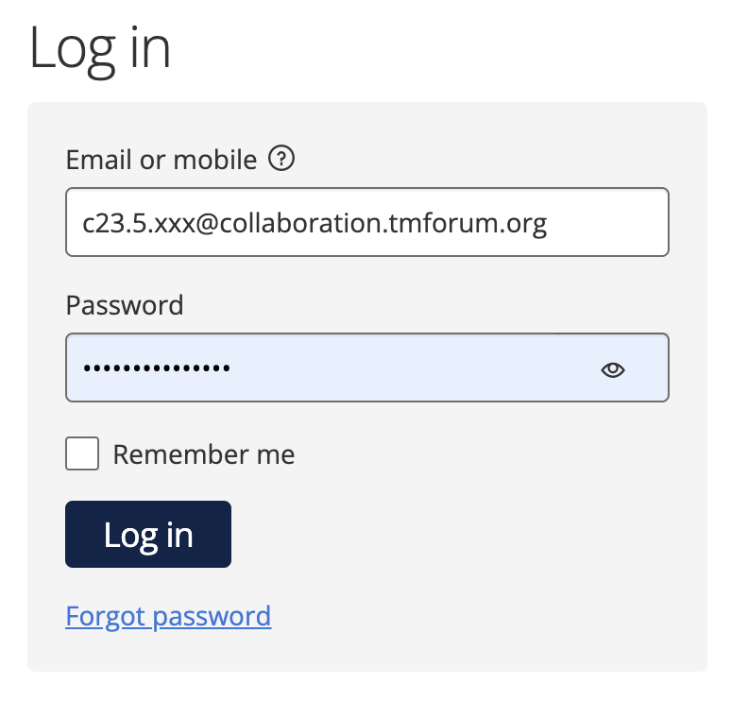
Awards submission form
For online submission, go to URL: https://awards.tmforum.org/
Login credentials emailed to each project lead or active team member. Please reach out if you any issue.
Buttons on form:
  START ENTRY‘ to start the entry form first time.
  'SAVE+NEXT' to save & proceed to the next tab.
  ’SAVE+CLOSE’ to save & return to form later. Also, to save form after submission (but before deadline).
  ‘PREVIEW’ to preview the entire form at anytime. Use this button specifically when filling tables.
  ‘SUBMIT’ when all tabs filled & team satisfied with their entry.
Scroll down online form completely to view & fill in all contents.
Preview the submission form before submitting.
  Even after submission, team can edit before 3rd March & submit by using ‘SAVE+CLOSE’ button instead.
Notes:
To start the entry for first time, click on 'Start Entry' button and initiate the form. Thereafter, link available on home page for accessing the form later.

Slide 7
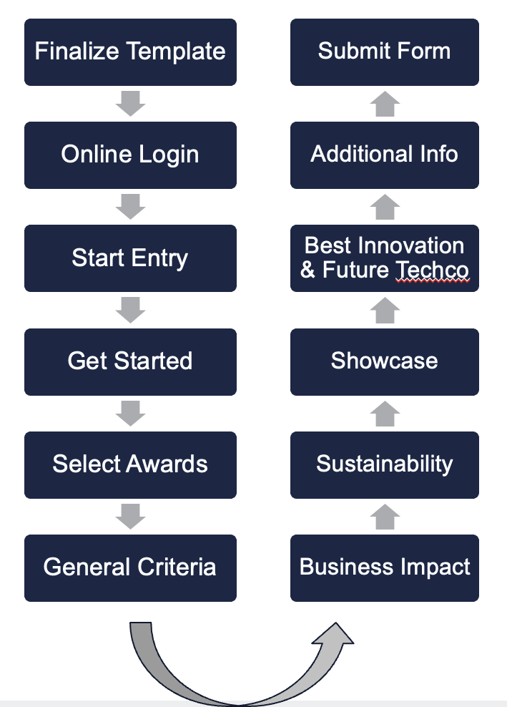
Live
tutorial

Slide 8


Submission Form
Sections
Get Started
General Criteria
Business Impact
Select Awards
Section common for ALL Award Categories.
Provide fields:-
Storyline & solution
Team Collaborations
Usage of TM Forum Assets
Proof of concept
Catalyst Value
Section used for judging Outstanding Catalyst- Business Impact award category.
Provide fields:-
Business Impact
Commercial Viability
Provide fields:-
Entry Name
URN
Title
Catalyst URL
Click SAVE+NEXT to save the form.
Select all Award Categories to activate the respective tab.

Slide 9

Submission Form
Sections
Sustainability & Impact on Society
Showcase
Best Innovation & Future Techco
Additional Info
Section used for judging Outstanding Catalyst- Showcase award category.
Provide fields:-
Regional Concerns
Onsite judging :-
Demonstration
Optional section to upload files/documents
Videos or links
Presentations
Any other team created relevant content (PDF etc)
Section used for judging Sustainability & Impact on Society award category.
Provide fields:-
Societal impact
Alignment to SDGs
Section used for judging Best Innovation & Future Techco award category.
Provide fields:-
Innovation
Future Potential

Slide 10

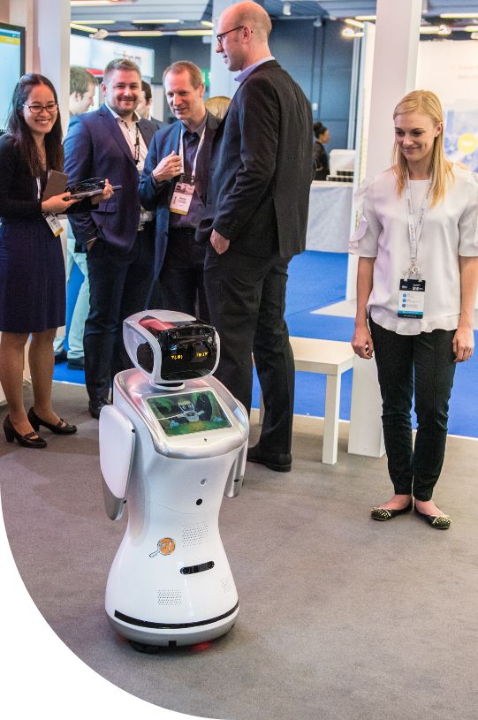
Onsite Judging
JUDGING SLOTS
  Judges visit teams at their stands to interact & score.
  Each team will be allocated total 3 Judges.
  Most judging slots will be focused on 14th March.
  Although most judges may visit together in slot, some may visit based on their availability.
  Details of allocated judges & slots will be available to teams by first week of March.
  Ensure presence of your key team member at kiosk.
  Judging slots different from presentation slots.
AWARD CEREMONY
  Winners will be announced at Awards Ceremony
  16th March 2023 at 3:30pm
BEST INNOVATION & FUTURE TECHCO

Slide 11





Timelines
Awards & Judging
Awards Submission Forms
6th February to 3rd March
Judging at DTW Asia
14th March &
15th March (till 12:30pm)
Catalyst Awards Webinars
11th January
&
15th February
Update Catalyst Spaces
by 8th March (recommended)
Catalyst Awards Ceremony
16th March at 3:30pm
* TBC
11

Slide 12





Best
Practices
invest
login
time on understanding judging criteria & filling Awards Submission forms. Use template to discuss with your team before submission.
using URL https://awards.tmforum.org/. Username / Password emailed to project lead or team member. Credentials can be shared. Create entry form & submit before deadline.
ensure
judges
single team member accesses the online form at a particular time. Form can be updated even after submission, by clicking on ‘save + close’ button.
will visit each team onsite during a ’judging slot’ to interact with the team. Express the rationale & significance of the Catalyst, clearly focussing on proof points.

Slide 13
DTW Asia’23
Post
Event

Slide 14

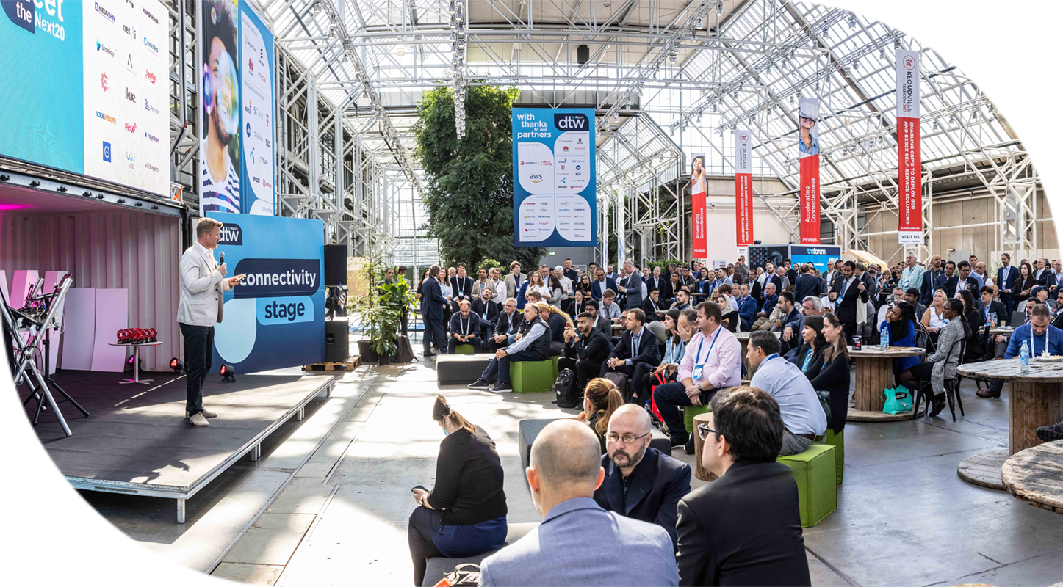
Post-event Award
Judged & Awarded Post-Event to Catalyst team that uses the program to make most substantial contribution to TM Forum’s assets.
All submissions reviewed by TM Forum Staff & judged by TM Forum’s Collaboration Sub-committee (include names).
Catalysts assessed based on
  Overall impact to collaboration projects
  Number of contributions
  Quality of contributions
Outstanding Contribution to TM Forum Assets
14
Notes:
Each Catalyst project is associated or related to a collaboration project or basic theme.

Slide 15
Application Process
To do contribution, you must be part of the TM Forum Collaboration program (free to all members).
Please find and join the right program https://myaccount.tmforum.org/joinproject
In confluence find the correct project & in Project space side bar, you can navigate to "Contributions" page
Click on "Submit Contribution” & select issue type as ”Catalyst Contribution”
Email list of contribution with project URN to Shengfan Hou.
Last date to submit contribution: 1st May
More details about process - here
More details about contribution-here
Outstanding Contribution to TM Forum Assets
15
Notes:
Each Catalyst project is associated or related to a collaboration project or basic theme.

Slide 16
Stay
Latest information available on Catalyst Awards page
Recording & presentation will be uploaded
All Catalyst program information available on TM Forum website
  Catalyst Spaces
  FAQs
Weekly check-in emails
Contact us:–
  TM Forum Service Desk, or
  Email us:-
    Catalyst Operations
    Mahima Khurana
    Shengfan Hou
informed!
Notes:
https://projects.tmforum.org/wiki/display/CS/2023+DTW+Asia+-+Catalyst+Team+Awards

Slide 17
DTW Asia’23
Any
Questions

