Slide 1

Notes:
Hello everyone,
Im Mahima Khurana, Head of Catalyst & would like to welcome you all to Moonshot Catalyst awards webinar for Innovate Asia event to be held in Bangkok in Nov.
This session is recorded & the recording along with presentation would be available by eod on our Catalyst Member portal.
We have a Q&A section at the end so kindly use the chat box to pop in questions & we can address them accordingly.
Link to member portal - https://projects.tmforum.org/wiki/display/CS/Moonshot+Catalyst+Awards+-+Innovate+Asia%2724

Slide 2




agenda
Award Category
Judging process & criteria
Awards submission form
Live Tutorial
Judging onsite
Timelines
Best practices & tips
Post-event
Q&A
4
moonshot catalysts
26
unique companies
unique
service providers
16

Slide 3

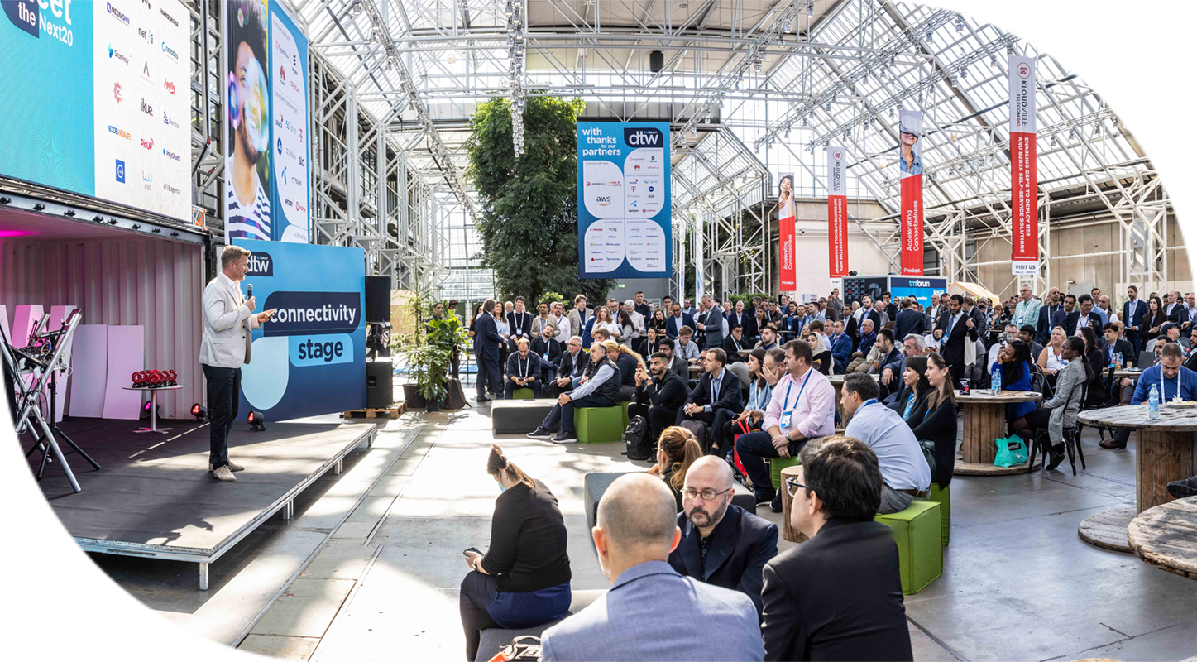

Moonshot
Recognizes catalysts which best solves the Moonshot Challenges offering innovative & commercially viable technology solutions to industry challenges.
Applicable only for Moonshot Catalysts.
Promotion & gaining industry feedback.
Judged by the executive panel of industry specialists.
Recognition through TM Forum wider media exposure, and social media.
Winners announced live at Awards Ceremony at Innovate Asia’24 on 7th Nov.
catalyst awards
3

Slide 4
award category

Slide 5

Best Moonshot Catalyst
AI Challenge
The challenge is a significant opportunity for CSPs to explore and harness the capabilities of AI.
With GenAI as a driving force, telecom companies can aspire to realize a substantial 30% increase in EBITDA (Earnings Before Interest, Taxes, Depreciation, and Amortization) and strategically enhance operational efficiency.

Slide 6
Coaches / judges, judging process & criteria

Slide 7
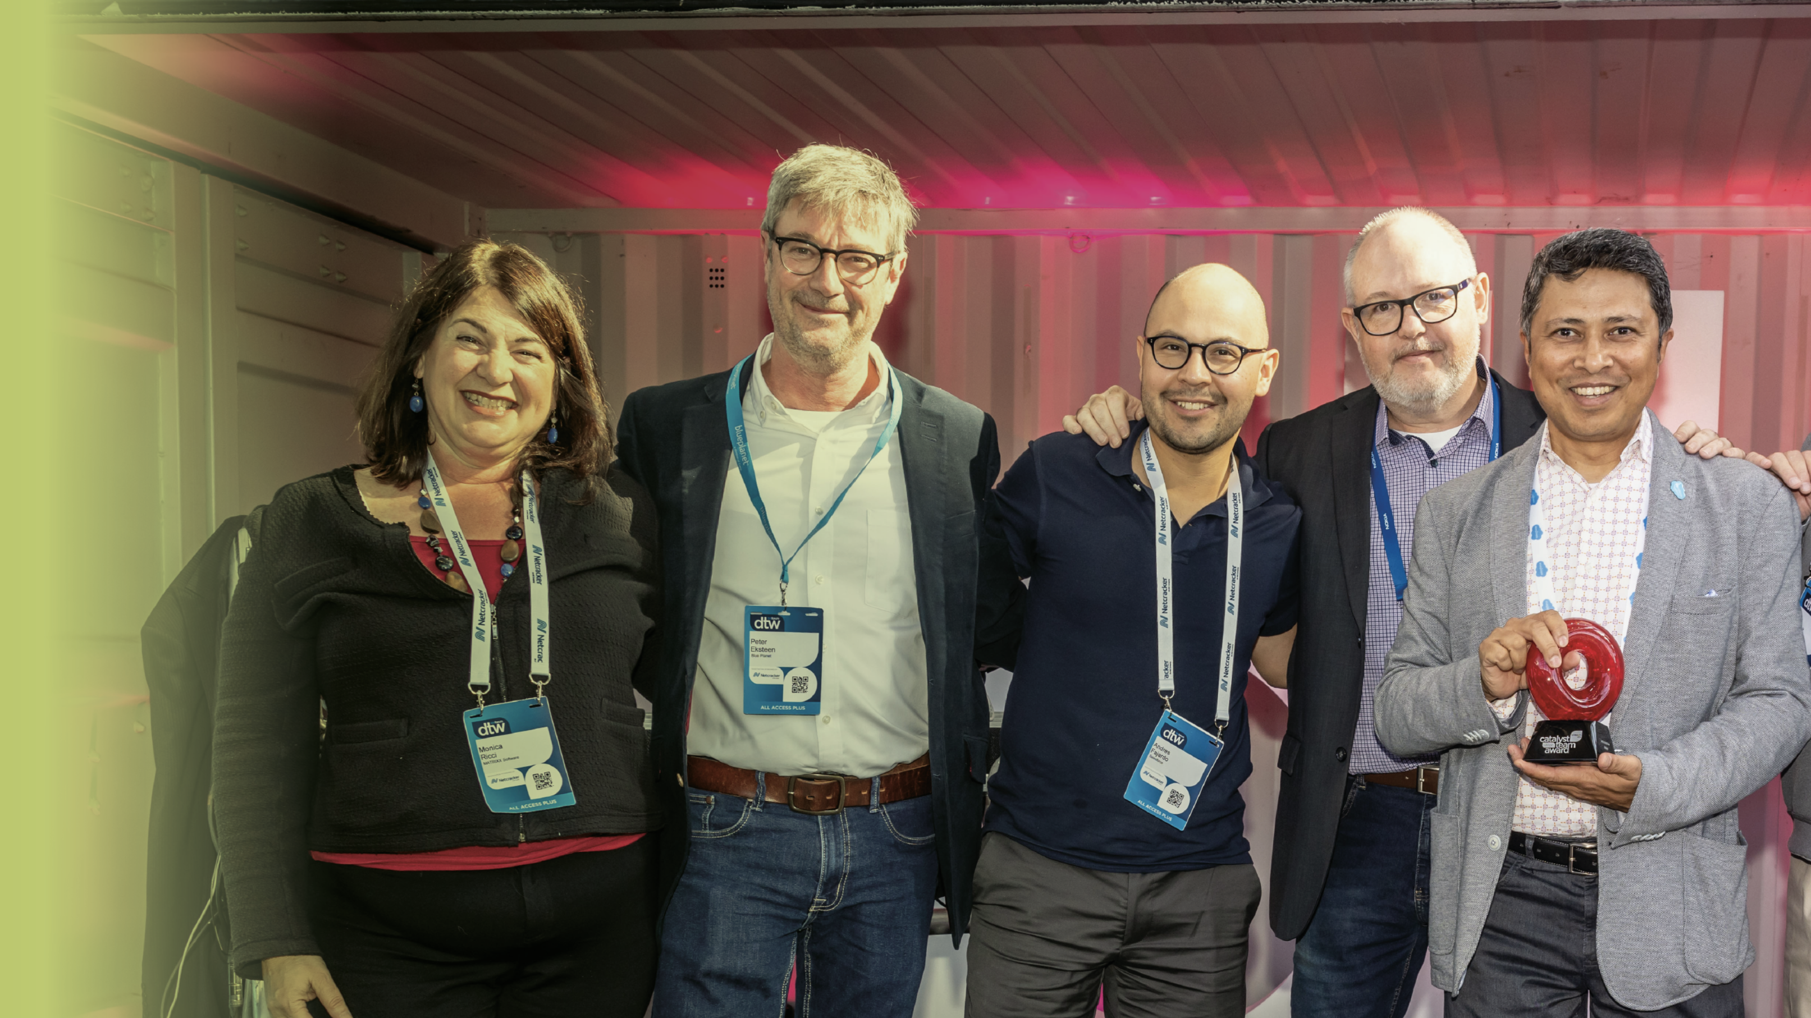


Executive Coaches & Judges’ for our exciting AI challenge
ROLES (Pre-event)
ROLES (At-event)
TIME COMMITMENT
Coaching & Mentoring to provide feedback to Moonshot Catalyst on business readiness, technical viability and suggestions for DTW’24 judging sessions.
Each coach allocated up to 1 team.
1:1 Meeting format: 30 min per team
  Team Pitch : 10 minutes
  Feedback : 20 minutes
Meeting will be scheduled during 1 - 10 Oct 24
Judging 4 Moonshot Catalysts
  20 minutes Judging slot per team to review Catalyst demo at their kiosks.
  All Judging slots to be scheduled for 5th Nov, before 2pm (Local time).
  Score teams on Awards platform. (Logins will be shared on later Oct.)
  Finalize winners in Executive Judges’ Discussion & Reception (Planed 5 Nov evening, invitation will be shared soon)
Pre-Event : 30-40
Coaching & mentoring : 30 minutes
Pre-read for Judging : 10 minutes
At-Event : <2hours
(5 Nov)
Moonshot Judging & scoring : 60-80 minutes
Judges’ discussion/Reception : 30 minutes

Slide 8

Judging
process
Each award category is judged against 6 criteria.
Teams are required to submit an awards submission form.
Judges review teams based on:
  Awards Submission form entries (Pre-read – Awards Platform)
  Catalyst Spaces/URL/Resources shared on TMF website (Pre-read)
  Onsite judging (Interaction/demo by teams at kiosk)
3 - 4 Judges will be allocated to teams to review & score them.
Login credentials for the Awards submission form has already been sent to teams via email (16th Sept onwards)

Slide 9
Judging criteria
Each criteria carries equal weightage
BUSINESS OUTCOME
TEAM COLLABORATION
SOLUTION
POTENTIAL IMPACT ON INDUSTRY
PITCH
Is the Catalyst able to quantify with proof points, the business outcomes (in terms of number, dollar, %age)?
How well does the Catalyst demonstrate their solution and successfully achieve the Moonshot ambition?
What is the potential impact of the Catalyst solution in revolutionizing & solving the moonshot challenge?
How well did the team pitch their Catalyst idea and solution to the Judges (showing relevance to their challenge outcomes and impact on the industry)?
How well has the participants & champions contributed & collaborated towards catalyst success?
MOONSHOT AMBITION
How well has the team defined the problem statement for their moonshot challenge?
(1=Not much impact, 10=Potential to create a ripple effect & solving the industry challenge completely)
(1=Did not define correctly, 10=Super clear & focused definition of the problem statement / Moonshot goals)
(1=Unimpressive solution, 10=Most innovative solution to their Moonshot ambitions)
(1=Not engaging/boring, 10= Engaging, interactive & clear demo/pitch with high relevancy to outcomes & impact)
(1=Vague results, 10=Clear & precise quantifiable business outcomes)
(1=Low level of team collaboration, 10= Excellent team collaboration with highest engagement from Champions and Participants)

Slide 10
awards submission form

Slide 11
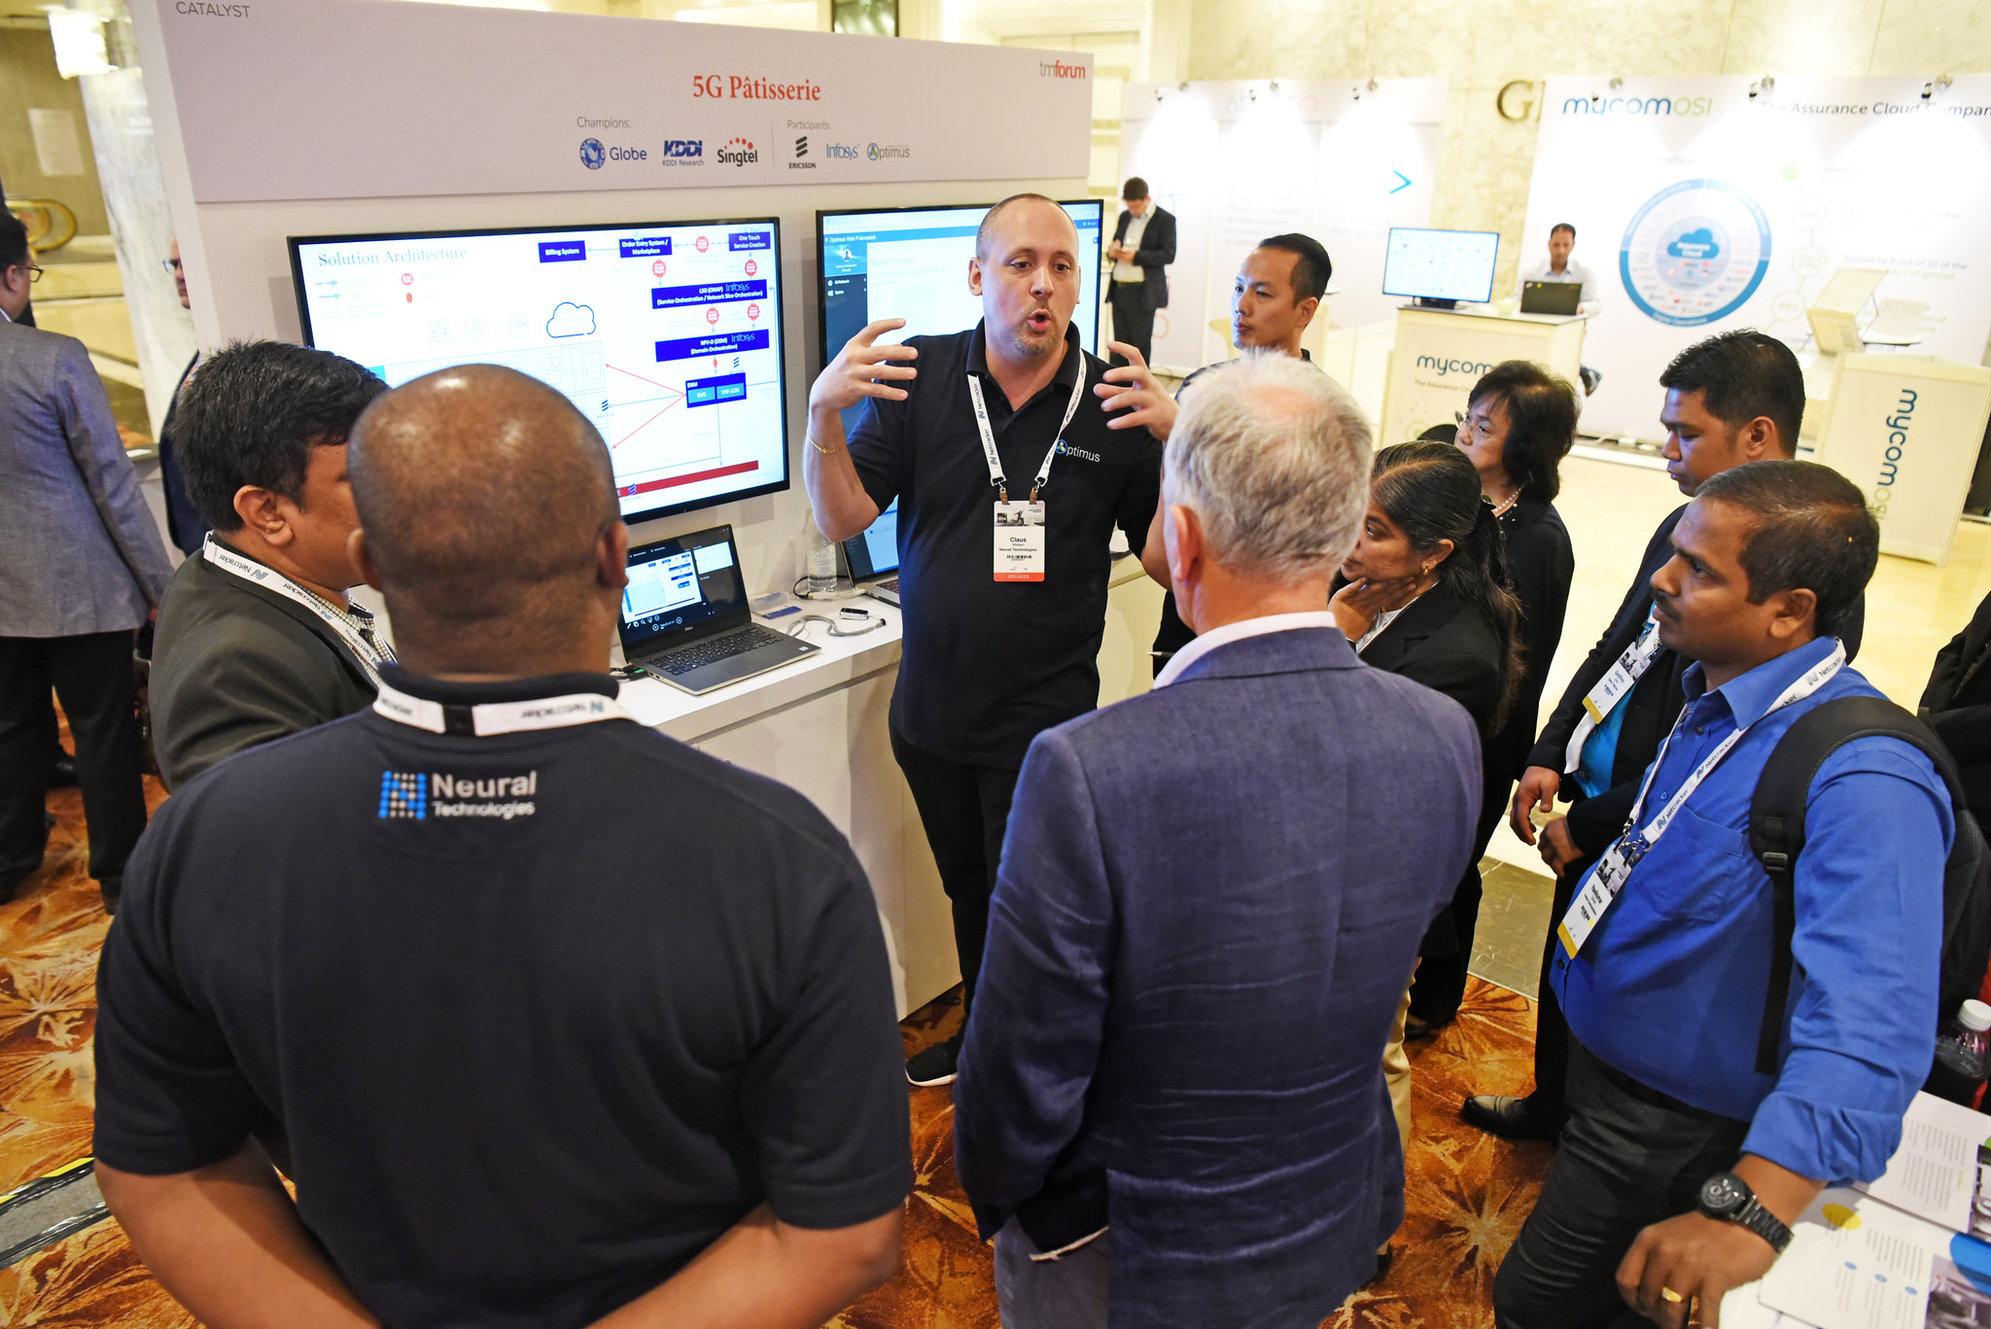
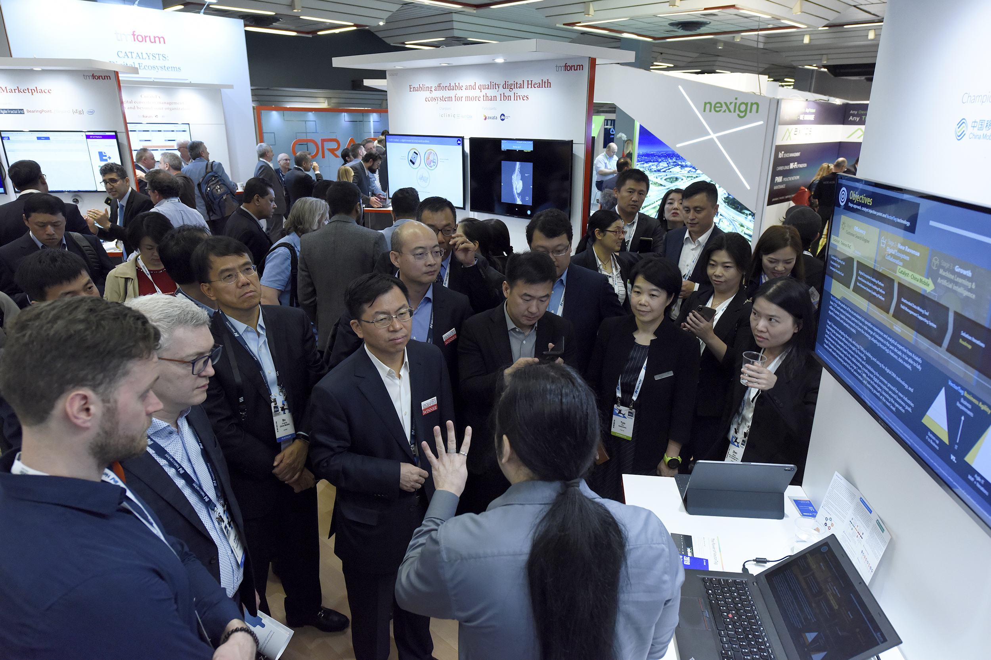
Award submission form
Before submitting online, download the award submission form template to discuss with your team.
Each team is required to fill in ONE FORM.
Entry deadline: 18th October (midnight - EST)
Please submit before deadline, as system will automatically close the entry submission after the deadline.
Notes:
So for Awards submission form, before online application – please download the template

Slide 12
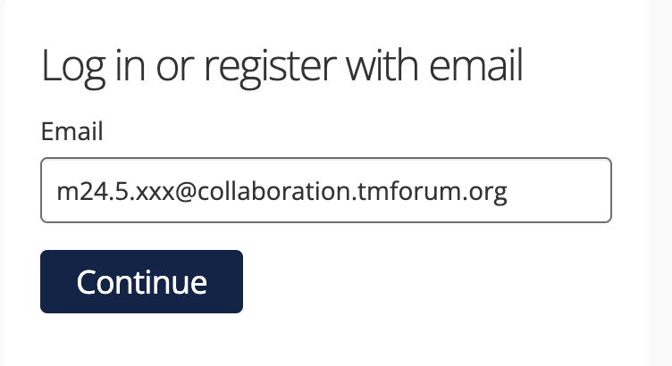
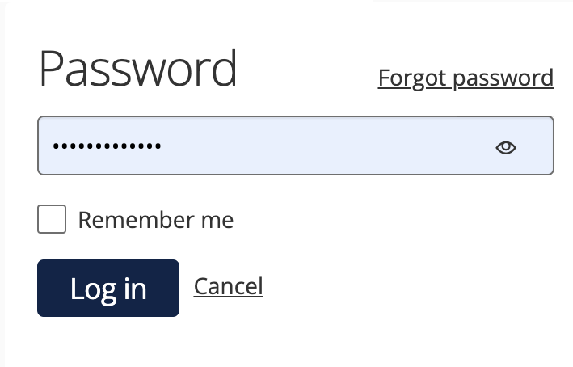
Awards submission form
For online submission, go to URL: https://awards.tmforum.org/
Login credentials have been uploaded to your confluence or emailed to each project team. Please reach out if not received or any issue. DO NOT RESET PASSWORD.
Buttons on form:
  START ENTRY‘ to start the entry form first time.
  'SAVE+NEXT' to save & proceed to the next tab.
  ’SAVE+CLOSE’ to save & return to form later. Also, to save form after submission (but before deadline).
  ‘PREVIEW’ to preview the entire form at anytime. Use this button specifically when filling tables.
  ‘SUBMIT’ when all tabs filled & team satisfied with their entry.
Scroll down online form completely to view & fill in all contents.
Preview the submission form before submitting.
  Even after submission, team can edit before 18th October & submit by using ‘SAVE+CLOSE’ button instead.
Notes:
To start the entry for first time, click on 'Start Entry' button and initiate the form. Thereafter, link available on home page for accessing the form later.

Slide 13
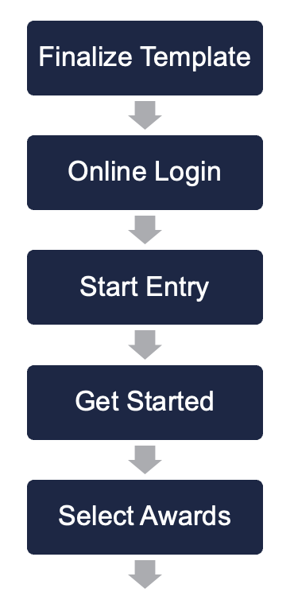
Submit before deadline
Save & edit later
Live
tutorial
TMF Assets & Additional Info
Best Moonshot – AI Challenge

Slide 14

Do’s &
Don'ts
DO: Select ‘Moonshot Catalyst Awards’ only.
DO: Select the ‘Award Category’ based on the Moonshot Challenge you are participating in.
DO: Single member access at a time.
DO: For ‘Entry Name’ – enter your final Catalyst Title (if changed). (Logins were created based on the current titles)
DO: You can edit the form multiple times BEFORE DEADLINE – even after submission.
DO: Submit before deadline → to avoid last minute technical glitches & delays.
DON’T: select ‘Forgot Password’ to reset. If any access issues, please reach out.
NOTE: This form will also be used for writing the INFORM ARTICLES.

Slide 15
judging onsite

Slide 16

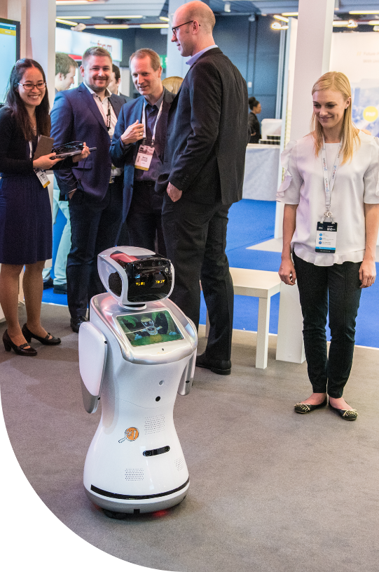
Onsite Judging
JUDGING BANDS
  Executive coaches / judges will visit teams at their kiosk to interact & score.
  Each team will be allocated 3 - 4 Judges.
  Most judging slots will be focused on 5th Nov, before 2pm.
  Although most judges visit together in slot, some may visit based on their availability.
  Details of allocated judges & slots will be available to teams ahead of event (28th Oct onwards).
  Pitch / demo should be no more than 10 minutes to allow judges time to ask questions afterwards.
  Ensure presence of your key team member at kiosk.
  Judging slots are different from presentation slots.
AWARD CEREMONY
  Winners will be announced at Awards Ceremony on 7th November at Innovate Asia, Bangkok
BEST INNOVATION & FUTURE TECHCO

Slide 17





Timelines
Awards & Judging
Awards Submission Forms
16th Sept to 18th Oct
Judging at event
5th to 6th Nov
Award categories announced
9th Sept onwards
Judges & Team Allocations
28th October onwards
(Also, ensure TMF webpages up to date)
Awards Ceremony
7th Nov
17

Slide 18
best practices & tips

Slide 19





Best
Practices
focus
update
on highlighting the goals & how Catalyst solution addressed the Moonshot Challenge. Use template to discuss with your team and then submit the Awards Submission form online.
Catalyst Spaces with all resources & content to illustrate the Catalyst in clear, concise & presentable way, by deadline.
follow
present
our Confluence page for latest information about Moonshot Catalyst Awards. Also recommend to promote catalyst using marketing toolkit.
to judges onsite - clearly expressing the how best the Catalyst addressed & achieved the set Moonshot challenge, focussing on proof points.

Slide 20
post event

Slide 21
Post-event award
Outstanding Contribution to TM Forum Assets
Judged & Awarded Post-Event to Catalyst team that uses the program to make most substantial contribution to TM Forum’s assets.
All submissions reviewed by TM Forum Staff & judged by TM Forum’s Collaboration Sub-committee.
Catalysts assessed based on
  Overall impact to collaboration projects
  Number of contributions
  Quality of contributions
21
Notes:
Each Catalyst project is associated or related to a collaboration project or basic theme.

Slide 22
Post-event award
To make a contribution, you must be part of the TM Forum Collaboration program (free to all members).
Please find and join the right program https://myaccount.tmforum.org/joinproject
In confluence find the correct project & in Project space side bar, you can navigate to "Contributions" page
Click on "Submit Contribution” & select issue type as ”Catalyst Contribution”
Email list of contribution with project URN to Shengfan Hou.
Last date to submit contribution: 20th December 2024
More details about contribution - here
More details about process - here
Application
Process
22
Notes:
Each Catalyst project is associated or related to a collaboration project or basic theme.

Slide 23
Post-event activity
Judges’ Feedback
Judges’ comments will be accessible through the Awards platform, using the same login credentials. Comments will be available from 18th November & will stay accessible until 31st January.
Post-event promotions
Catalyst promotions & inform articles will continue to be published post-event as well.
Next Phase preparations
Catalyst cycles are continuous, so continue planning for next phase.
23
Notes:
Each Catalyst project is associated or related to a collaboration project or basic theme.

Slide 24




Stay
Important Catalyst webpages:
  TM Forum website
  Catalyst Spaces
  Member Portal - Awards
    Recording & presentation will be uploaded in the member portal.
Weekly check-in emails
Contact us:
  TM Forum Service Desk
  Email us:
    Catalyst Operations
    Mahima Khurana (for awards)
    Shengfan Hou (for contributions)
informed!

Slide 25
Any Questions?

Slide 26
Thank
You!

