Slide 1
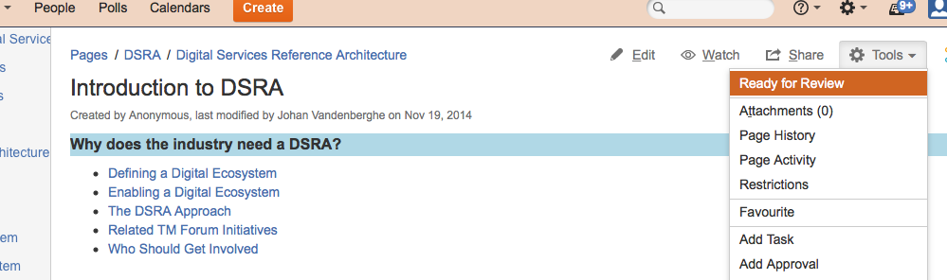
Publishing in Confluence
Step 1: Setting to Review

Slide 2
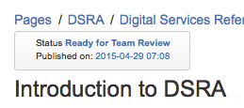
Publishing in Confluence
Step 2: Deliverable is ready for Team Review
Project Team carry out their internal review

Slide 3
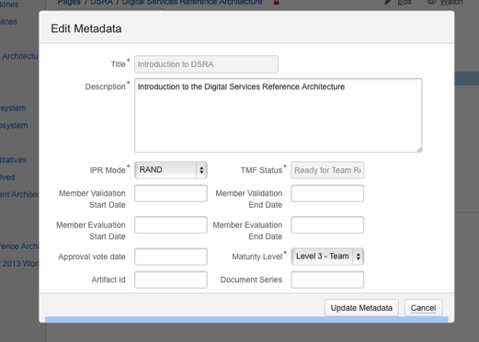
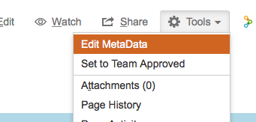
Publishing in Confluence
Step 3: Edit Meta Data
Click Tools > Edit Meta Data and complete required fields

Slide 4
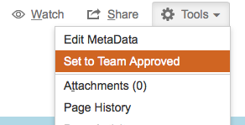
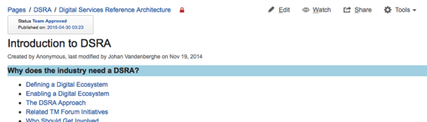
Publishing in Confluence
Step 4: Set as Team Approved
Project Team member sets as Team Approved
Deliverable is then locked and cannot be edited by Project Team

Slide 5
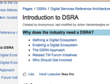
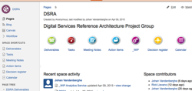
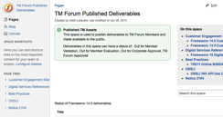
Publishing in Confluence
Step 5: Publishing
The Publisher selects “Publish” and a copy of the deliverable is taken and moved to the “Published” space
The “Published” space is available to all members for member validation (& evaluation) as read only
Project Space (Project Members only)
“Published” Confluence space (all TM Forum members)
Fx 15 Deliverable
Publishing
Read Only Published Fx 15 Deliverable

Slide 6
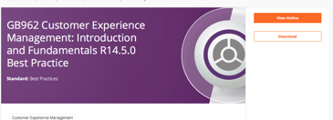
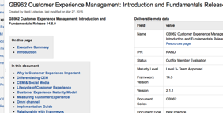
Publishing in Confluence
Step 6: Deliverable is added to Resources
The deliverable is automatically added to the Resources area on www.tmforum.org/resources
Users will see a “View Online” button which links to the deliverable in the “Published” space in Confluence:
www.tmforum.org/resources
Published page on Confluence

Slide 7
How to Publish in Confluence
Step 7: Deliverable is unlocked to the project team
The Publisher unlocks the deliverable in the source project
Clicking the link after “Published on:” takes you to the copy of the deliverable in the shared published space
Project Team may now continue editing

