Slide 1
B2B2X Business Scenario
Draft
<Presentation Title>
<Presenter Name>, <Title>, <Company>
    Real-World Business User Stories

Slide 2

Catalyst Participants
….
Optional
This slide is specific to catalysts business scenarios
It lists the companies involved in the catalyst and their roles
Notes:
Objective:
This slide is specific to catalysts business scenarios. It list the companies involved in the catalyst and their roles
Content:
Provide a list the companies involved in the catalyst with their roles.
Logos can also be added.
This slide is optional

Slide 3
Content Overview
Scenario Setting
Scenario Contexts
Key actors & roles
Problem Statement
Drivers
Overall Value
Business Model Canvas
Partnering Models
High level Use Case Walkthrough
Scenario Components
Use Cases
Partner Perspectives
Frameworx Components Used
DSRA Mapping
Metrics
Privacy
CEM
Data Analytics
Zoom
Scenario Conclusion
Benefits of Using Frameworx Standards and Best Practices
Lessons Learned
Notes:
Objective:
The objective of the Business Scenario template is to provide both Catalyst Projects and member contributed scenarios with a consistent structure and content to more effectively communicate to both Business and Technical viewers.
The completed Business Scenario slides will be ingested through the Digital Services Toolkit which will enable the content to be reviewed and refined, and then published for consumption by members.
Content:
The Business Scenario slides are grouped under four categories, Scenario Setting, Contexts, Components and Conclusion. The Slides within the Scenario Setting and Contexts should iteratively be completed first, and then be further refined as clarity becomes available as additional content is added. The completion of the Scenario Setting and Contexts slides are mandatory for all Business Scenarios, and it should be possible to complete these at an early stage of the project (e.g. As part of Catalyst application or pre exploration of TM Forum components).
Scenario Setting Slides (Mandatory)
These Slides will contain the key information to provide the viewer with the important facts related to the Problem that the scenario is solving, the key Social, Economic and/or Market drivers, the overall value that will be achieved and finally a summary of the key participants. These slides and the Context slides are typically worked on iteratively and agreed by the team prior to commencement of the Scenario Components slides.
Scenario Context Slides (Mandatory)
Based on the previous slides, this next set of slides provides details on the Business Model (shown as a Business Model Canvas), the Partnering Model and finally a high level walkthrough of Use Case(s) that are within the scope of the Scenario.
Scenario Components Slides
These slides will provide further details on four key areas;
Decomposition of the High Level Use Cases summarised as a Context slide. The number of Use Cases and the level of details provided will vary per scenario.
Provide technical or business insights or perspectives from each of the key participants. This may include specific details on their role and responsibilities, value gained, approach, opportunities identified and any perspectives they want to add related to the TM Forum Components used.
An overview of the TM Forum Frameworx components used. This is a summary slide as the detailed information related to the items used from the various TM Forum Projects should be detailed on the individual slides.
Individual slides should be completed for the key Frameworx areas using the structure provided.
Scenario Conclusion Slides
At the completion of the Project the team should provide an overview of the benefits (and any gaps identified) of using the Frameworx components, standards or best practices, and finally a summary of the lessons learned.

Slide 4
Key actors and roles
Who are the key actors (such as CSP, Supplier …) and their roles?
Note that an actor can have several roles.
List of actors must be compliant with the one mentioned on “problem statement” and “Business model canvas” (customers + partners) slides
Describe main interactions and information exchanged between actors. see example in appendix
Optionally, financial flows between actors can be described. See example in appendix
Mandatory
Notes:
Objective:
It is important for the viewer to understand at a early stage who the key actors involved in the Business Scenario are. It also will help the team to determine high level roles and responsibilities.
Content:
Provide a list of the key actors and the high level roles they play in the Business Scenario. It is important to ensure that the terminology is consistent and easily understood by the viewer so include definitions if necessary. The partnering model for the actors are detailed further in the Partnering Model Slide so keep the information clear and summarised.
Note that an actor can play several roles. For example, in a digital payment business scenario, the actor “CSP” can play the role of “connectivity service provider” but also the role “Financial service provider”
List of actors needs to be consistent with actors mentioned in problem statement slide and list of customer segments and key partners from business model canvas slide
Describe main interactions and information exchanged between actors
This slide is mandatory

Slide 5
Problem Statement
Mandatory
….
What was the specific Business Problem that you were addressing?
This should be phrased as…
As a ……………,
I need to………
so that I can ……….
To do this I need to…..
I know that I am successful when….
A separate Problem Statement may be provided for each Use Case actor.
If the business scenario aims at solving several problems, several problem statements can be provided for each actor
Notes:
Objective:
The Problem Statement(s) should be written so that it's as easy for your audience to understand as possible. Avoid using jargon. For many Business Scenarios it may make sense to provide separate Problem Statements for each of the key participants.
Content:
The Problem Statement should be phrased as
As a …. (enter the participant name)
I need to…… (detail the problem you want to solve)
So that I can….. (the benefits or outcome that will be achieved as a result of solving the problem)
To do this I need to …. (what are the key activities that the participant will need to complete)
I know that I am successful when…. (how will you measure success – what is the success criteria)
This structure isn’t mandatory but highly recommended
If the business scenario aims at solving several problems, several problem statements can be provided for each actor
This slide is mandatory

Slide 6
Drivers
Mandatory
….
Are there specific Social, Economic or Market Drivers, trends, KPIs that will help provide useful background information to the Scenario Reader?
Notes:
Objective:
The Drivers slide provides a Macro view of the key Market, Social and/or Economic drivers that are relevant to the larger Ecosystem or Market
Content:
The information provided should provide the viewer with the context around why this Business Scenario is relevant. It may include;
Market Size and growth expectations
Industry or segment drivers
Market and Analyst Insights
Trends
Socio-economic drivers

Slide 7
Overall value creation
Mandatory
What are the sources of value creation associated with the Scenario?
Optionally, Alexander Osterwalder’s value proposition canvas can be used to describe value creation. see example in appendix
Notes:
Objective:
It is important to provide a summary of the overall value that will be created by the Business Scenario. This does not need to be participant specific but rather more at a Macro level describing the value that will be gained.
Content:
Summary statements such as the following ;
New market opportunities unlocked
Benefits to the end customer
New or improved revenue streams
Improved Efficiencies
Reduced time-to-market
Validating new Ecosystems
Providing new Digital connectivity or services to new customer segments
This slide is mandatory

Slide 8








Business Canvas
Mandatory
Key Partners
Key Activities
Value Proposition
Customer Relationships
Customer Segments
Who are our Key Partners?
Who are our key suppliers?
Which Key Resources are we acquiring from partners?
Which Key Activities do partners perform?
What Key Activities do our Value Propositions require?
Our Distribution Channels?
Customer Relationships?
Revenue streams?
What type of relationship does each of our Customer Segments expect us to establish and maintain with them?
Which ones have we established?
How are they integrated with the rest of our business model?
How costly are they?
For whom are we creating value?
Who are our most important customers?
What value do we deliver to the customer?
Which one of our customer’s problems are we
helping to solve?
What bundles of products and services are we
offering to each Customer Segment?
Which customer needs are we satisfying?
Mass Market
Niche Market
Segmented
Diversified
Multi-sided Platform
Categories
Production
Problem Solving
Platform/Network
Characteristics
Newness
Performance
Customization
“Getting the Job Done”
Design
Brand/Status
Price
Cost Reduction
Risk Reduction
Accessibility
Convenience/Usability
Motivations for Partnerships
Optimization and economy
Reduction of risk and uncertainty
Acquisition of particular resources and activities
Examples
Personal assistance, Dedicated Personal Assistance, Self-Service, Automated Services, Communities, Co-creation
Key Resources
Channels
What Key Resources do our Value Propositions require?
Our Distribution Channels? Customer Relationships?
Revenue Streams?
Through which Channels do our Customer Segments want to be reached?
How are we reaching them now?
How are our Channels integrated?
Which ones work best?
Which ones are most cost-efficient?
How are we integrating them with customer routines?
Types of Resources
Physical
Intellectual (brand patents, copyrights, data)
Human
Financial
Channel phases
1. Awareness - How do we raise awareness about our company’s products and services?
2. Evaluation - How do we help customers evaluate our organization’s Value Proposition?
3. Purchase - How do we allow customers to purchase specific products and services?
4. Delivery - How do we deliver a Value Proposition to customers?
5. After sales - How do we provide post-purchase customer support?
Cost Structure
Revenue Streams
What are the most important costs inherent in our business model?
Which Key Resources are most expensive?
Which Key Activities are most expensive?
Is your Business More;
Cost Driven (leanest cost structure, low price value proposition, maximum automation, extensive outsourcing)
Value Driven (focused on value creation, premium value proposition)
Sample Characteristics
Fixed Costs (salaries, rents, utilities)
Variable costs
Economies of scale
Economies of scope
For what value are our customers really willing to pay?
For what do they currently pay?
How are they currently paying?
How would they prefer to pay?
How much does each Revenue Stream contribute to overall revenues?
Types
Asset sale, Usage fee
Subscription Fees
Licensing, Brokerage fees
Advertising
Fixed Pricing
List Price
Product feature dependent
Customer segment dependent
Volume dependent
Dynamic Pricing
Negotiation (bargaining)
Yield Management
Real-time-Market
Use a Business Canvas to detail the Business Model
Notes:
Objective:
A business model describes the rationale of how an organization create, delivers and captures value and it important to understand it. To do so, proposed business model description is based on the widely adopted Business Model Canvas proposed by Alexander Osterwalder that describes the logic of how a company intends to make money through nine basic building blocks
Content:
Complete the 9 building blocks business model canvas by answering to the questions highlighted in yellow.
All participants don’t follow necessarily the same business models. So describe as much Business Models Canvas as different business models from participants point of view
Additional information about Business Model Canvas can be found on Business Model Generation website: http://businessmodelgeneration.com/book
This slide is mandatory
.

Slide 9
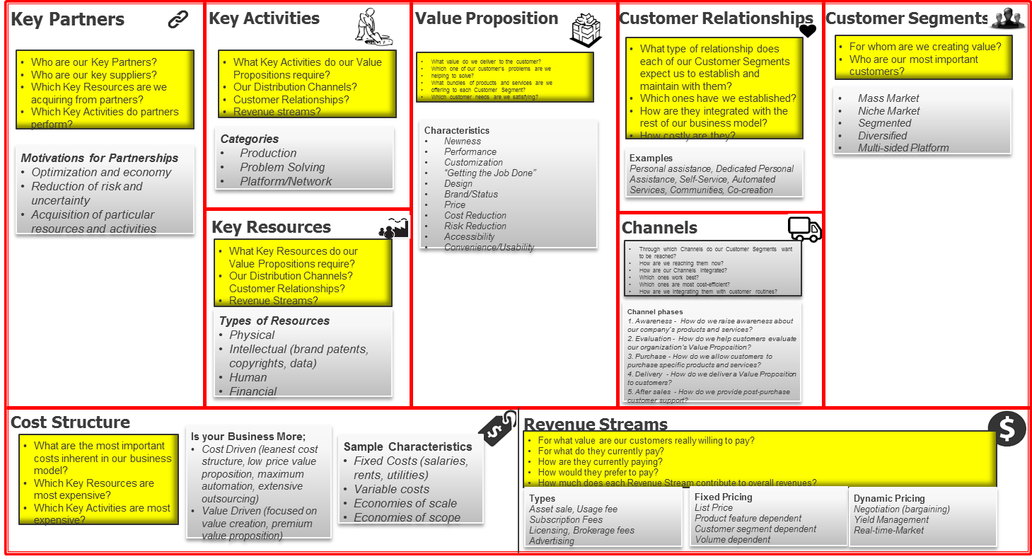
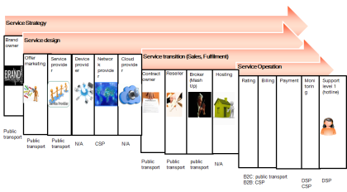
Partnering Model
Mandatory for all B2B2X type business scenario
Example
Contractual
Commercial
Financial
Financial
Business
Financial
Operational
Business
The Business model was presented before
TR211
Contract Type: Distribute
Role:
Sold through
I sell the products / services of a partner to deliver their product / service.
I may or may not have a contractual relationship with the end customer
Generator –> Distributor –> Reseller –> Prosumer
DSP´s role:
communication, platform as a service
Partner:
Value chain intermediation
See appendix
What partnering model was agreed?
This should use the models defined in the Partnering Guide – TR211
Examples provided in appendix can be used to detail business relationship and responsibility sharing between partners
Notes:
Objective:
Understand and formalize partnering relationship between business scenario participants from 3 points of view
commercial / contractual,
Financial
operational
The commercial / contractual model describes the detailed contractual relationships between participants in the business scenario along with the detailed terms and condition for these contractual relationships.
The financial model describes the roles partners perform with respect to Financial aspects of the service.
The operational model describes the position a participant occupies in the responsibility chain.
Content:
Describe the partnering relationship using the proposed template
Descriptions must follow the instruction provided in TR211 Online B2B2X Partnering Step by Step Guide about Contractual model types and responsibilities, standardized financial models and responsibility chain description
Additional information can be found in : http://projects.tmforum.org/wiki/display/B2B2X/TR211+Online+B2B2X+Partnering+Step+by+Step+Guide+R15.0.0
This slide is Mandatory for all B2B2X type business scenario

Slide 10
High Level Use Case Walkthrough
1) Initial user account, billing, and service is setup in Vendor x GUI, and equipment type and location data is sent to Team X and Vendor z
2b) Vendor z receives data from Vendor x and displays planned equipment location and service + status updates from Team X in geospatial GUI
Example
3) Once equipment is turned on, Vendor y sends “device come alive” event back to Team X
Mandatory
2a) Team X receives data from Vendor x, begins scheduling dispatch of equipment, and sends updated dispatch location status data onwards
4) Team X dispatches additional work crews + sends 2nd set dispatch data to Vendor z’s GUI and to Vendor x’s configuration and Inventory app
5a) Vendor z receives and displays 2nd set dispatch status updates from Team X in geospatial GUI
8) Updated equipment and network info is also visible in Vendor z’s GUI
7) Vendor y receives updated status and inventory data from Vendor x and begins monitoring the new equipment and network
6) Vendor x updates service status and starts billing/management cycle
5b) Vendor x proceeds with equipment SW and network config and updates inventory and sends “complete” status to Vendor y
Provide a High Level visual walkthrough to the Use Case.
Notes:
Objective:
Describe the most significant uses cases part of the business scenario
For each use case, describe:
the activities performed and their sequencing
the participants responsibilities with regard to activities
the touchpoints between activities / participant
Content:
Use an activity or interaction diagram, such as the proposed example, to describe the use case
Highlight the activities under responsibility of each participant (use of different colors)
Show the sequencing of activities
Check the consistency with key participants diagram previously provided
This slide is mandatory

Slide 11
Use Cases description
Optional
Provide a more detailed description of each use covered by the business scenario. See examples in appendix
Notes:
Objective:
Detail each significant uses cases part of the business scenario
For each use case, describe:
the activities performed and their sequencing
the participants responsibilities with regard to activities
the touchpoints between activities / participant
Content:
Use an activity/interaction diagram or a sequence diagram to describe the use case
Highlight the activities under responsibility of each participant (use of different colors)
Show the sequencing of activities
Check the consistency with high level use case walkthrough diagram previously provided
This slide is optional

Slide 12
B2B2X Service Provider Perspective
Mandatory for all B2B2X type business scenario
Why is this Business Scenario important from an Ecosystem Owner or Primary partner perspective?
See example below
Digital Service Provider Perspective
Challenges
How can I partner with other service providers to offer more integrated products and services as well as attract a large customer base?
My customer expects me to provide services that are personalised, how can I get access to the data to understand my customers better
Benefits
Enhance my customer/user base by partnering with others
Enhance my product offering by collecting customer insights
Increases data monetization opportunities
Improves customer experience
Notes:
Objective:
The slide provides the Ecosystem Owner or Primary partner organisation with the opportunity to provide an insight into why this Business Scenario is important, challenges encountered and the value or benefits that will be realised.
Content:
This may take the format of bullet points, a diagram or even a video from a key stakeholder from the Ecosystem Owner or Primary partner organisation.
This slide is optional and must be provided only if there is partnering relationship in the scope of the business scenario

Slide 13
B2B2X Partner Perspective
Mandatory for all B2B2X type business scenario
From one or more of the partner organisations - Why is this Business Scenario important?
See example below
….
Communications Service Provider Perspective
Challenges
Pressure on revenues from OTT players
Need new customers at low cost and need to support new business models
Customer expects reliable, easy to use and relevant services
Customers wants to self-manage his own digital lifecycle
Integrating new services with my core business is always expensive and difficult
Benefits
Extended customer base
Enhances product offering
Provides a foundational platform to launch new innovative services
Simplifies integration of digital services with operating businesses
Increases data monetization opportunities
Improves customer experience
Notes:
Objective:
The slide provides the participating partner organisations in the scenario ecosystem with the opportunity to provide an insight into why this Business Scenario is important, challenges encountered and the value or benefits that will be realised.
Content:
This may take the format of bullet points, a diagram or even a video from a key stakeholder from the partner organisation.
This slide is optional and must be provided only if there is partnering relationship in the scope of the business scenario

Slide 14
B2B2X Perspective
Mandatory for all B2B2X type business scenario
From the a second level partner organisation (e.g. App Development SME) - Why is this Business Scenario important?
See example below
….
Customer/Users Perspective
Benefits
Seamless access to all services, accessible under 1 Digital ID
Any service from any device from anywhere
Preferences and personalization across all services
Manage my own Digital lifecycle, Delegate access to my services with my Family & Friends securely
Single bill and single point of contact
Notes:
Objective:
The slide provides second level partner organisation (e.g. App Development SME) in the scenario ecosystem with the opportunity to provide an insight into why this Business Scenario is important and the value or benefits that will be realised.
Content:
This may take the format of bullet points, a diagram or even a video from a key stakeholder from the partner organisation.
Examples; the point of view of the end user of TM Forum Frameworx, the final partner in the chain. E.g. Development Company, OTT Service Provider, etc.
This slide is optional and must be provided only if there is partnering relationship in the scope of the business scenario

Slide 15
TM Forum Components Used
Mandatory
…
Describe Framework components used
Information Framework – Level 1 ABEs
eTOM level 2 process elements
The Telecom Application Map – Level 1 applications
Notes:
Objective:
Describe TM Forum components or asset used within the business scenario.
Components or assets encompass:
Business Process Framework (eTOM): process element and process flows (sequence of process element linked together)
Information Framework (SID): ABE
Application Framework (TAM): Application
Security
B2B2X
Any relevant best practices or technical reports in business scenario context
etc.
Note that specifics slides are dedicated to description of API, DSRA, CEM, metrics, data analytics and privacy assets within business scenario.
Content:
Information about assets used can be provided in the form of lists or, if relevant, mapping on diagrams or posters.
ABE, process elements and applications used can, if possible, be described by a mapping on SID, eTOM and TAM diagrams or posters (see diagrams on slide)
if information Model assets are described, level 1 ABE used must be presented at least
if Business Processes are described, level 2 process element must be presented at least
if applications are described, level 1 applications must be presented at least
Component used within business scenario but missing in TM forum Frameworx should be mentioned.
Additional information helpful to identify components used are available in:
TM Forum resources library (https://www.tmforum.org/resources/?filter_frameworx-version=4271)
document GB921E for information about process flows
Description of TM Forum Frameworx component used is mandatory

Slide 16
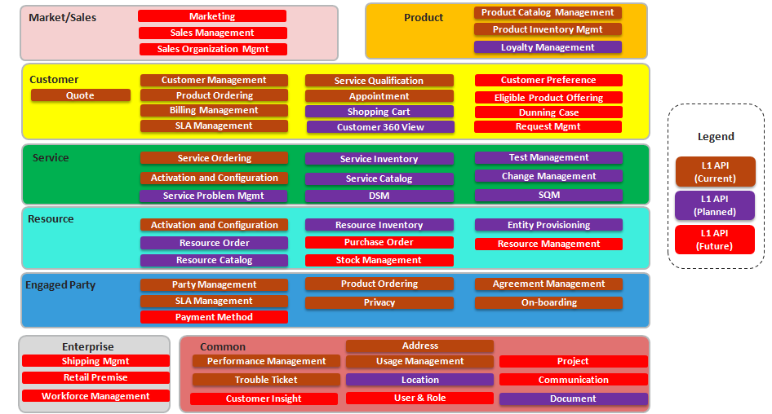
API
Optional
Provide the list of API used to support the business scenario. See API map & API portal: https://projects.tmforum.org/wiki/display/API/TM+Forum+Ecosystem+API+Portal
Describe the context of API use (interactions / touchpoints supported). See example in appendix
list missing APIs that could be useful for business scenario
API level 1 map
Notes:
Objective:
Provide a list of TM Forum API used within the business scenario.
Content:
Information API used can be provided in the form of lists or, if relevant, diagrams.
Context of API use should also be described i.e.
Reason of API use
Interaction or touchpoint supported by API within the business scenario
if possible, name of source and target process elements interfaced via the API
Missing API that could be useful for business scenario implementation can also be mentioned.
In the same way, missing or incorrect information in API documentation can be pointed out
Additional information helpful to identify API used are available in API zone (https://www.tmforum.org/strategic-program/api-zone/) for description of published API
This slide is optional and must be provided only if TM Forum API are used in the business scenario

Slide 17
DSRA information
Optional
CHANNELS / MARKETPLACE / STORE
DEVELOPMENT
DOWNLOAD /
UTILIZATION
SERVICE APIS CATALOG
APPS CATALOG
CONSUMPTION
SERVICE COMPOSITION/ORCHESTRATION MANAGEMENT
API BROKER/PLATFORM (FUNCTIONAL AND MANAGEMENT API)
CATALOG LIFECYCLE
MGMT & FEDERATION
EXPOSURE
CONFIGURATION
& ACTIVATION
IDENTITY
MANAGEMENT
POLICY BASED
ROUTING
ASSURANCE
& TRACEABILITY
PROFILE
MANAGEMENT
ON-BOARDING
ANALYTICS
CHARGING
INVOICING
SERVICE DOMAIN
(PUBLIC CLOUD)
SERVICE DOMAIN
(IAAS / PAAS)
SERVICE DOMAIN
(PRIVATE CLOUD)
SERVICE DOMAIN
(CAAS / NAAS)
IMPLEMENTATION
SERVICE
DEPLOYMENT
Any platform that intends to form part of future digital ecosystems should implement both the best practices and support some new “support services”. See the list on the Business Scenario Positioning versus DSRA slide, with more information available in:
Introductory Guide to the DSRA IG1126
DSRA Guide
CaaS: Communication as a Service; Iaas: Infrastructure as a Service;
NaaS: Network as a Service; PaaS: Platform as a Service
Notes:
Objective:
To have a graphical representation of the Digital Services Reference Architecture components that are relevant within the business scenario.
Content:
Color the DSRA components that are NOT relevant for your Business Scenario in grey.
Additional information about DSRA can be found
on DSRA information slide
on DSRA confluence space (http://projects.tmforum.org/wiki/display/SES/DSRA) and particularly :
in “introduction to DSRA” page (http://projects.tmforum.org/wiki/display/SES/Introduction+to+DSRA)
in “DSRA technology architecture page” (http://projects.tmforum.org/wiki/display/SES/DSRA+Technology+Architecture) where support services are described
This slide is optional

Slide 18
Business Scenario Positioning versus DSRA
Support Service Name | In scope (Y/N) | Comment
Identity Mgmt
Profile Mgmt
Analytics
Policy Based Routing
Configuration & Activation
Assurance & Traceability
Charging
Invoicing
Catalog Lifecycle Mgmt & Federation
On-boarding
Optional
Notes:
Objective:
To list the DSRA Support Services exposed and/or consumed within the business scenario.
Content:
Indicate
which Support Services are relevant for the Business Scenario by filling out the proposed table template
what are the lessons learned from implementing DSRA concepts
Additional information about DSRA can be found
on DSRA information slide
on DSRA confluence space (http://projects.tmforum.org/wiki/display/SES/DSRA) and particularly :
in “introduction to DSRA” page (http://projects.tmforum.org/wiki/display/SES/Introduction+to+DSRA)
in “DSRA technology architecture page” (http://projects.tmforum.org/wiki/display/SES/DSRA+Technology+Architecture) where support services are described
This slide is optional

Slide 19
Customer Experience Management
Optional
How will you measure if the customer (at any point in the value fabric) is having a good experience?
see examples in appendix
Who is providing the experience?
see examples in appendix
For each persona what defines a good experience for them? What would be a bad experience? (this applies for B2B and B2C relationships
see examples in appendix
Notes:
Objective
For any service, it is important to understand what the end-to-end customer experience will be. A customer can be the end user of a service or any party in the value chain who is the customer of another party.
Content
1. Persona: Who is the customer? Define the typical customer or groups of customers
2. Experience provider: Who is providing the experience for this persona or customer group? This may be one party or many parties. Think about all of the parties the user has to interact with to use a service
3. High level description of the customer’s/user’s experience – for each persona develop a description around the lifecycle of the customer’s interaction with the service. This can be written as a paragraph or bullets, or it can use TM Forum’s lifecycle model to develop customer journey maps (use GB962C to do this)
Define business oriented KPIs for the customer’s experience (for example Customer Effort Score or NPS) Use GB935A for these metrics or create your own if you have ideas for new metrics to measure this service.
5. Define metrics for the customer experience by looking at critical elements in the experience (e.g. time from order to service) . Select one or two key metrics for each critical aspect of delivering and using the service. Use G962A for these metrics or create your own if you have ideas for new metrics to measure this service.
Assistance
The TM Forum’s Customer Experience Management project group is available to help at anytime. Please contact Rebecca Sendel (rsendel@tmforum.org) for assistance.
This slide is optional

Slide 20
Metrics
Optional
What metrics did you use to measure the delivered value proposition?
see examples in appendix
What existing TM Forum metrics (if any) did you use?
What new metrics did you define?
see examples in appendix
Notes:
Objective
To ensure quantitative measures of success are in place for the service.
Content
Identify and/or define key metrics for success for each of your user stories. Depending on the kind of service, this is likely to be a new metric not defined in TM Forum. For example, for an eHealth age at home service, the high level metric could be around number of trips to the doctor that could have been avoided with better service.
Create a balanced scorecard of metrics that are relevant to your service. Use GB935/GB935A
What are the key operational measures?
What are the goals for revenue and margin?
What is are the key measures of Customer Experience? (see prior slide)
Additional metrics definitions are found in GB988.
Assistance
Questions around defining metrics? Contact Robert Bratulic bratulic@ca.ibm.com, Paul Ousterhout paul@kpiguy.com, or Rebecca Sendel rsendel@tmforum.org
This slide is optional

Slide 21
Data Analytics
Optional
How are you using data analytics to deliver the value proposition?
see examples in appendix
What existing TM Forum data analytics use cases apply to your business scenario? (if any)
What new analytics use cases did you define?
see examples in appendix
Notes:
Objective:
To define how data analytics will be used in order to achieve the goals defined in the user stories and the Osterwalder Canvas
Content:
Identify/define data analytics use cases to capture how analytics will be used in your solution. Start by identifying which of TM Forum's existing use cases apply towards meeting the business objectives. Refer to GB979A for the current library. In addition create use cases particular to your scenario using the TM Forum use case template.
Assistance:
Questions around TM Forum’s data analytics? Contact Peter Livaudais plivaudais@parstream.com or Rebecca Sendel rsendel@tmforum.org
Data Analytics Solution Suite: https://www.tmforum.org/resources/?filter_topic=2337
This slide is optional

Slide 22
Privacy management
What data that concerns the end-user are exchanged through partners? (SID)
What treatment is done to this data : usage purpose, retention policy and duration, transmission to other partners, anonymization or not.
see examples in appendix
Is there a step where the end-user should have to give consent for data sharing ?
see examples in appendix
Are there processes to manage data life cycle, history of usage, etc. ?
Is there a end-user interface to view data usage?
see examples in
appendix
Do you use Party_Management_API_ REST_Specification ?
Do you use Authorization solution such as OpenId Connect / Oauth 2
see examples in appendix
Optional.
Notes:
This slide is optional

Slide 23
Benefits of Using TM Forum Assets
….
Mandatory
What were the benefits of using the TM Forum Framework components and standards?
Notes:
Objective:
It is important to describe what are the benefits of using TM Forum component for the business scenario
Lacks in or possible improvements of TM Forum assets can also be pointed out
Content:
Description of benefits brought by use of TM Forum assets:
Can cover all TM Forum assets used or only focus on a part of them
Can be a summary of information already provided in “TM Forum assets used” section
Should explain how TM Forum assets helped to solve a business problem and allowed to deliver a solution quickly, easily and securely
As mentioned above, lack and / or possible improvement of TM Forum assets can also be pointed out. if so, justification of lack or requested improvement should be provided.
Note that business scenario template is part of TM Forum Assets, SO, benefits of using business scenario template, lacks in business scenario template or possible improvements can also be highlighted
This slide is mandatory

Slide 24
Lessons Learned
……
Mandatory
What did the participants learn?
Positives?
Negatives?
Recommendations?
Notes:
Objective:
It is important to highlight what the participants learned of business scenario building.
Content:
It is up to participants to describe what they learned
Lessons learned can encompass:
Use of business scenario template
Development / implementation of business scenario
Usability of TM Forum assets
useful tips coming from practical experience
etc.
This slide is mandatory

Slide 25
APPENDIX
Examples for:
Key actors & roles
overall value creation
partnering model (Business Relationships, partnering model)
Use Cases description
API
Customer Experience Management
Metrics
Data analytics
Privacy
Notes:
Objective:
This slide is specific to catalysts business scenarios. It list the companies involved in the catalyst and their roles
Content:
Provide a list the companies involved in the catalyst with their roles.
Logos can also be added.
This slide is optional

Slide 26
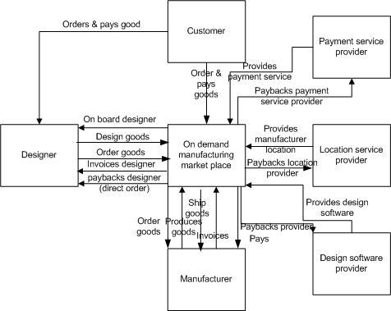
Examples for key actors and roles
Example for interactions and information exchanged between actors

Slide 27
Examples for key actors and roles
Example for financial flows

Slide 28
Examples for overall Value Creation
Alexander Osterwalder’s value proposition canvas
Notes:
Objective:
Describe overall value creation and “value proposition” building block in Business Model Canvas
Content:
Alexander Osterwalder’s value proposition canvas can be used as a tool to describe overall value creation and value proposition in business model canvas.
This slide is optional

Slide 29


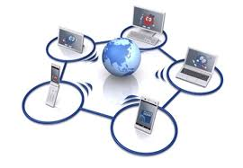

Example for Business Relationships
business relationship between partners can be detailed using the template presented below
1
2
3
pays service usage or device cost
1
2
3
pays usage or one off charge
pays usage or one off charges
sells digital & traditional services
Digital Service Provider
1
Global Communications Service Provider
Global Communications Service Provider
2
3
provides digital services for resell
Provides services for resell
Local Communications Service Provider
Local Communications Service Provider
B2B
B2B
B2C
Provide relevant ,personalized services
Digital Service Provider
Provide context driven insights
4
Providers single portal to manage all services
4
Registers for services
4
Use digital services
Provide usage data
provides App
4
4
4
Digital Service Provider
Creates Digital ID
Communications Service Provider
Use communication services
Provide usage and customer data
Global Communications Service Provider
Provide relevant ,personalized services
Local Communications Service Provider
B2B2C
Provide context driven insights
Note: ignores Hosting aspects
Notes:
Objective:
Detail the business relationship between partners
Content:
Use the template proposed to describe business relationship
This slide is optional and must be provided only if there is partnering relationship in the scope of the business scenario

Slide 30



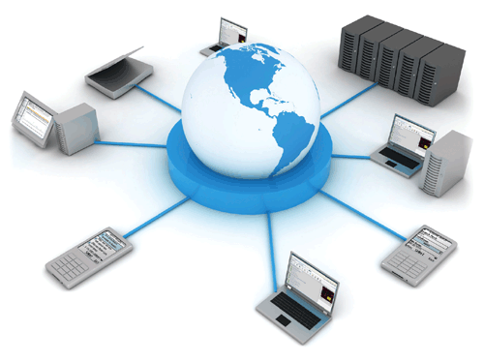












Examples for Partnering Model
Value chain responsibility sharing between partners can be described using the template below
Service Strategy
Brand owner
Service design
Offer marketing
Service transition (Sales, Fulfilment)
Contract owner
Service Operation
Service provider
Device provider
Network
provider
Cloud
services
Reseller
Broker
(Mash Up)
Hosting
Rating
Billing
Payment
Monitoring
Support level 1 (hotline)
solution provider
solution provider
solution provider
device manager
GIS provider
Device
provider
Cloud Provider
CSP
solution provider
Solution provider
Solution provider
Cloud Provider
Solution provider
solution provider
Solution provider
Notes:
Objective:
Describe the value chain responsibility sharing between partners
Content:
Use the template proposed to describe responsibility sharing
This slide is optional and must be provided only if there is partnering relationship in the scope of the business scenario

Slide 31
Examples for Use Cases description

Slide 32
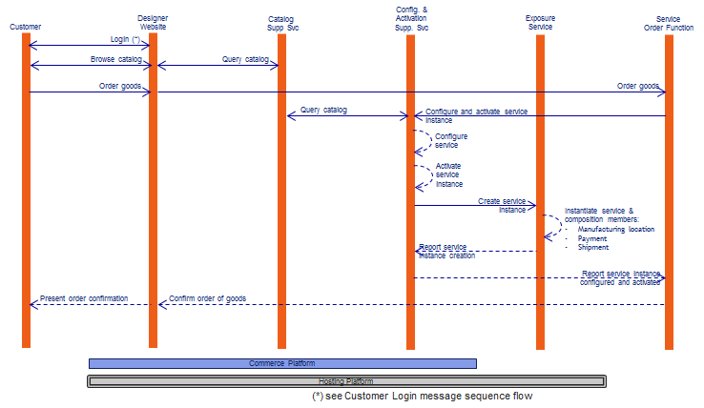
Examples for Use Cases description

Slide 33
Example for Use Cases description

Slide 34
Examples for API

Slide 35
Examples for Customer Experience Management
How will you measure if the customer (at any point in the value fabric) is having a good experience?
CSAT and NPS surveys post interaction
Direct contact (call/web chat/email etc) from CC during and after interaction
KPIs re conversion rate, resolution time, channel time and changes,
Direct and indirect feedback mechanisms in social media, DSP web site and apps etc
Who is providing the experience?
The DSP and its service provision eco system partners.
For each persona what defines a good experience for them? What would be a bad experience? (this applies for B2B and B2C relationships
Persona | Good experience | Bad experience | Status
Business Elite | Good coverage; Good connection everywhere; Effective and excellent customer service; A perceived seamless, holistic, consistent personalized experience; Exceeding customer experience; Regardless of channels being used | Bad coverage; Bad connection; Repeat to report questions | Used in this scenario
Heavy User | Good coverage; Good connection everywhere; Super fast speed of 4G, regardless of channels being used | Disconnected, poor network | Used in this scenario
Head of the Family | All charges in one bill, Good high performance cost ratio; Multi-services; Feels natural to the customer; A perceived seamless, holistic, consistent personalized experience | Cannot meet the requirements for the whole familiy | Developing
Value-Chaser | Cheap plan; Good promotion | unexpected charge exceed price of plan | Developing
Socialiser | Good connection everywhere; Personalised; Social media is the preferable channel, Quick response, The latest devices/events. | Bad connection; unattractive offers | Developing

Slide 36
Examples for Metrics
What metrics did you use to measure the delivered value proposition?
What existing TM Forum metrics (if any) did you use?
What new metrics did you define?
Customer Acquisition
Web-chat Acceptance Rate
  Web Chats-Accepted/ Web Chats-Offered
QR App Download Success Rate
  App Download from QR/App Download QR Offered
Call-Back Acceptance Rate
  Call-Backs-Accepted/ Call-Backs-Offered
Appointment Acceptance Rate
  Appointments-Accepted/Appointments-Offered
Basket Abandonment Rate
  Baskets-Abandoned/Baskets-Created
Basket Recovery Success Rate
  Baskets-Recovered/Basket-Recovery-Attempts
  Dimensions: Abandoned Channel, Recovery Channel

Slide 37
Examples for Data Analytics
How are you using data analytics to deliver the value proposition?
What existing TM Forum data analytics use cases apply to your business scenario? (if any)
What new analytics use cases did you define?
Based on the analysis project, The project associates with following TM Forum data analytics use cases
EN-DM-6: Retail Branch Indoor Analytics
EN-DM-8: increase Footfalls and improve Sales through Personalized Offers to consumers
MS-SAM-3: Real-time Personalized Offers while Browsing
MS-SAM-4: Real-time Personalized Offers during Checkout
MS-SAM-T3: Real-time Personalized Offers during a Live Interaction
MS-SAM-6: Real-time Personalized Offers Based on Location
MS-SAM-7: Real-time Personalized Offers Based on Usage
MS-SAM-9: Intelligent Advertising Based on Browsing History.
New analytics use case:
Real time information likes Geolocation, current product catalogue, touch point analysis results would be sent to Real Time Decision Engine on Per User basis (including CEI data, Persona analysis, Service Quality History, User profile/behavior data, Churn prediction in the event of no NPS/CSAT data available, TMF defined metrics performance, decision tree…). This will provide best offers and indicate the channel customer prefers to Vodafone/App partners.
Sophisticated analytics are applied to touch point analysis, inference and decision making relating to “next best actions”.
We also use analytics in our customer behaviour models and churn prediction models.
Finally analytics provide real time proactive dash board capabilities to the operator.

Slide 38
Examples for Privacy management
What data that concerns the end-user are exchanged through partners? (SID)
Primary is User log in and authentication via App or Website. Anonymous Retail Touch point analysis data, offer catalogue selection, GIS data management is also managed.
Our Zero Knowledge Proof Authentication methodology is a crucial part of the solution in that authentication of the user’s personal identifier is not stored, transmitted or exposed during user authentication. Password and phone ID is kept private and never shared outside the device.
What treatment is done to this data : usage purpose, retention policy and duration, transmission to other partners, anonymization or not.
The core methodology used are a series of complex isomorphic graphical algorithms to authenticate users without storing or exposing their underlying identifiable information. It involves abstraction of a person’s identity attributes so the person has to be prove “knowledge” or “control” of the attribute instead of proving what the attribute is. It is a subtle but very important difference.
Is there a step where the end-user should have to give consent for data sharing ?
No, this is not necessary as our authentication service doesn’t share personal information
Are there processes to manage data life cycle, history of usage, etc. ?
Yes, all authentications are recorded in a log file which can be used for audit.
Is there a end-user interface to view data usage?
Yes, but it is very basic. Future versions will allow the user to see a full, detailed record of their activity. Additionally, there are operator dashboards to track all aspects of service delivery
Do you use Party_Management_API_ REST_Specification ?
Not currently. However complying with this specification is very straightforward
Do you use Authorization solution such as OpenId Connect / Oauth 2
Our authentication system currently uses SAML 2.0 for Single Sign On. Oauth 2 and OpenId Connect are currently in development.

