Slide 1
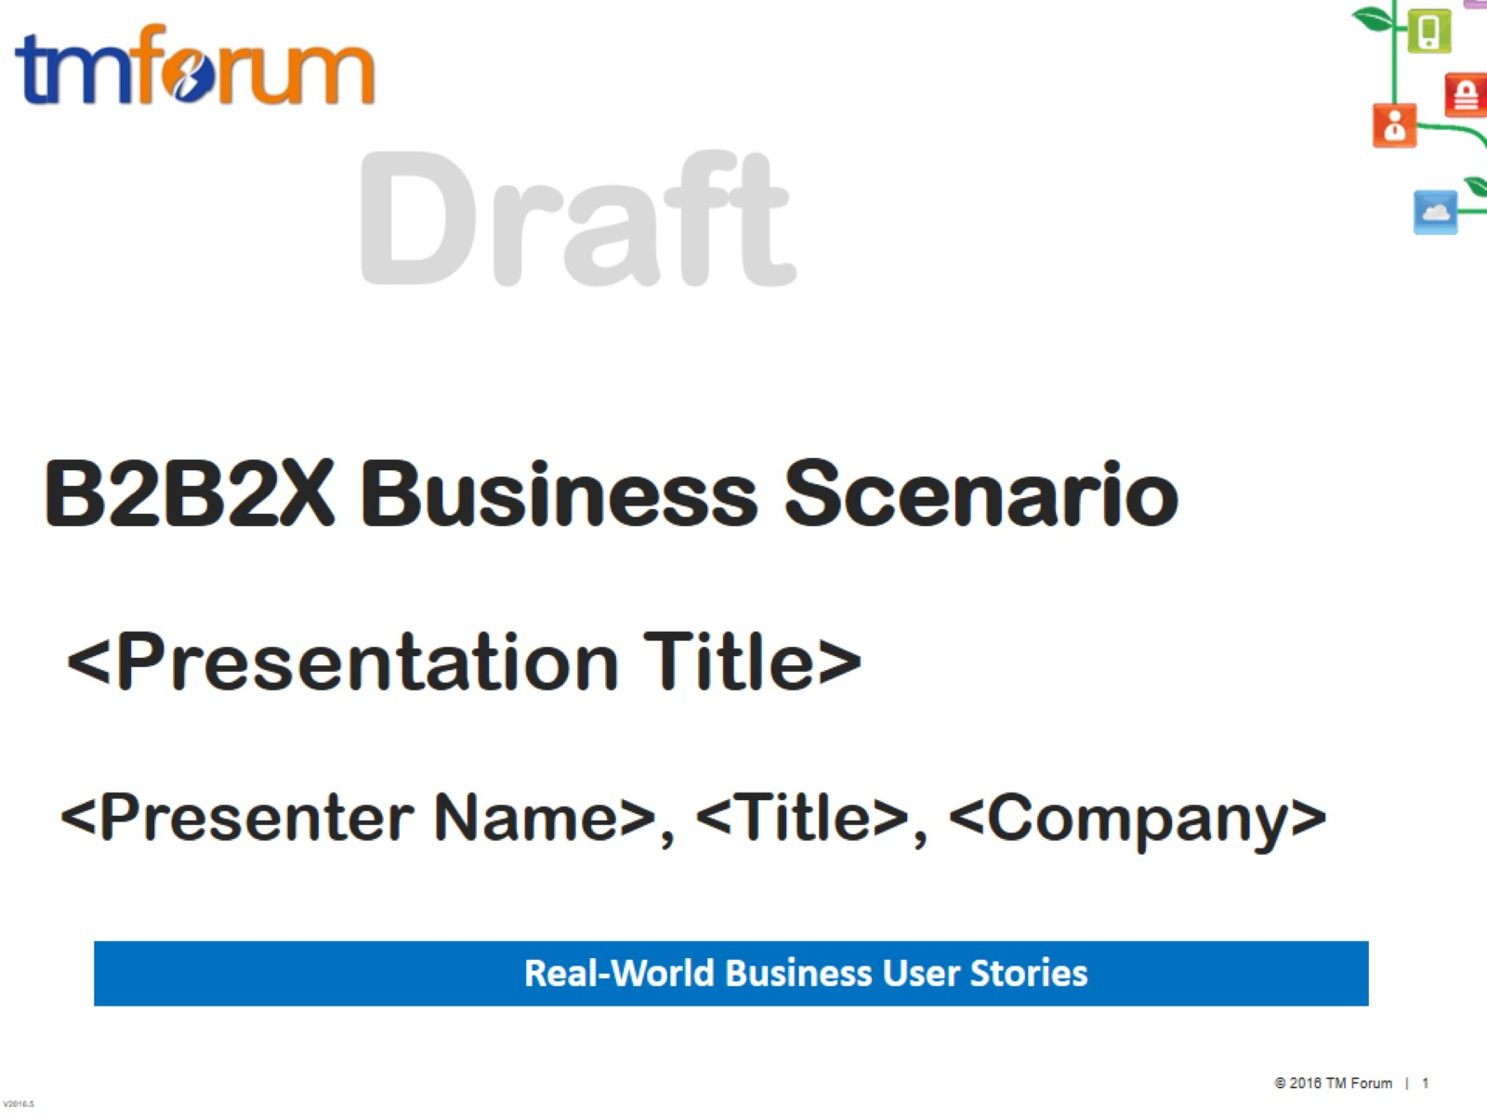
B2B2X Business Scenario

Slide 2
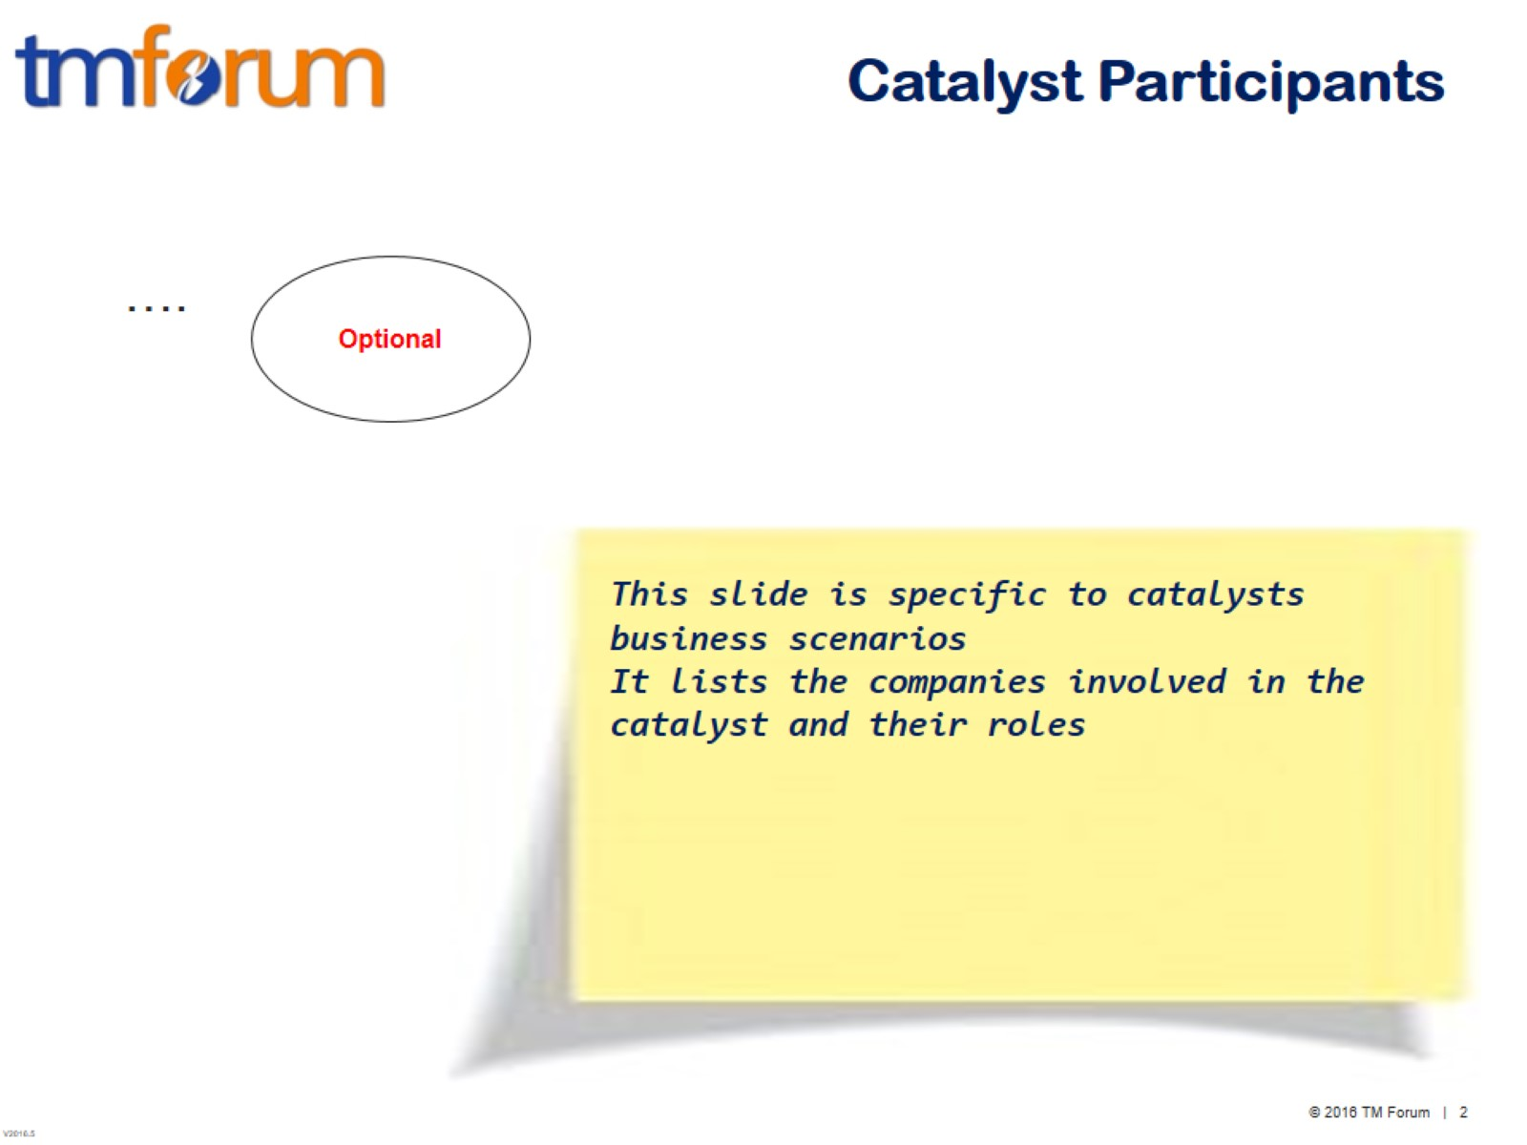
Catalyst Participants

Slide 3
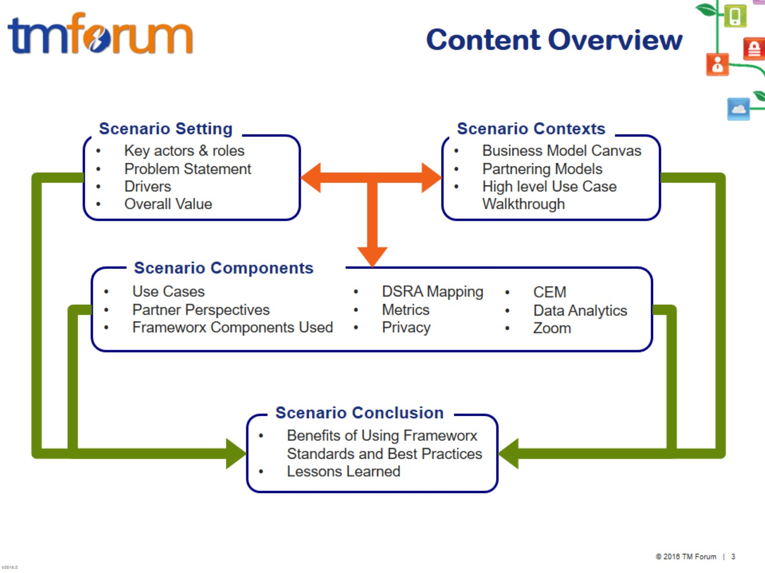
Content Overview

Slide 4
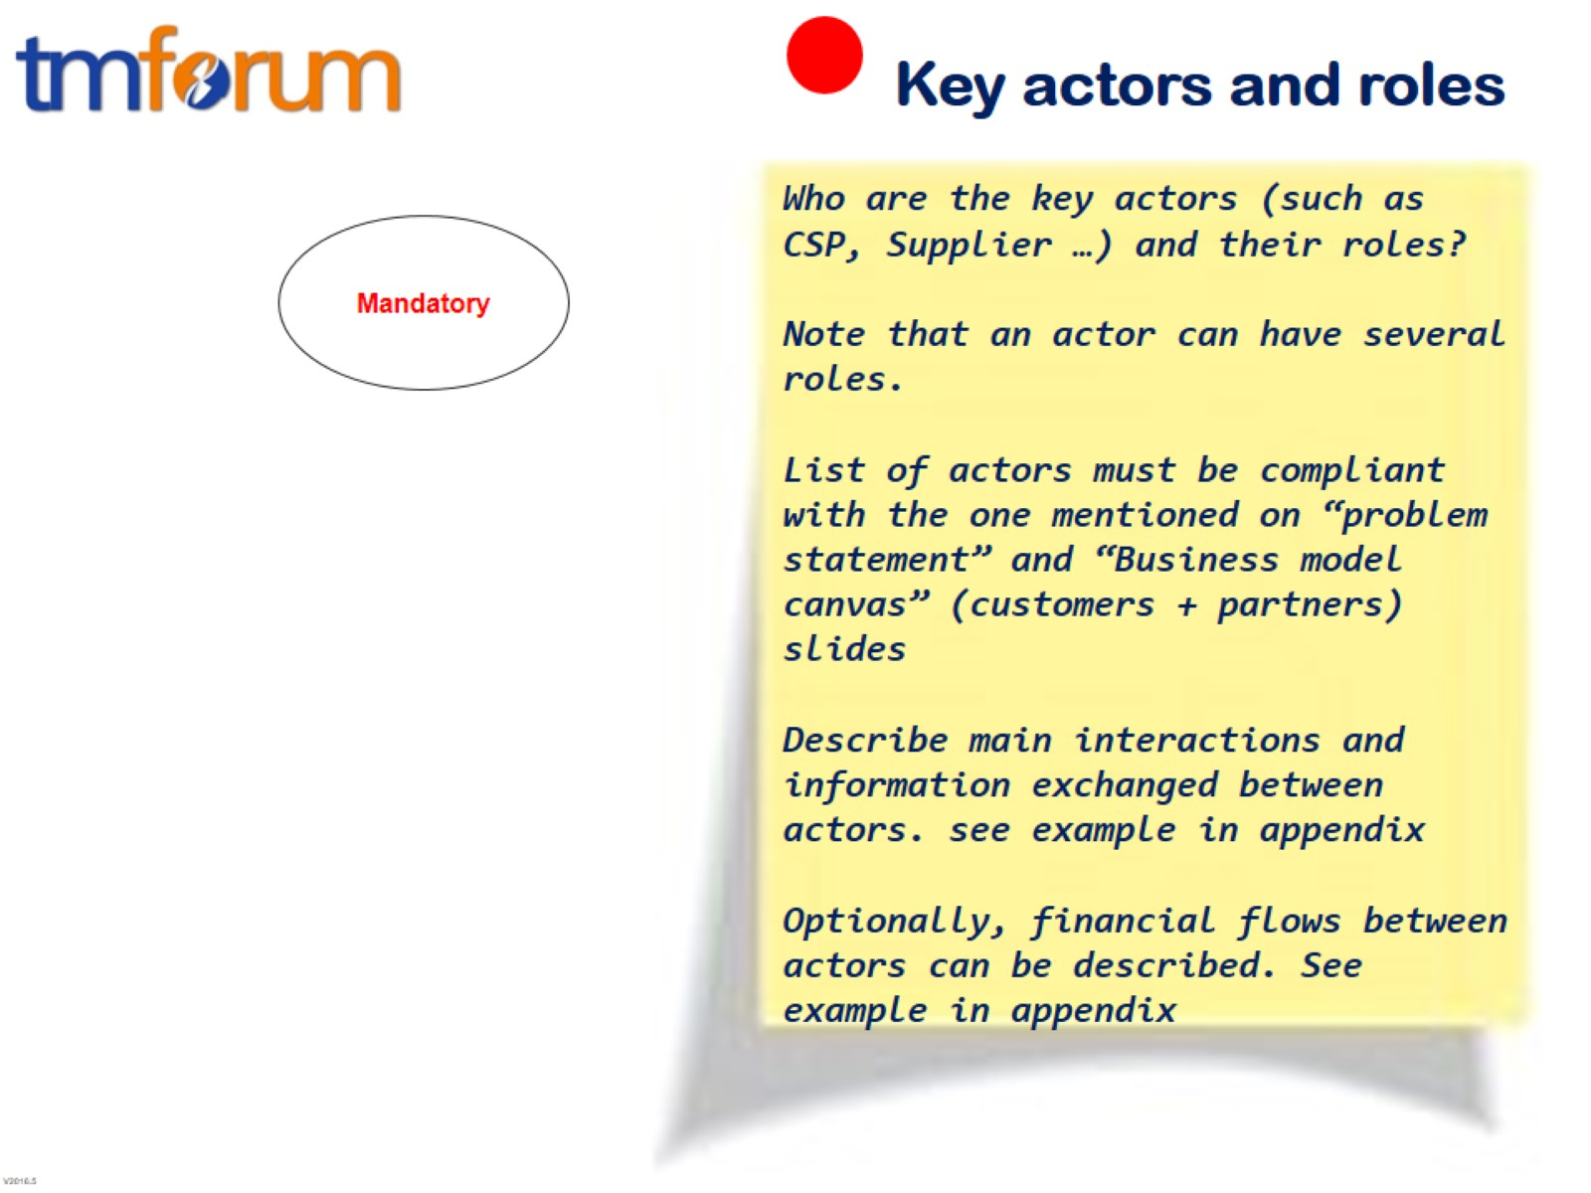
Key actors and roles

Slide 5
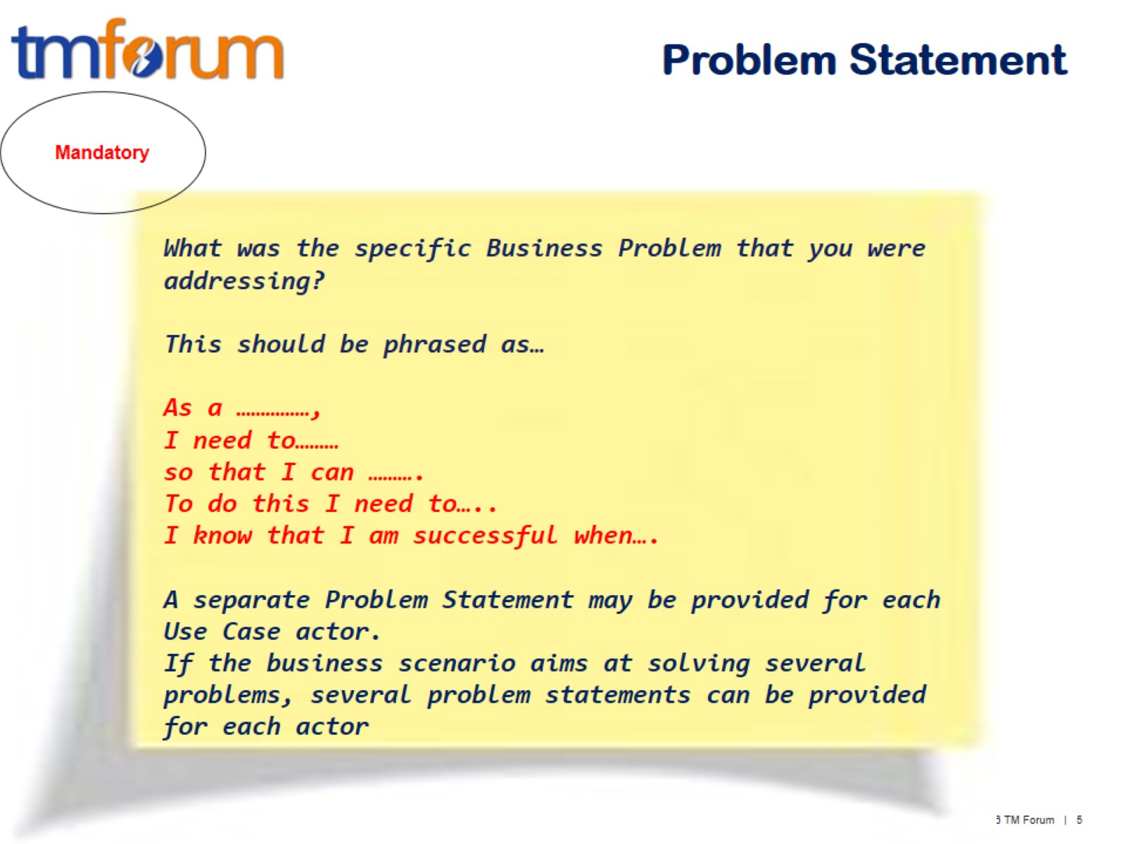
Problem Statement

Slide 6
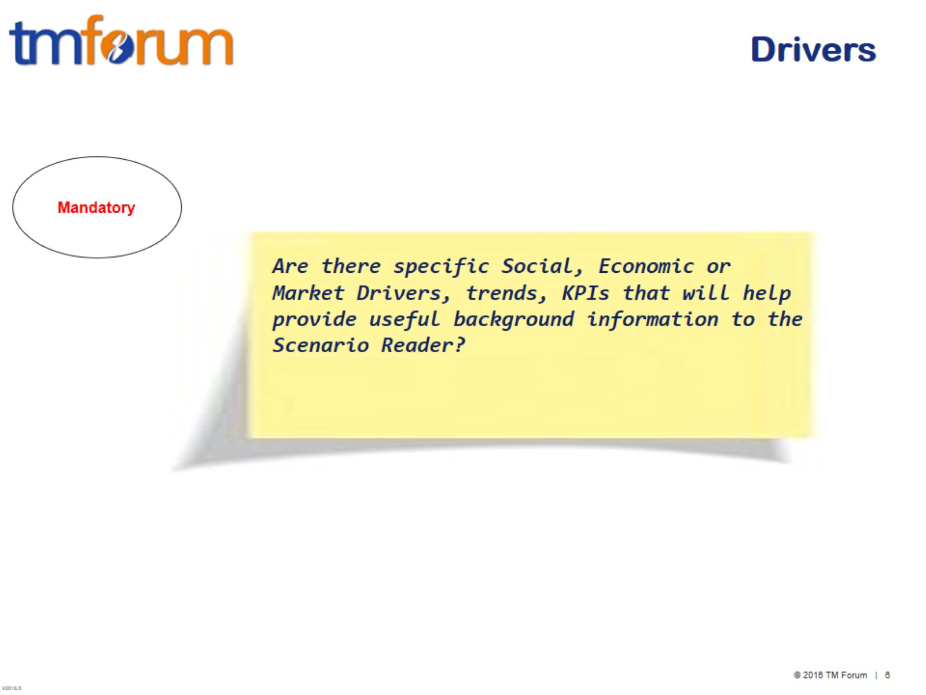
Drivers

Slide 7
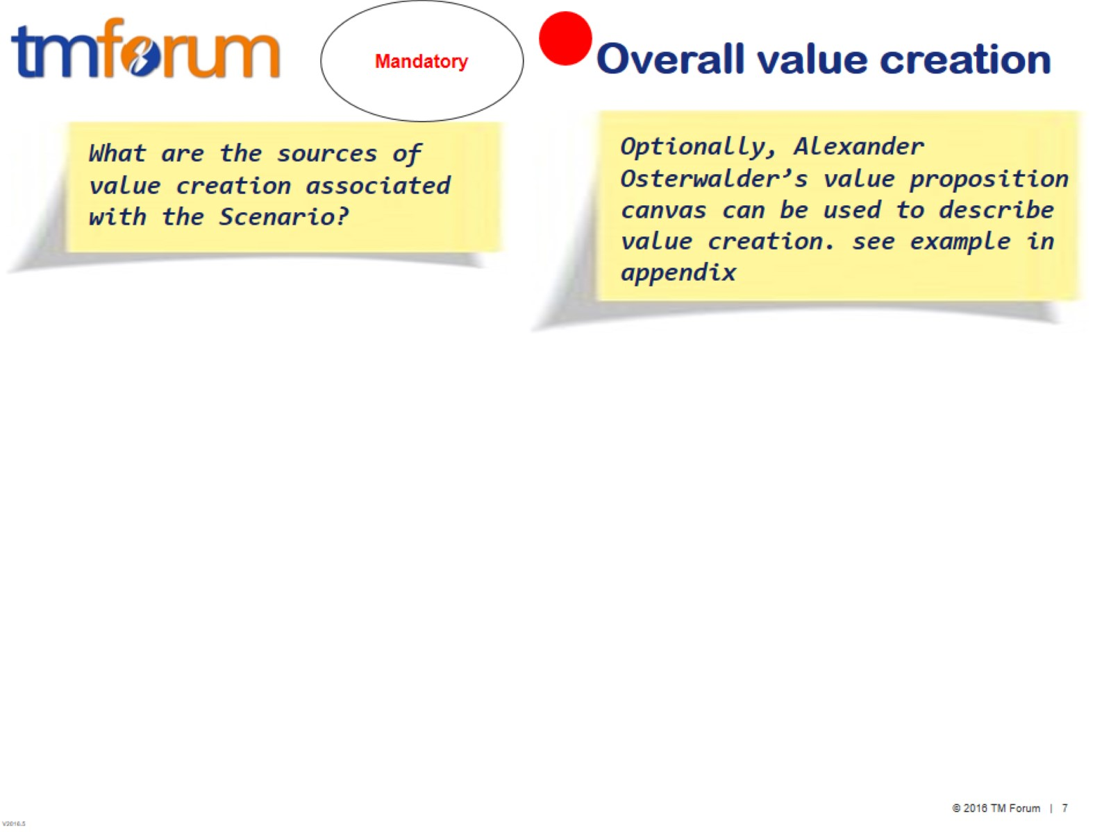
Overall value creation

Slide 8
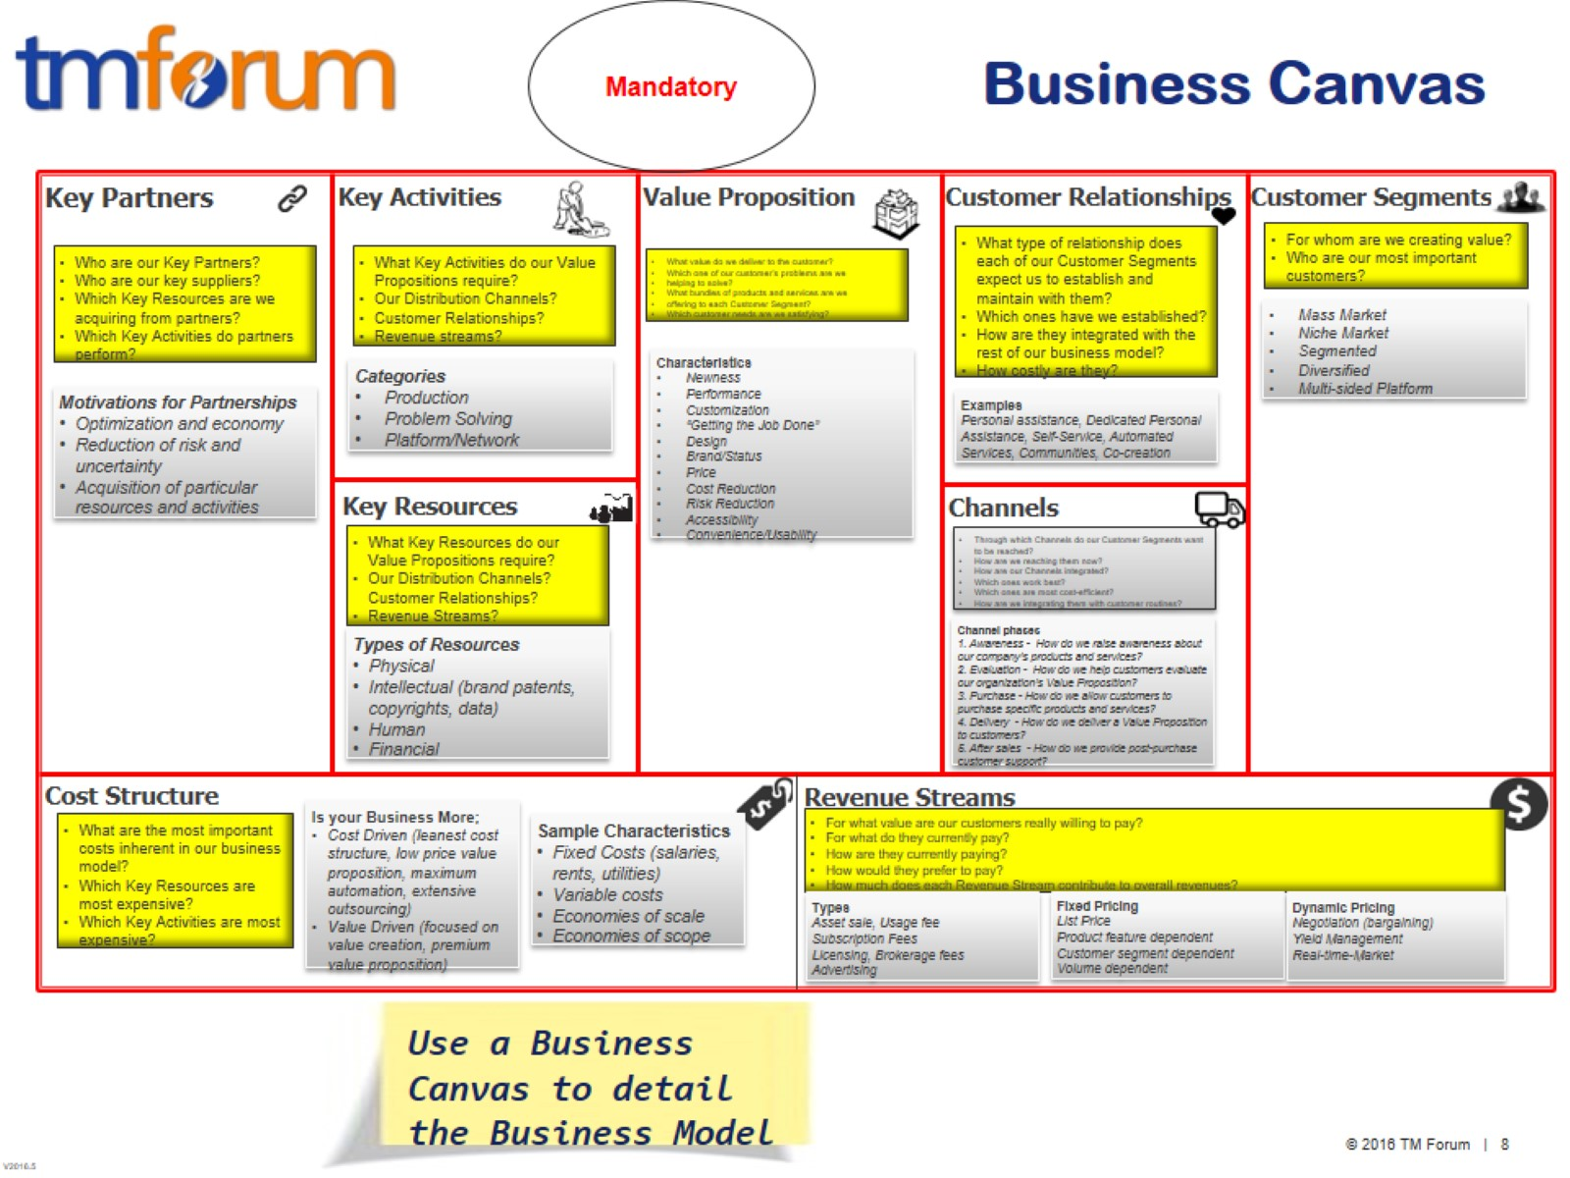
Business Canvas

Slide 9
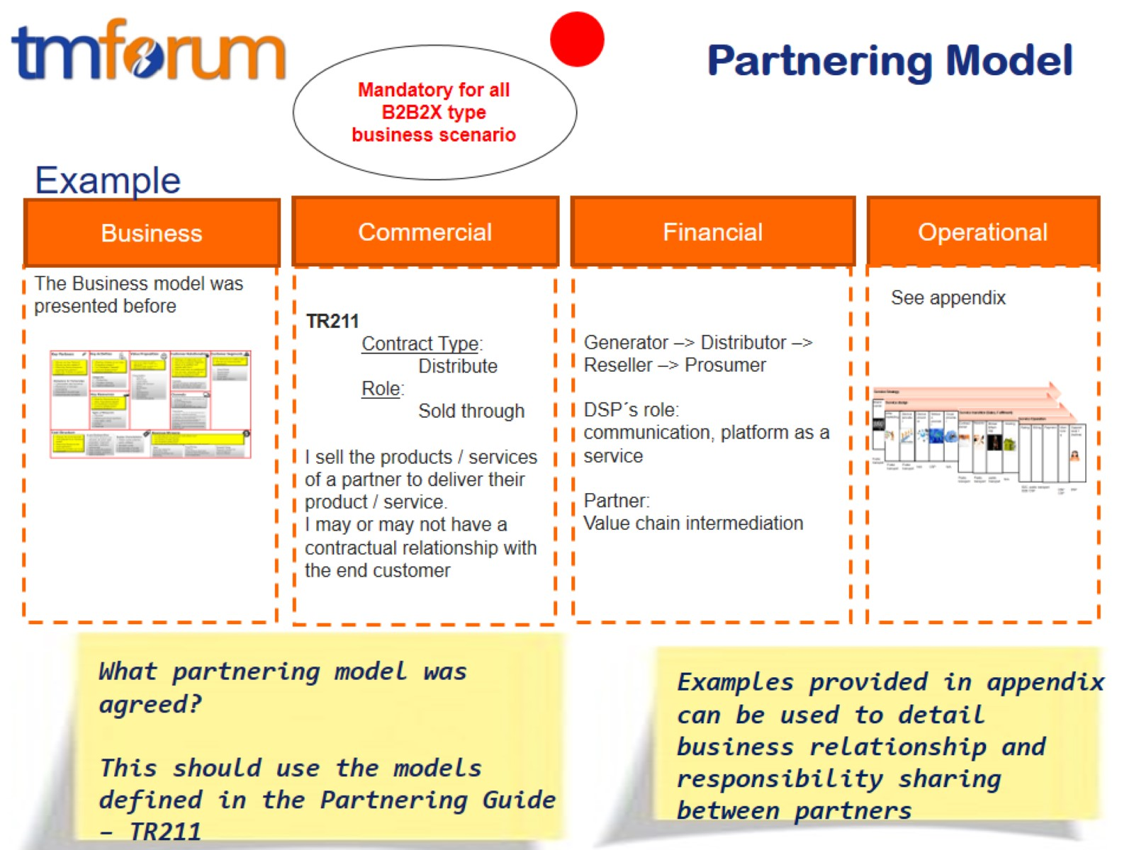
Partnering Model

Slide 10
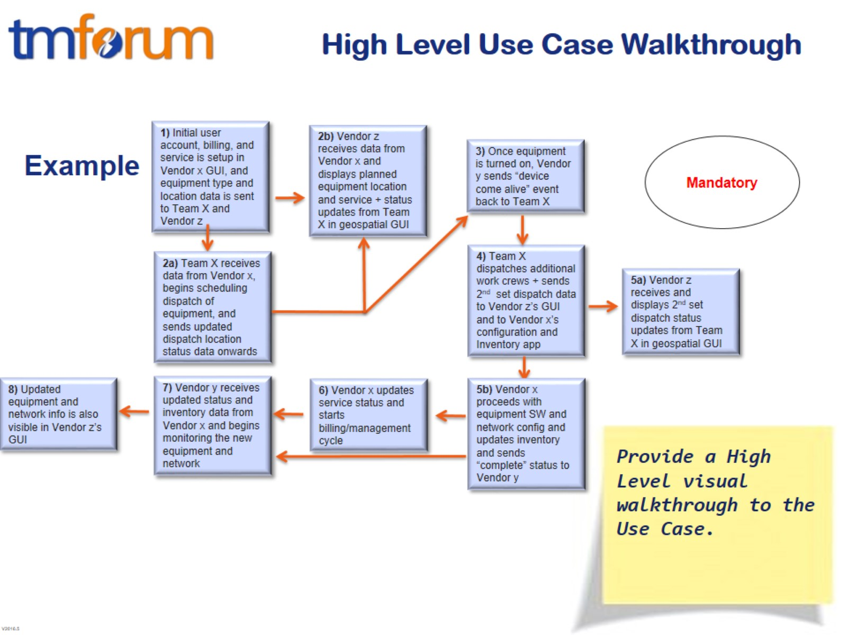
High Level Use Case Walkthrough

Slide 11
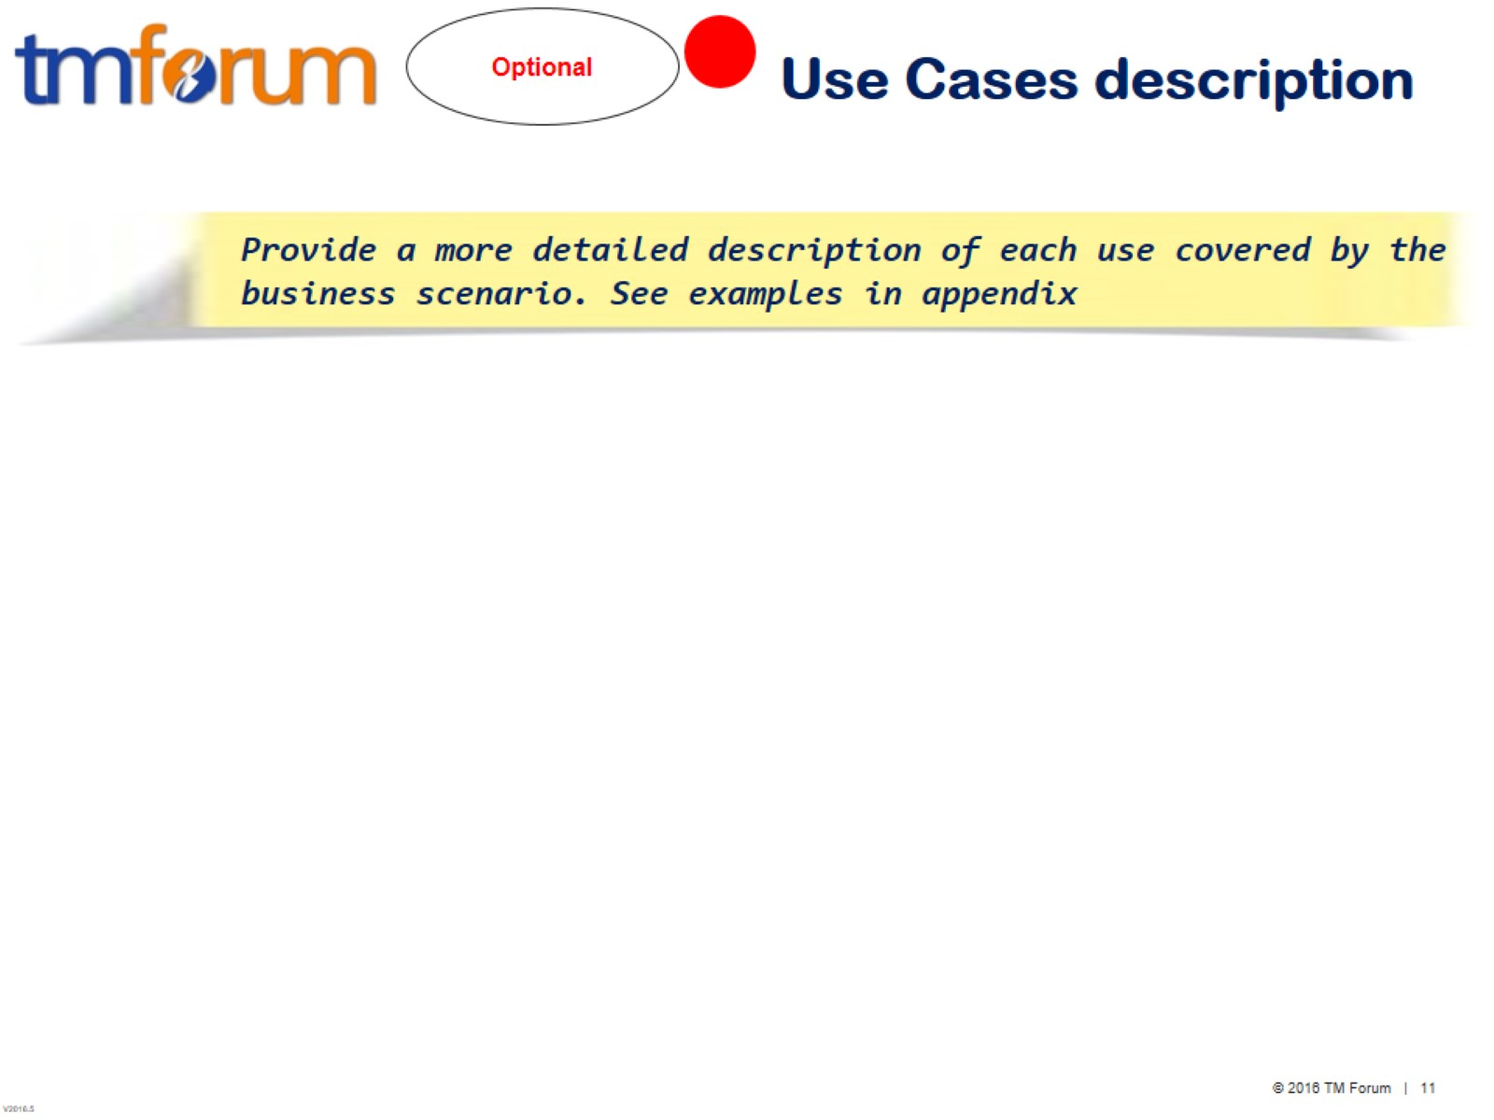
Use Cases description

Slide 12
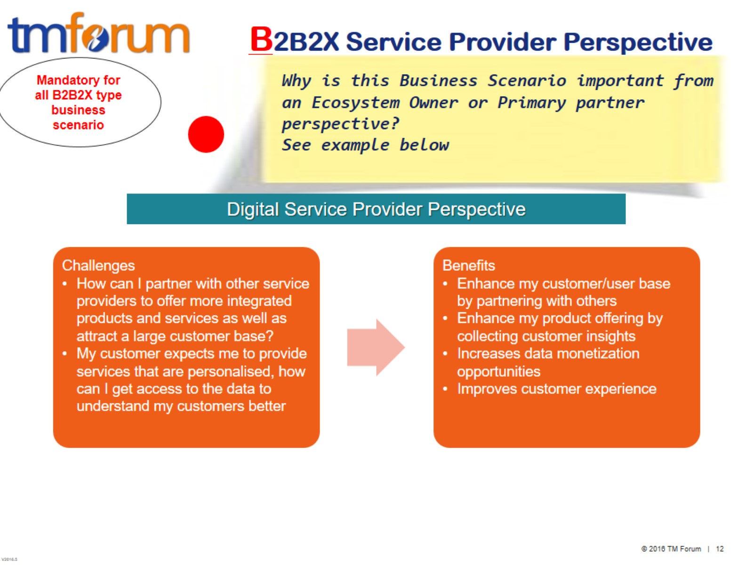
B2B2X Service Provider Perspective

Slide 13
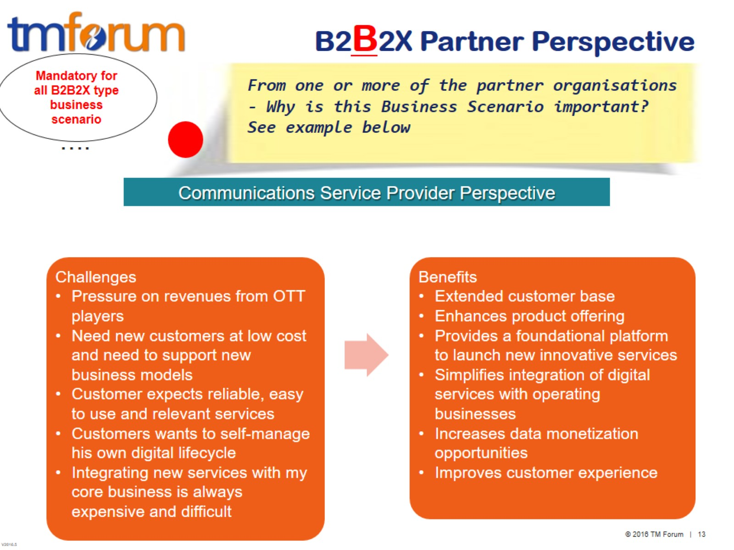
B2B2X Partner Perspective

Slide 14
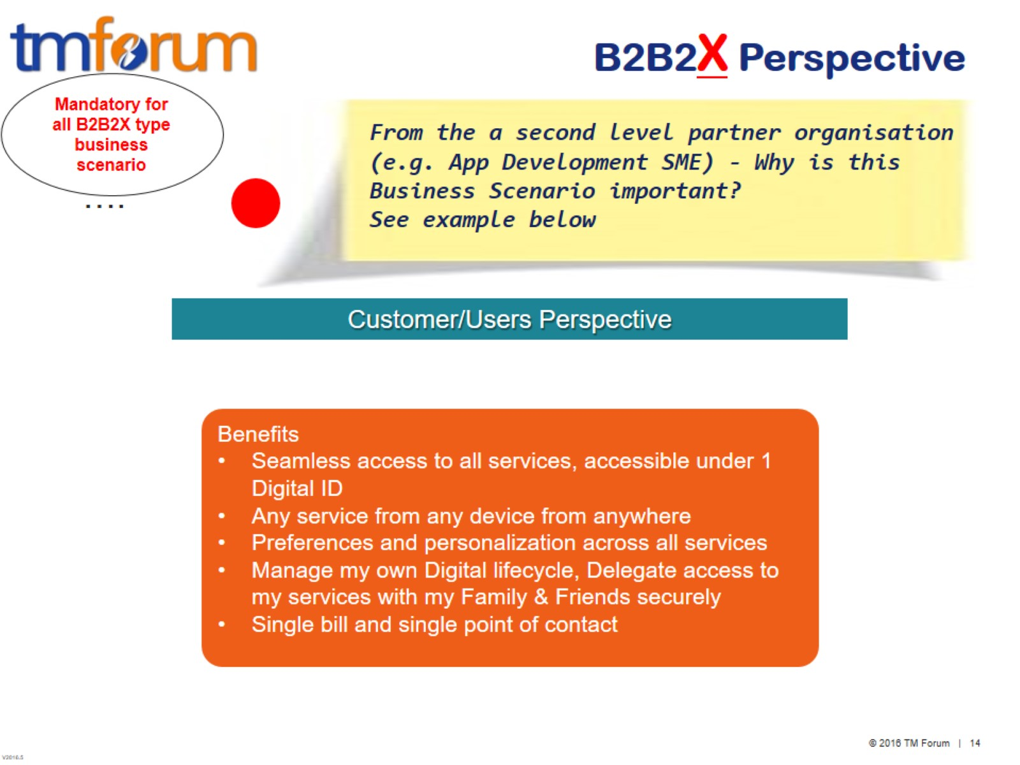
B2B2X Perspective

Slide 15
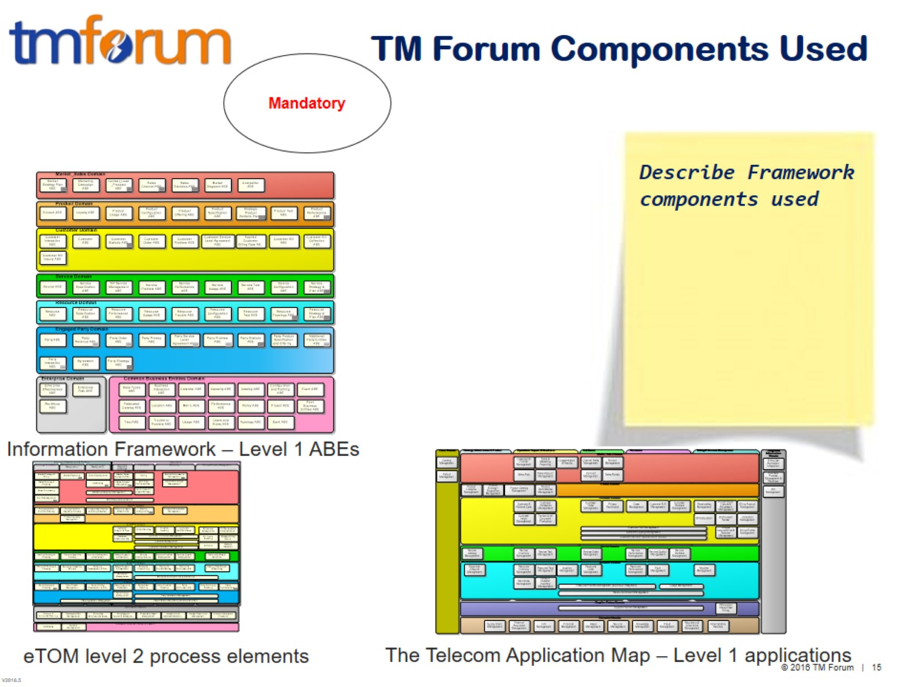
TM Forum Components Used

Slide 16
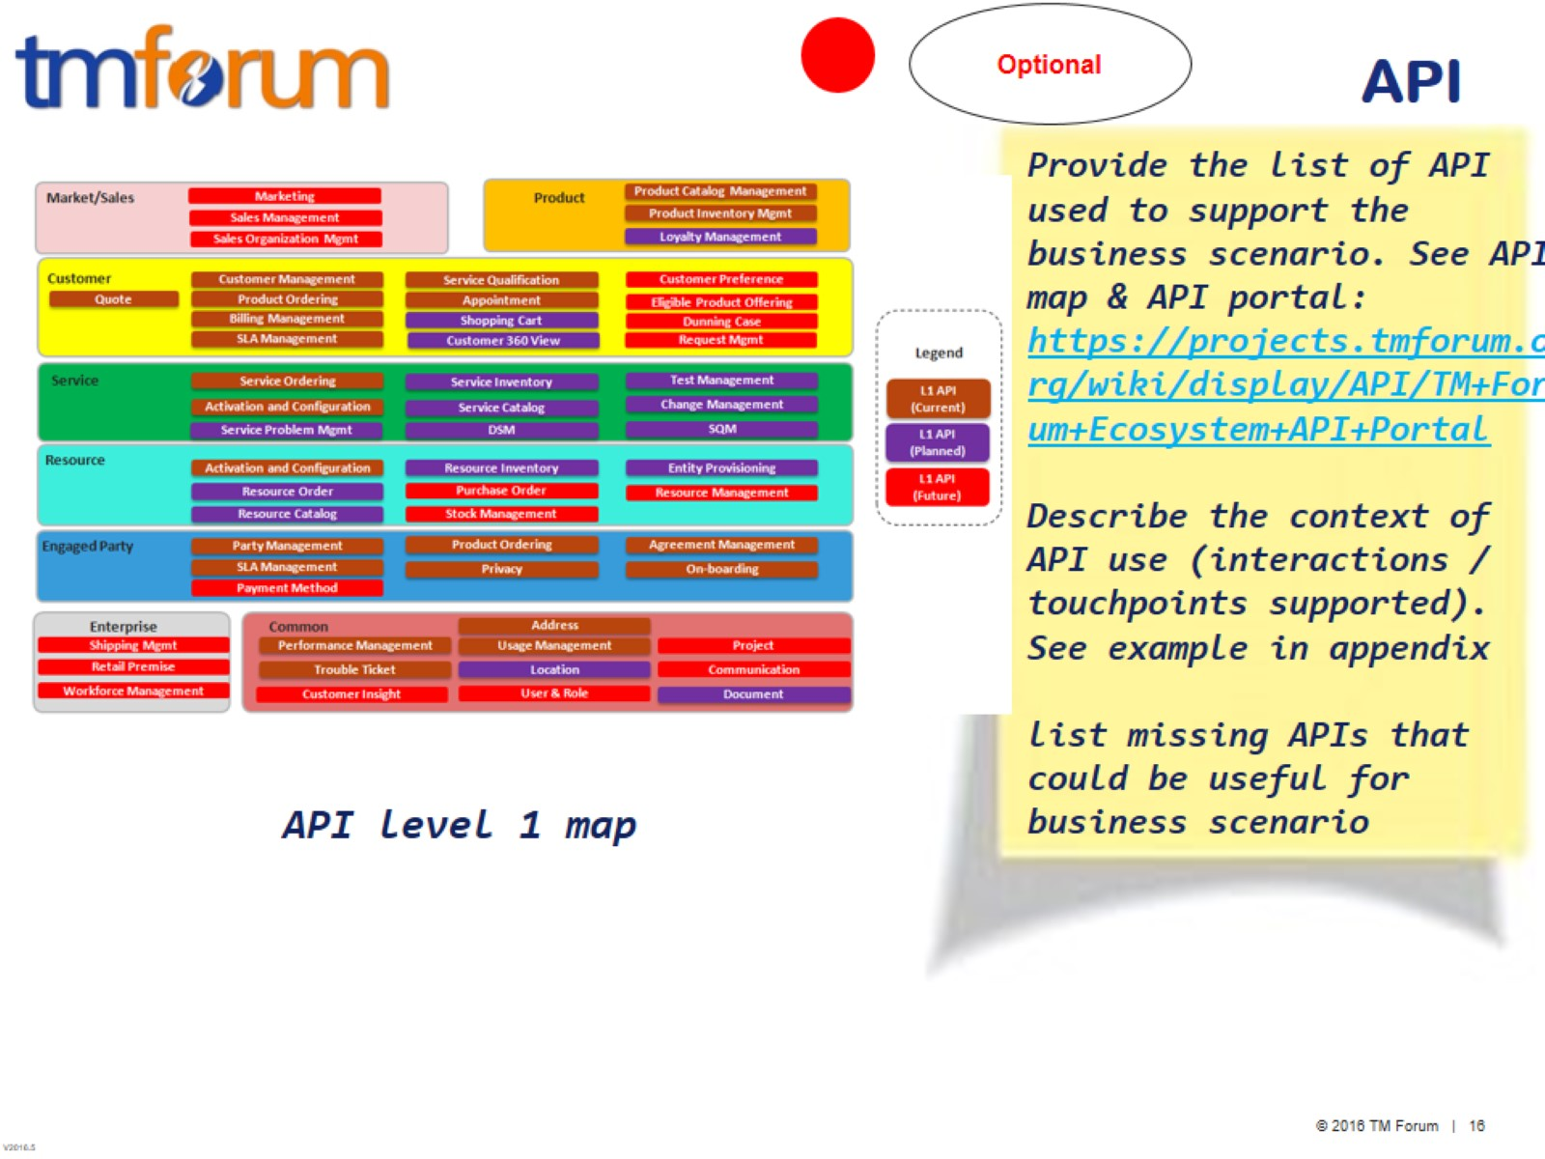
API

Slide 17
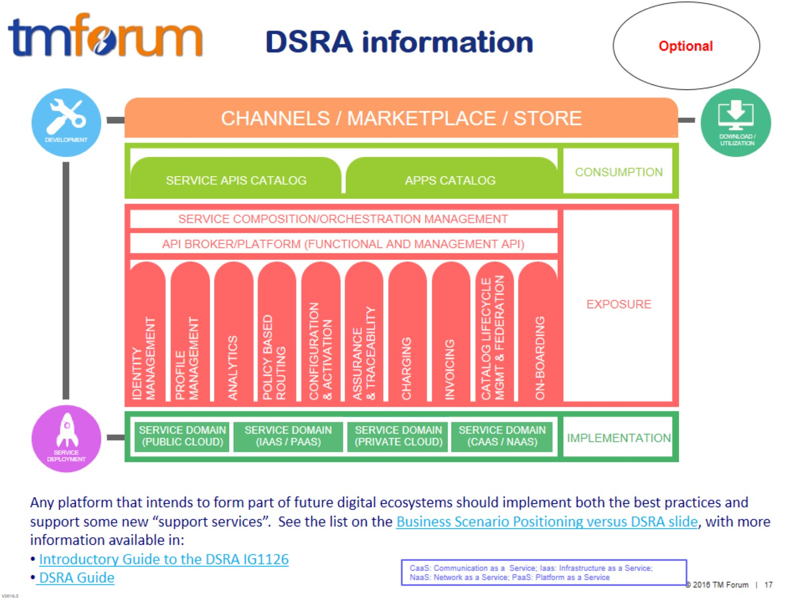
DSRA information

Slide 18
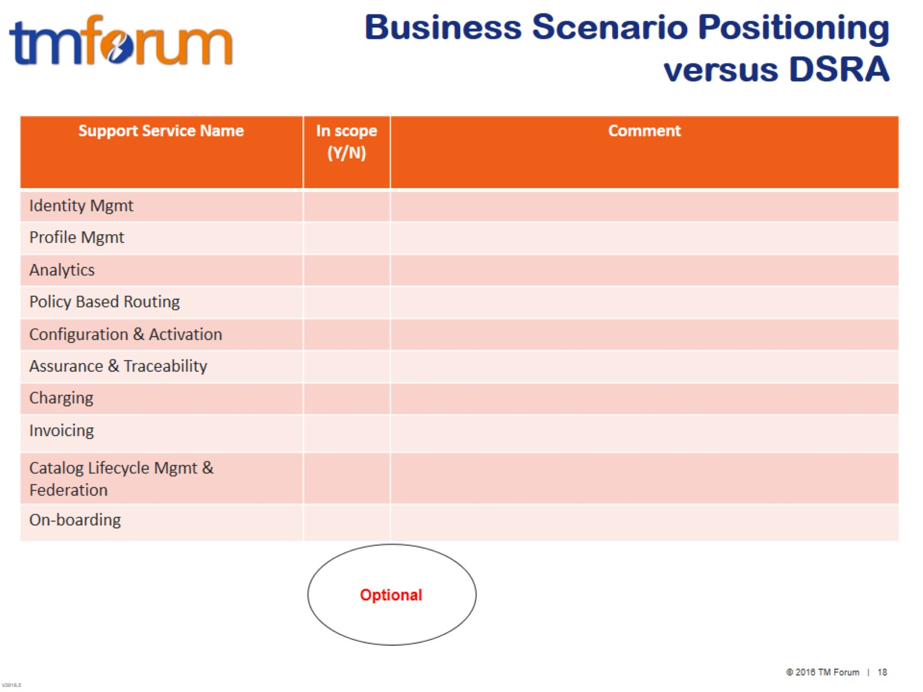
Business Scenario Positioning versus DSRA

Slide 19
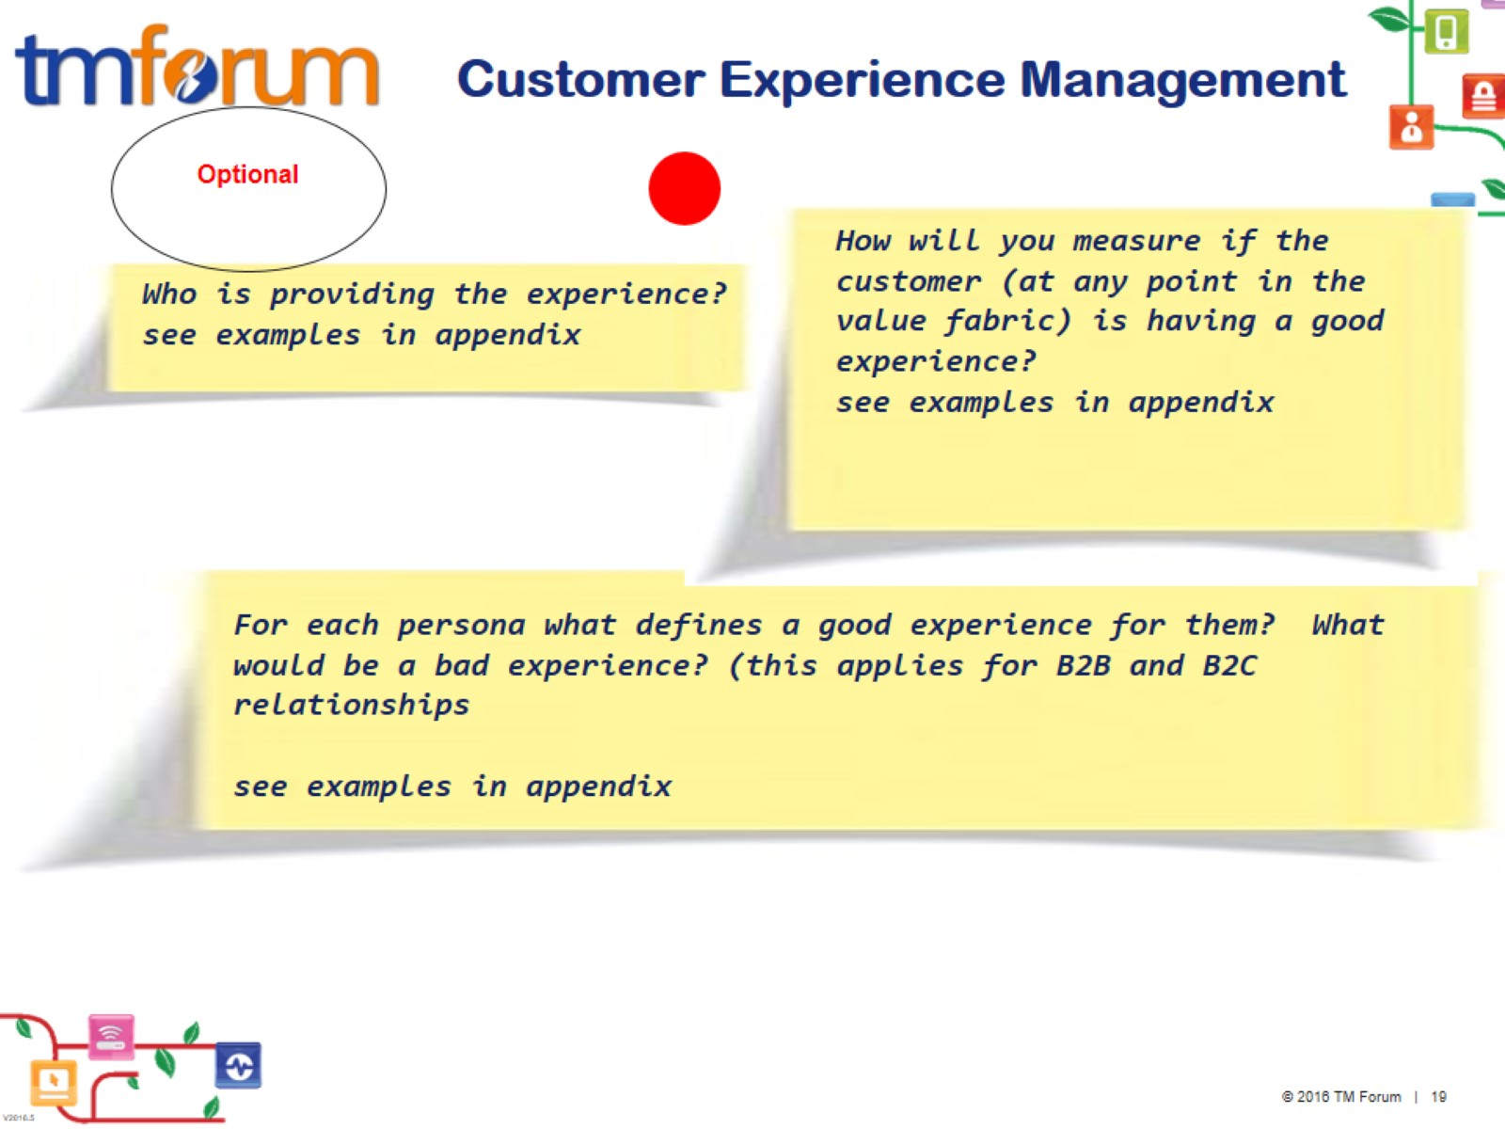
Customer Experience Management

Slide 20
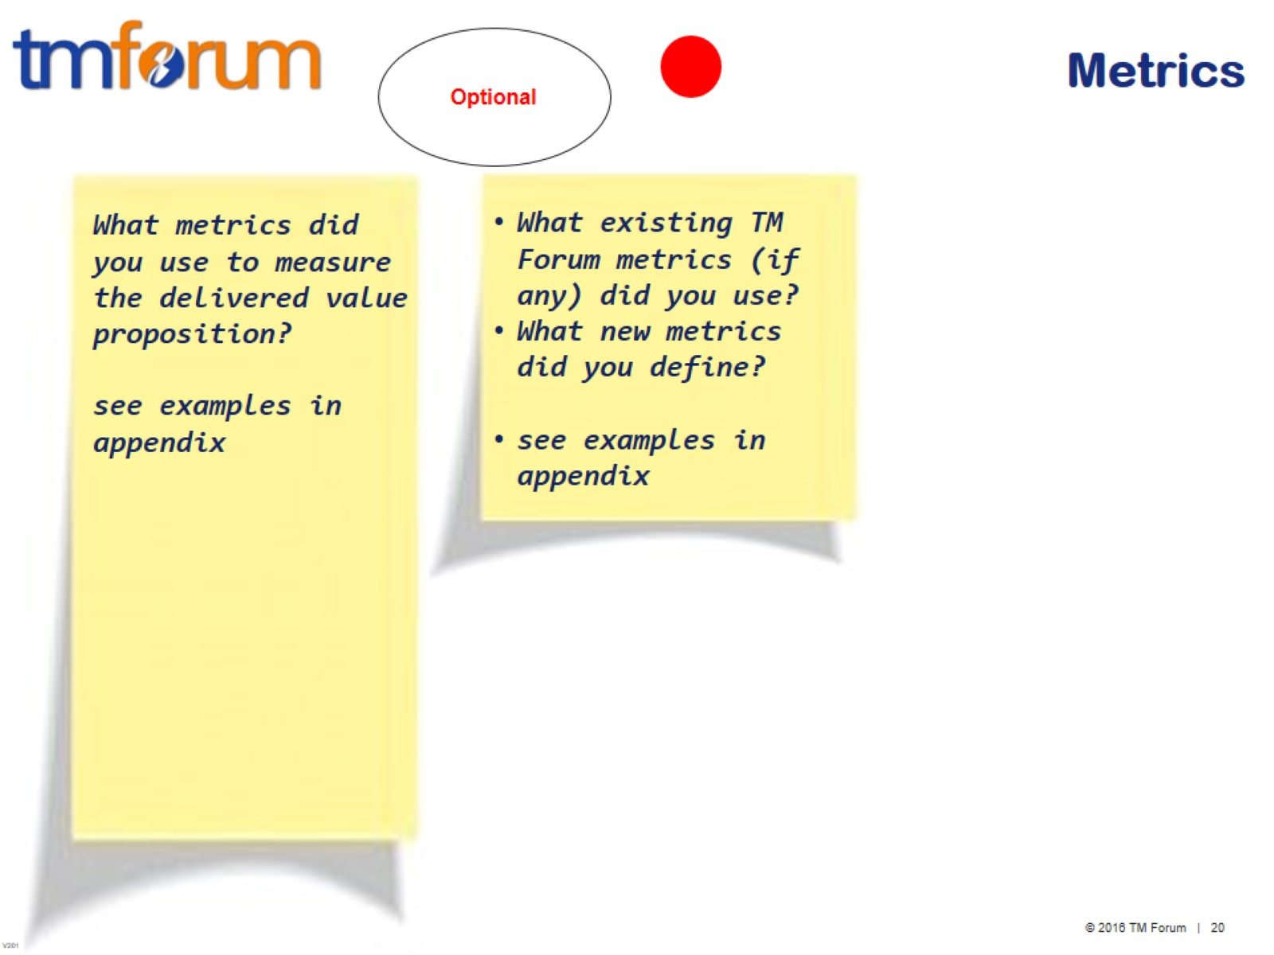
Metrics

Slide 21
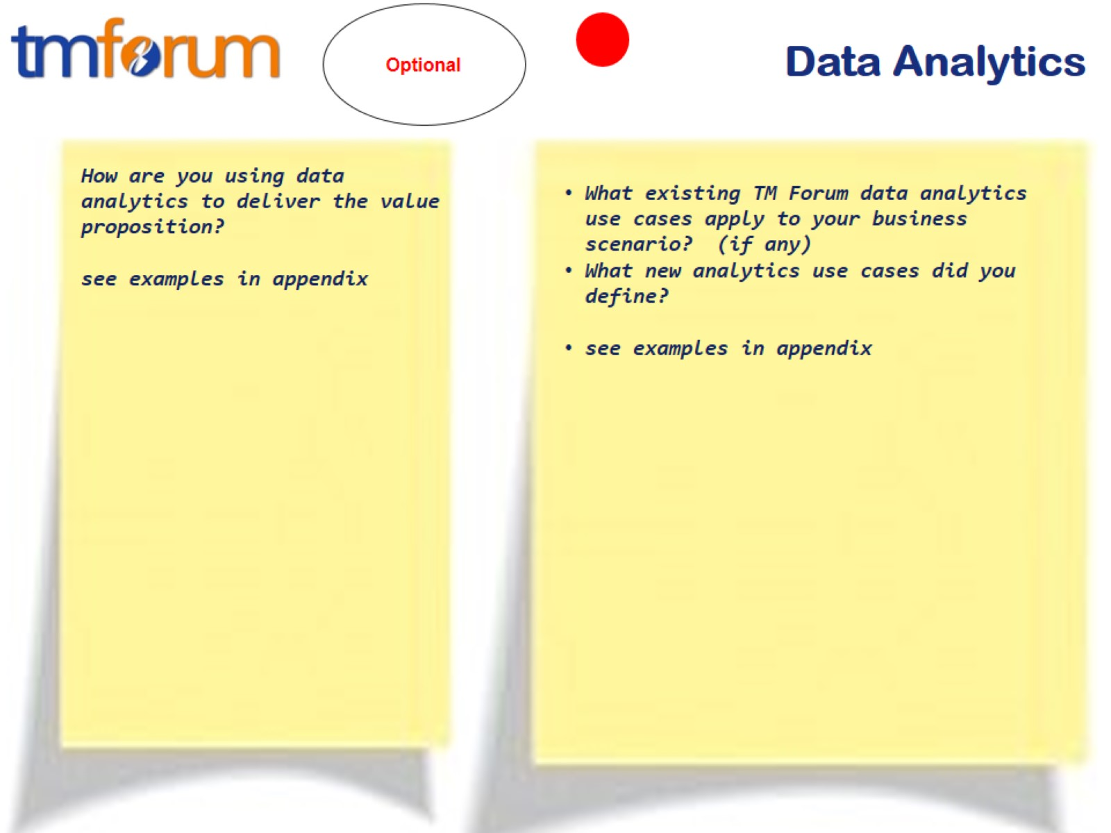
Data Analytics

Slide 22
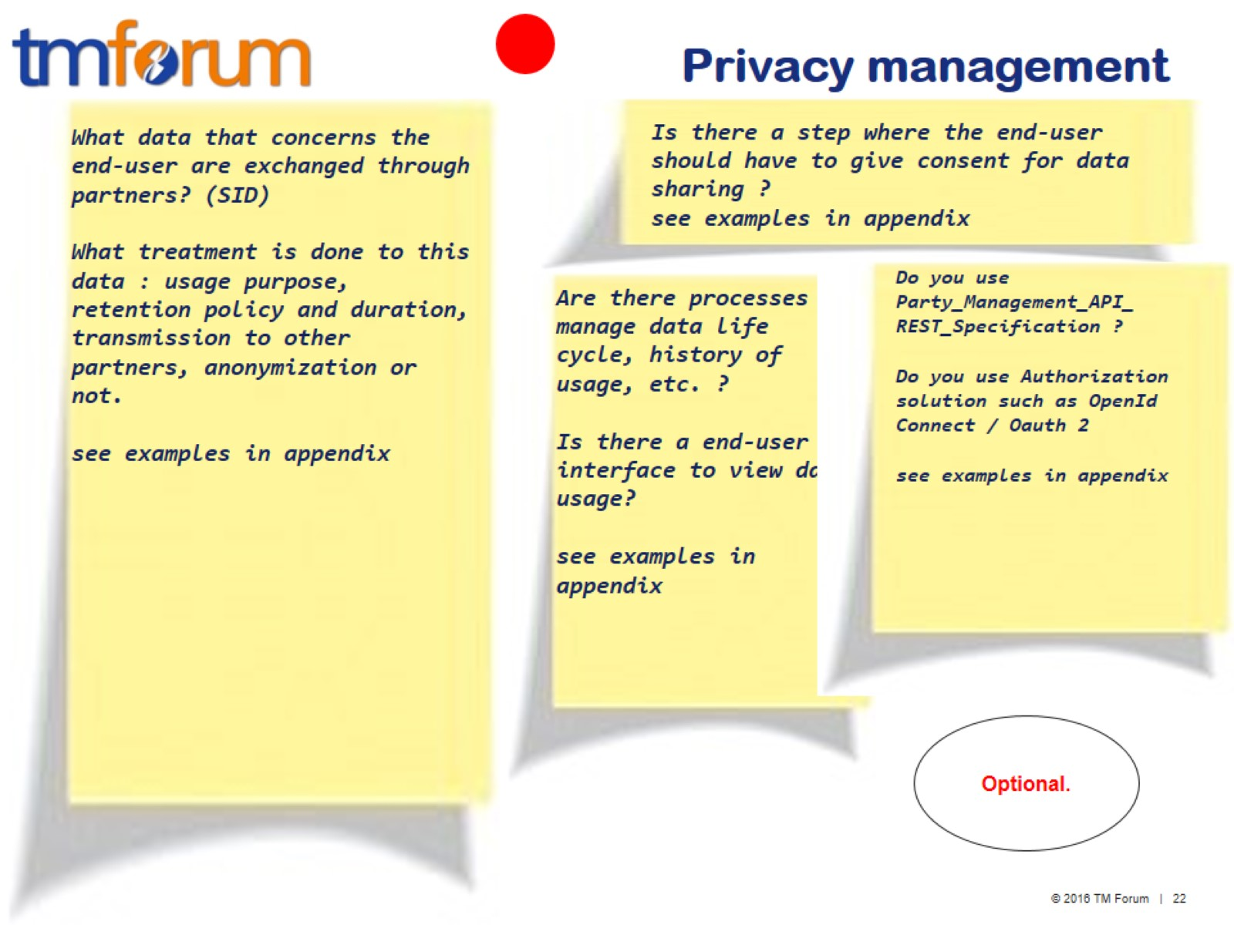
Privacy management

Slide 23
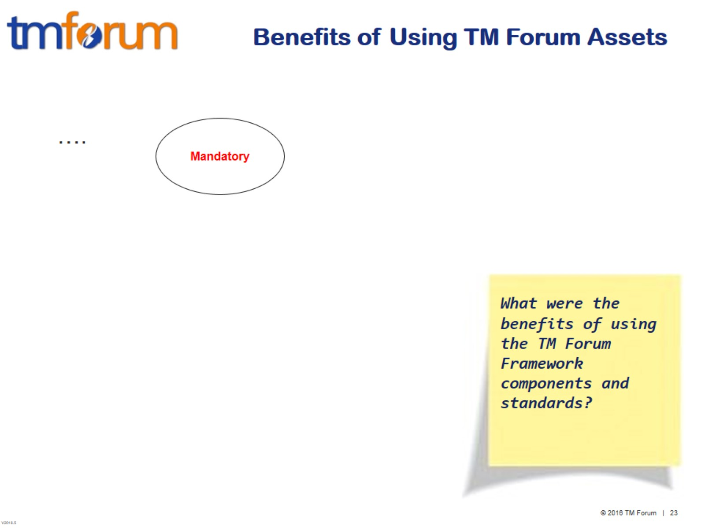
Benefits of Using TM Forum Assets

Slide 24
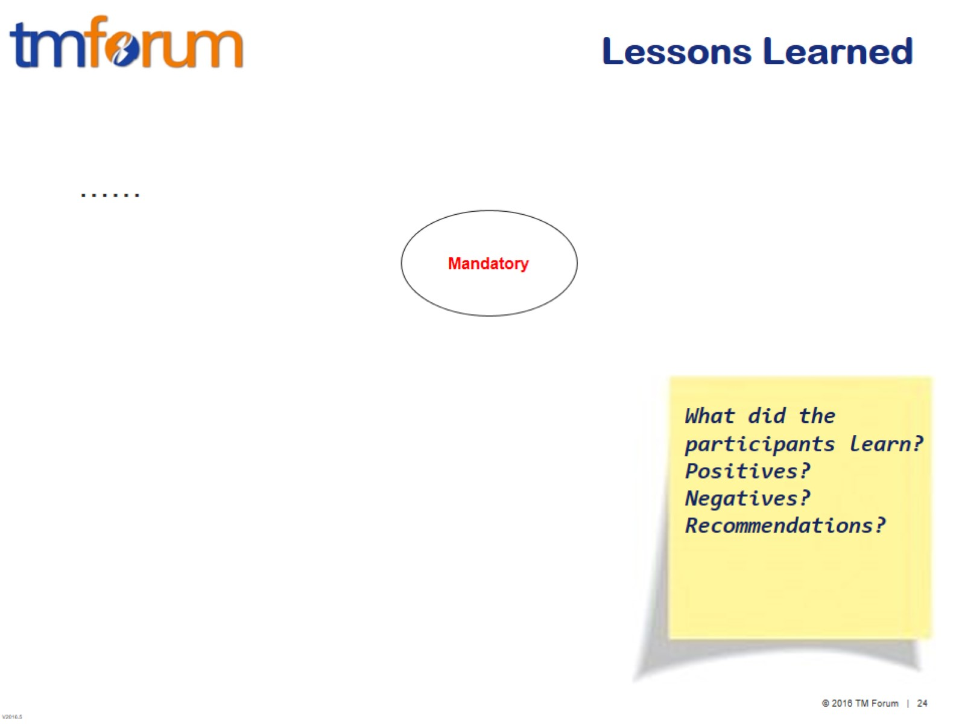
Lessons Learned

Slide 25
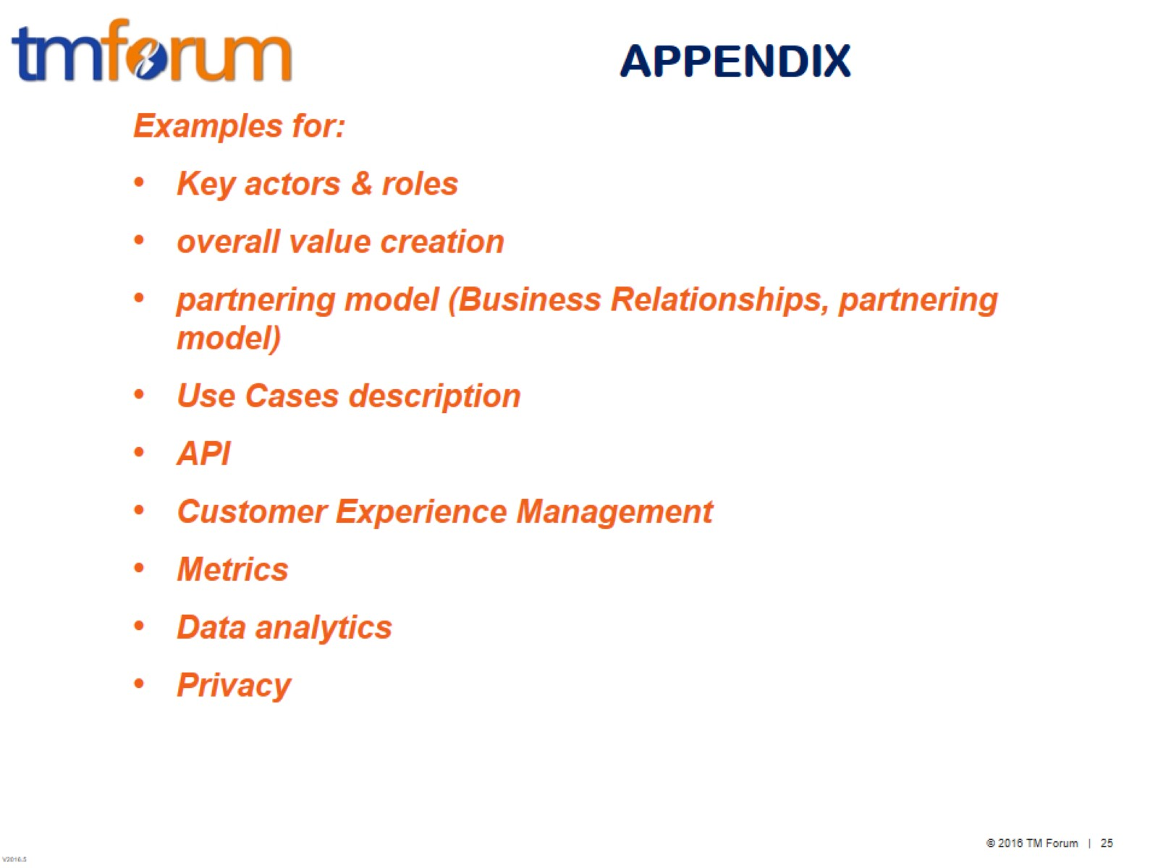
APPENDIX

Slide 26
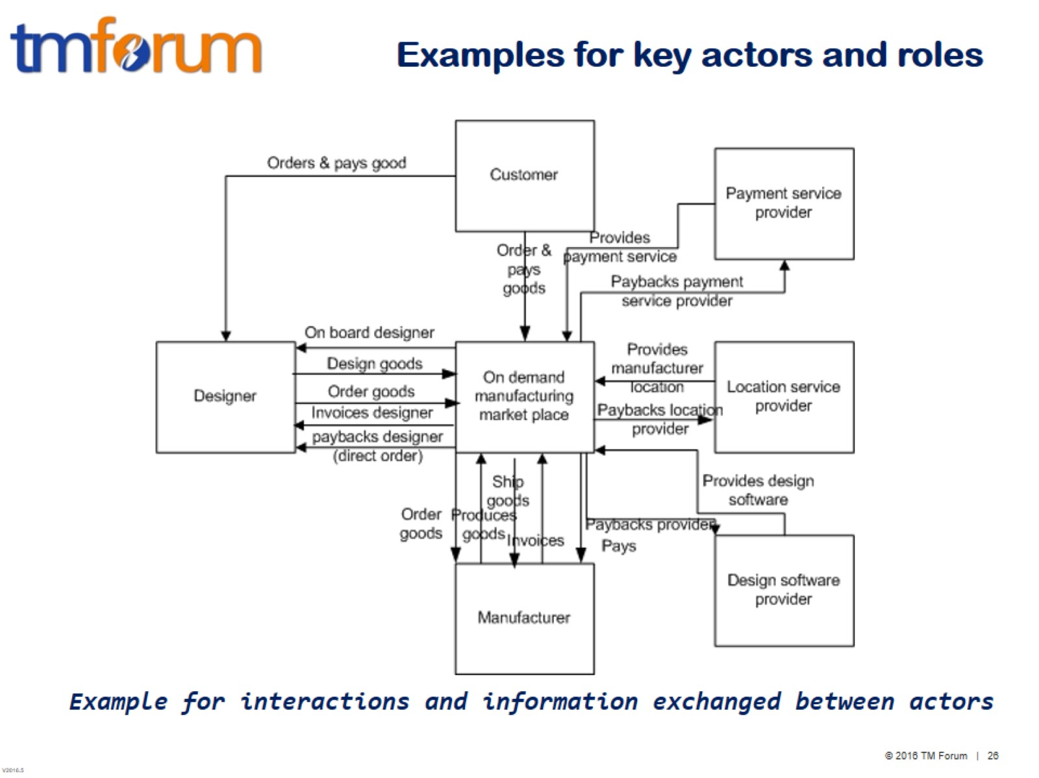
Examples for key actors and roles

Slide 27
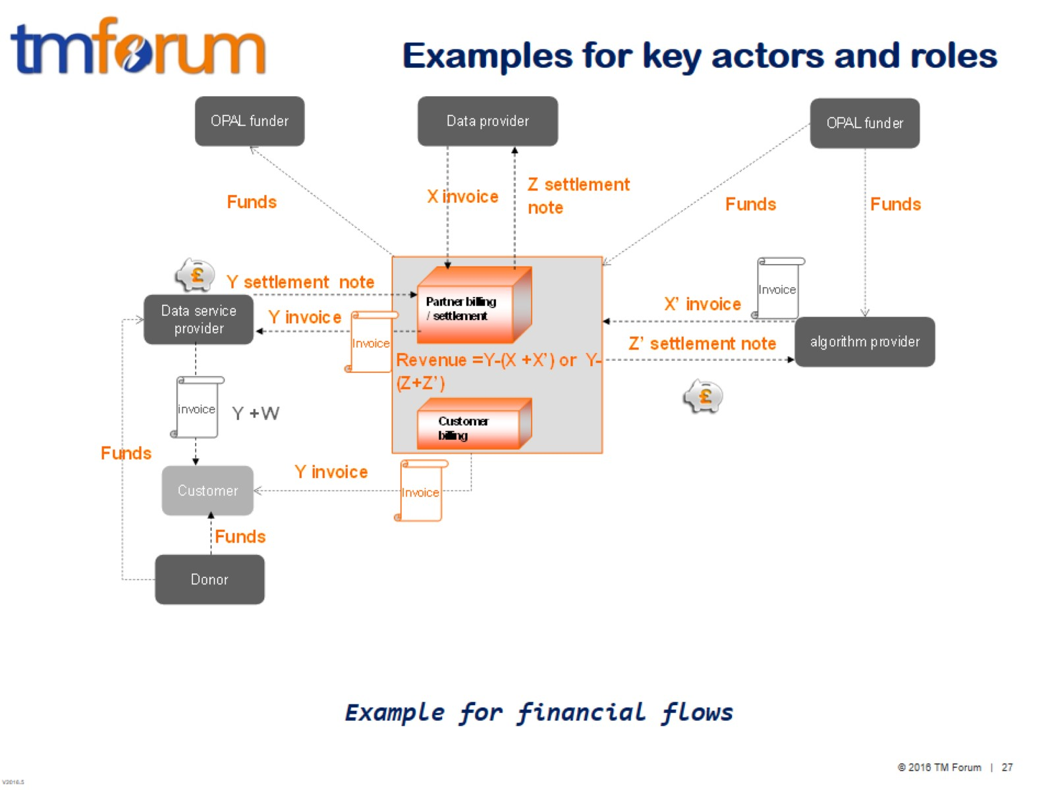
Examples for key actors and roles

Slide 28
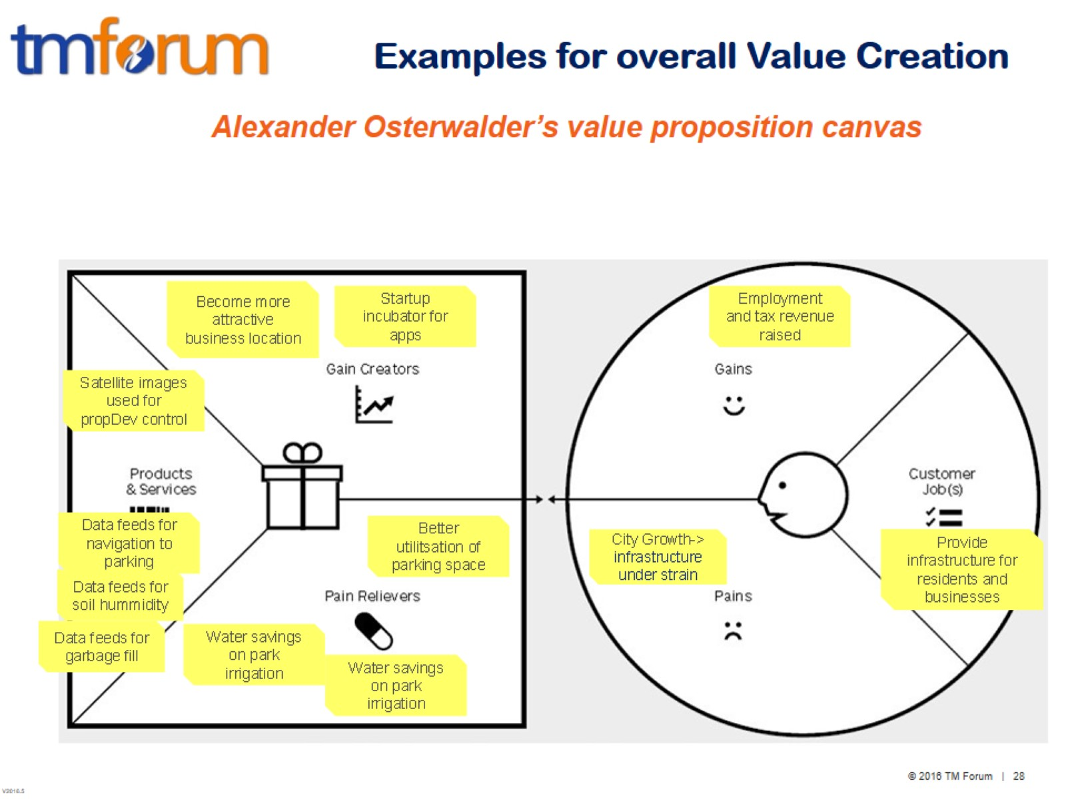
Examples for overall Value Creation

Slide 29
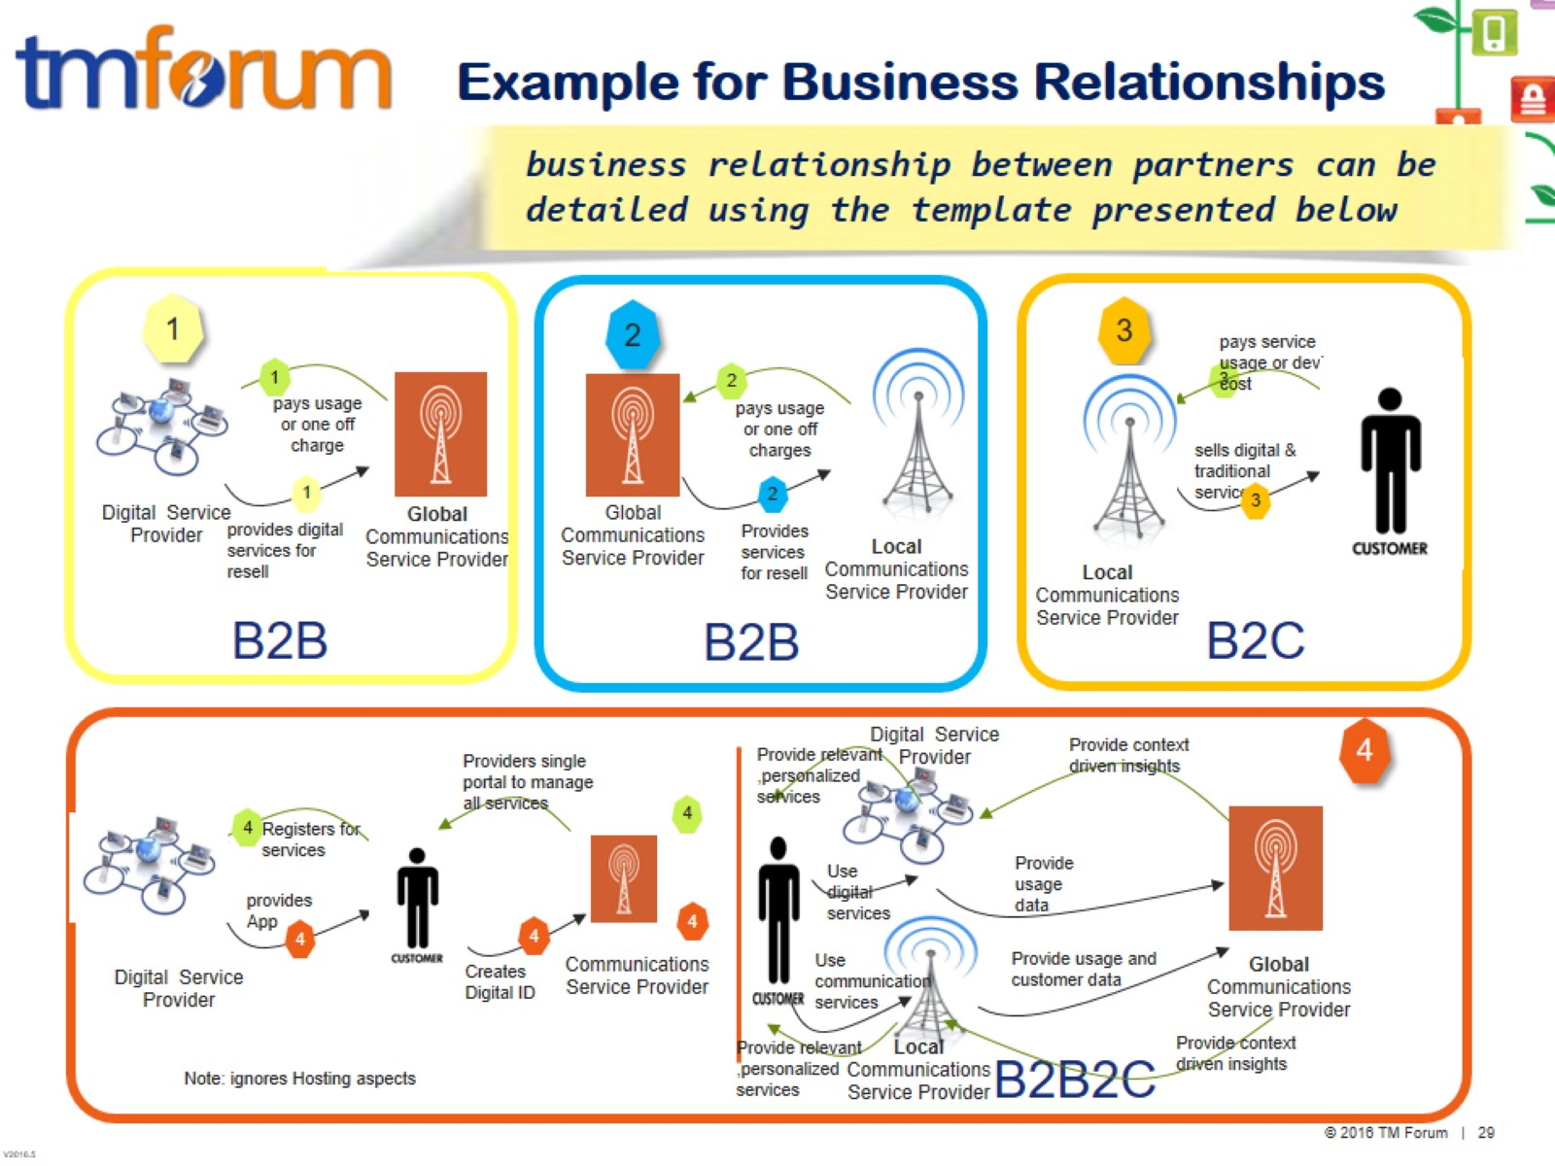
Example for Business Relationships

Slide 30
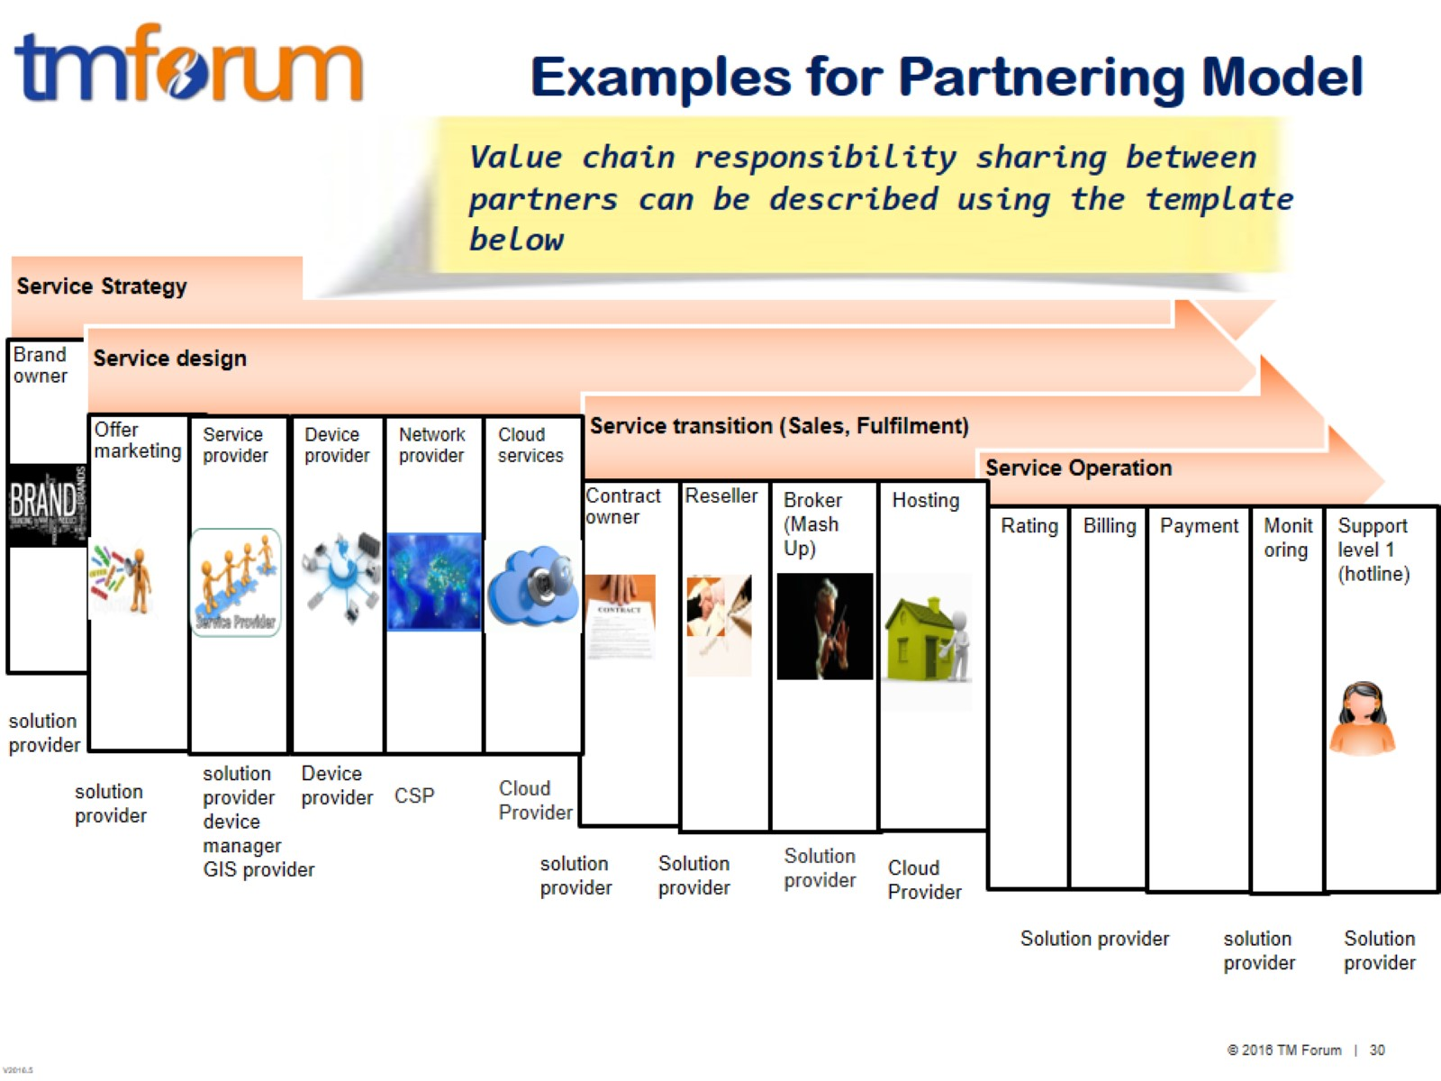
Examples for Partnering Model

Slide 31
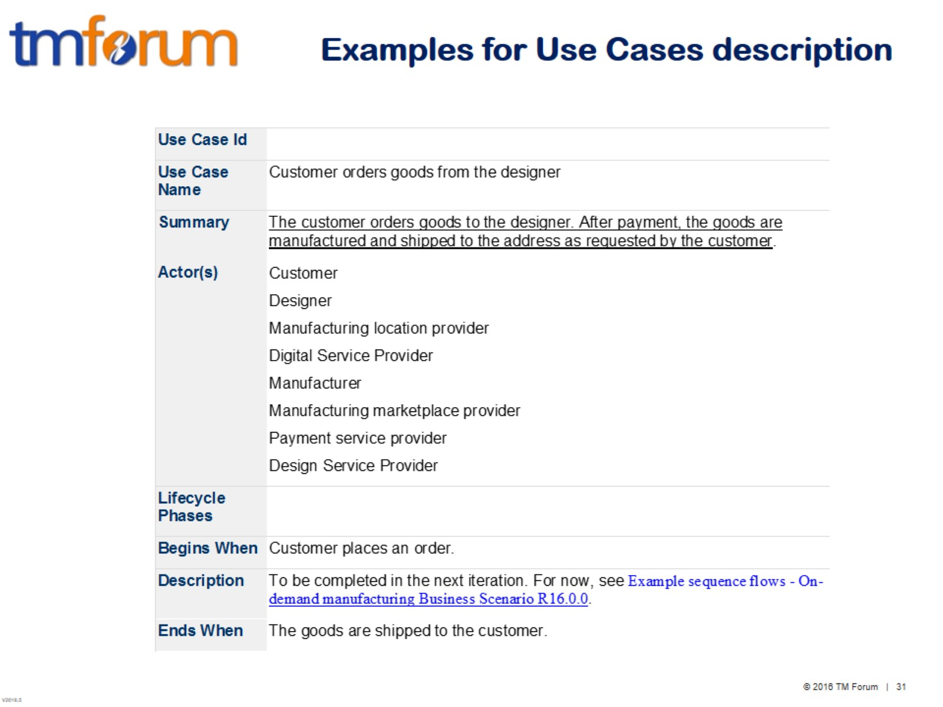
Examples for Use Cases description

Slide 32
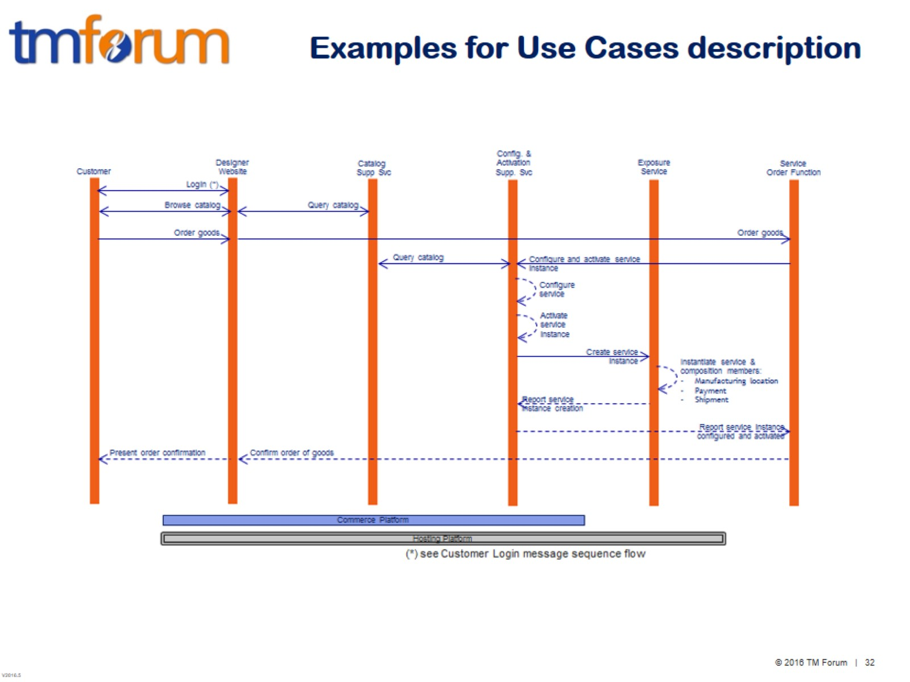
Examples for Use Cases description

Slide 33
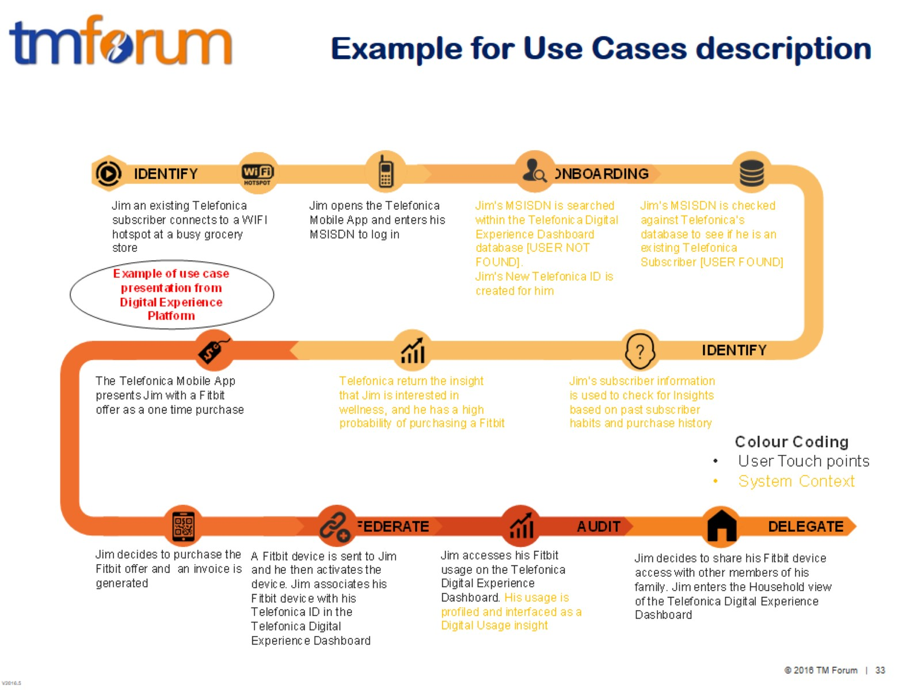
Example for Use Cases description

Slide 34
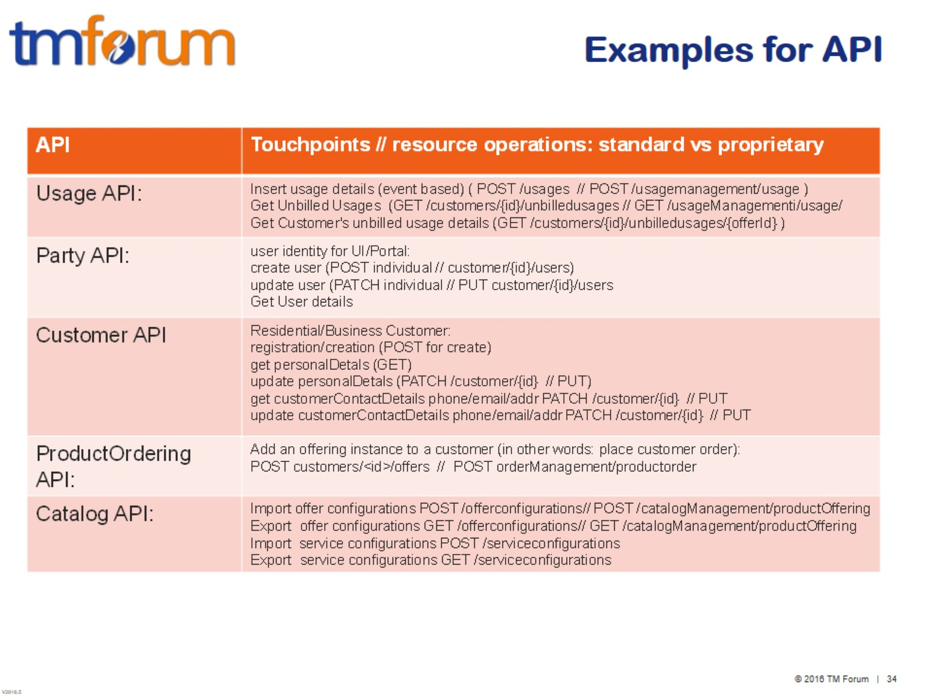
Examples for API

Slide 35
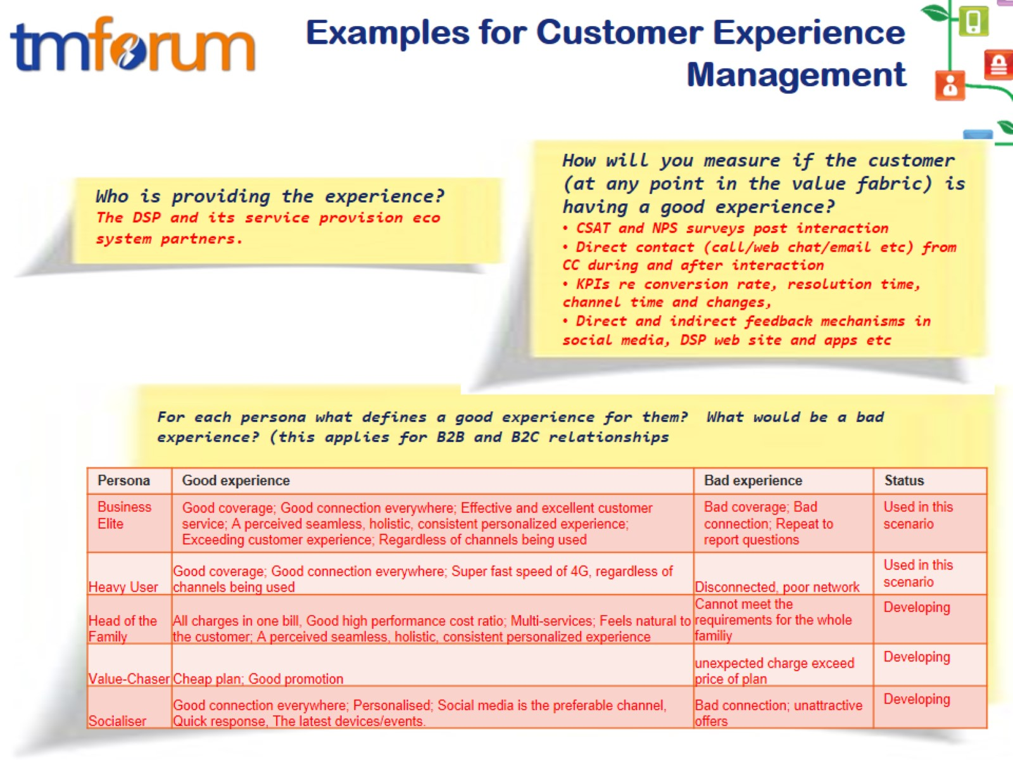
Examples for Customer Experience Management

Slide 36
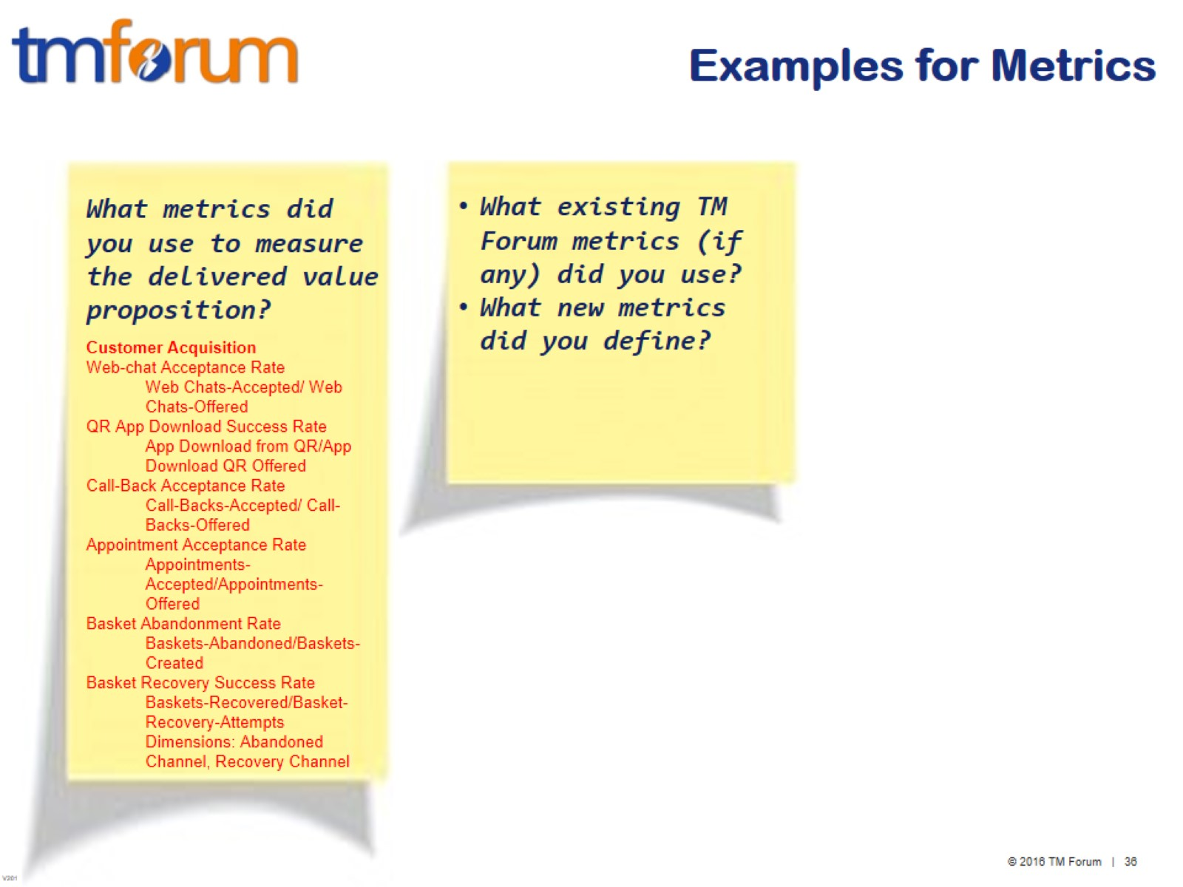
Examples for Metrics

Slide 37
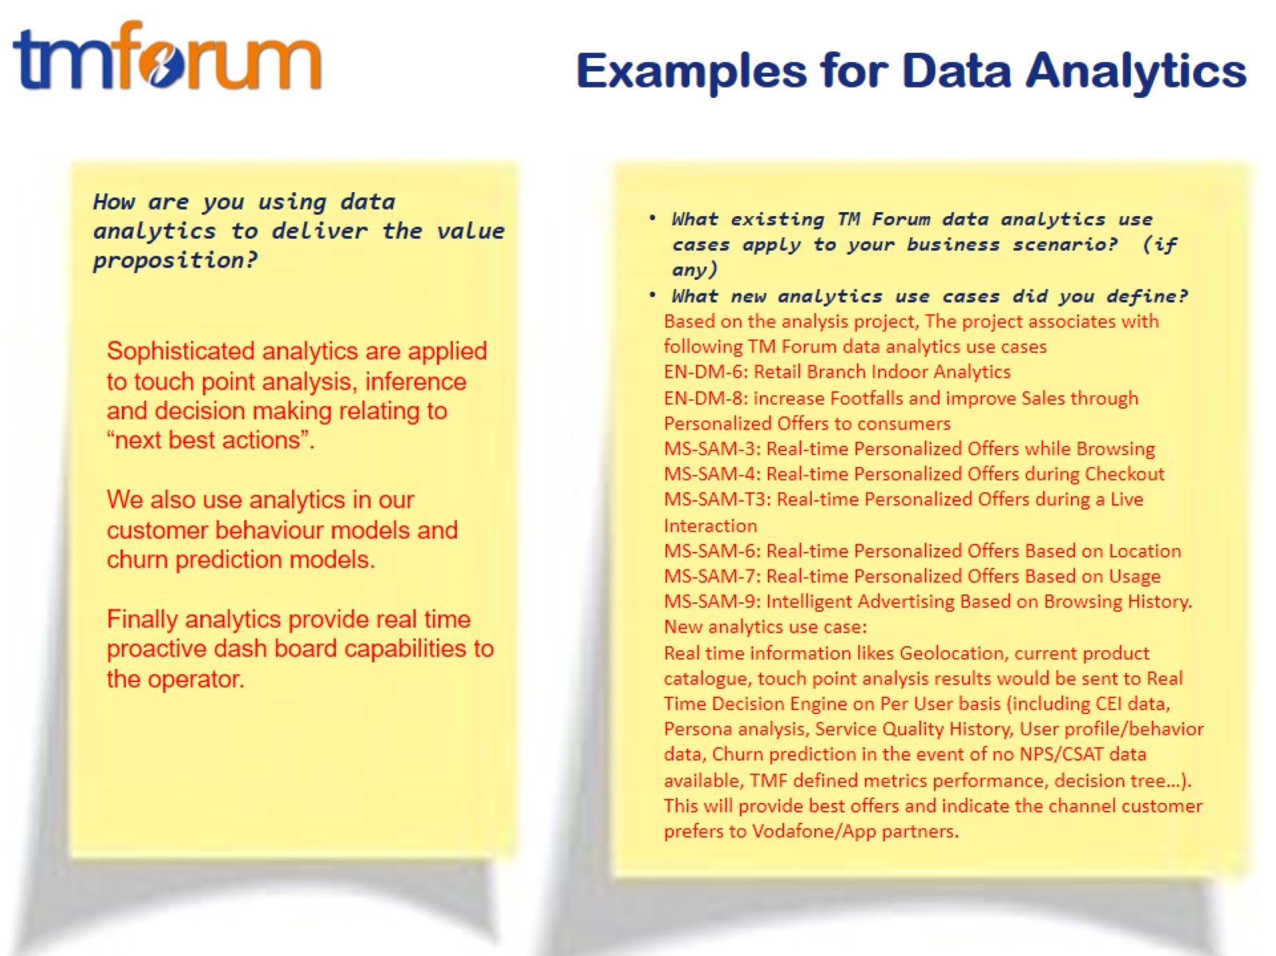
Examples for Data Analytics

Slide 38
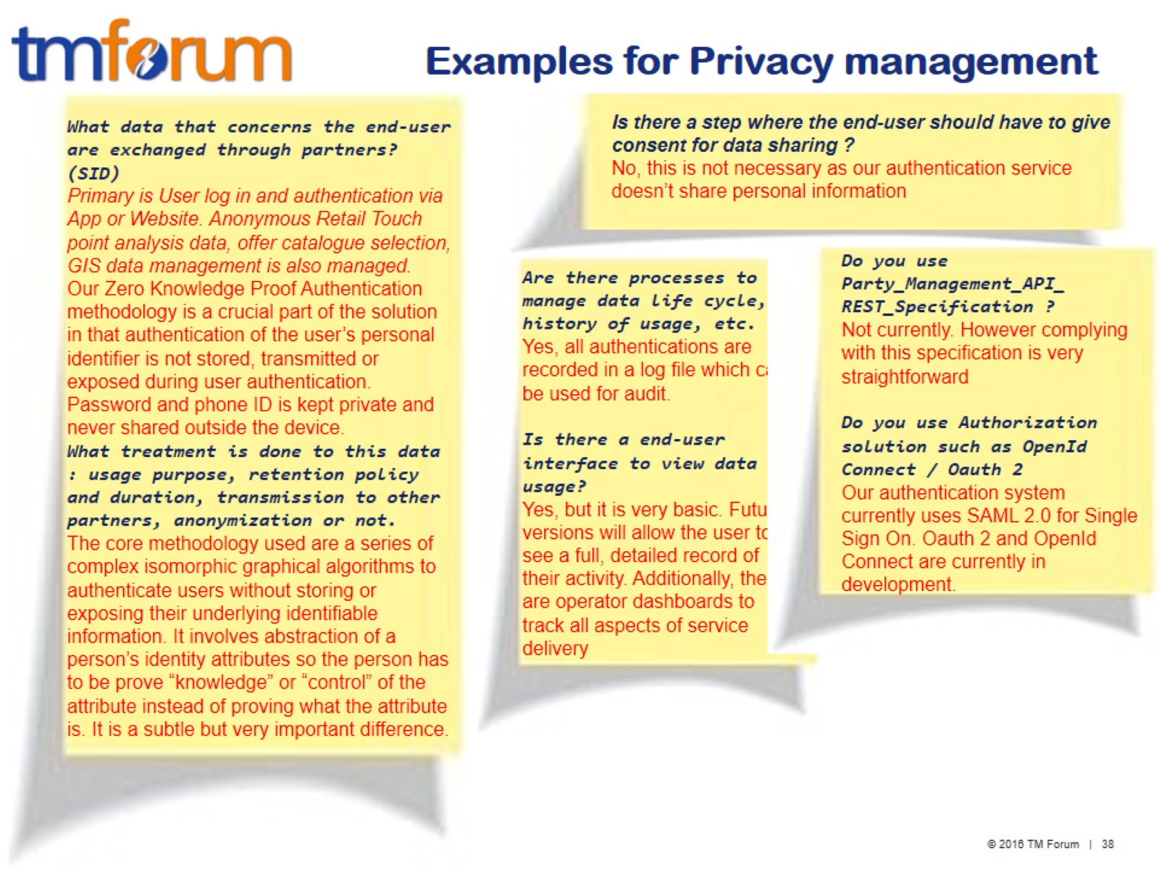
Examples for Privacy management

